Slide 1

[
]
WELCOME!

Slide 2

Shelly Derby
Executive Coordinator
Nutrametrix Consultant
Physical Therapist
Certified Athletic Trainer
Naples, Florida

Slide 3
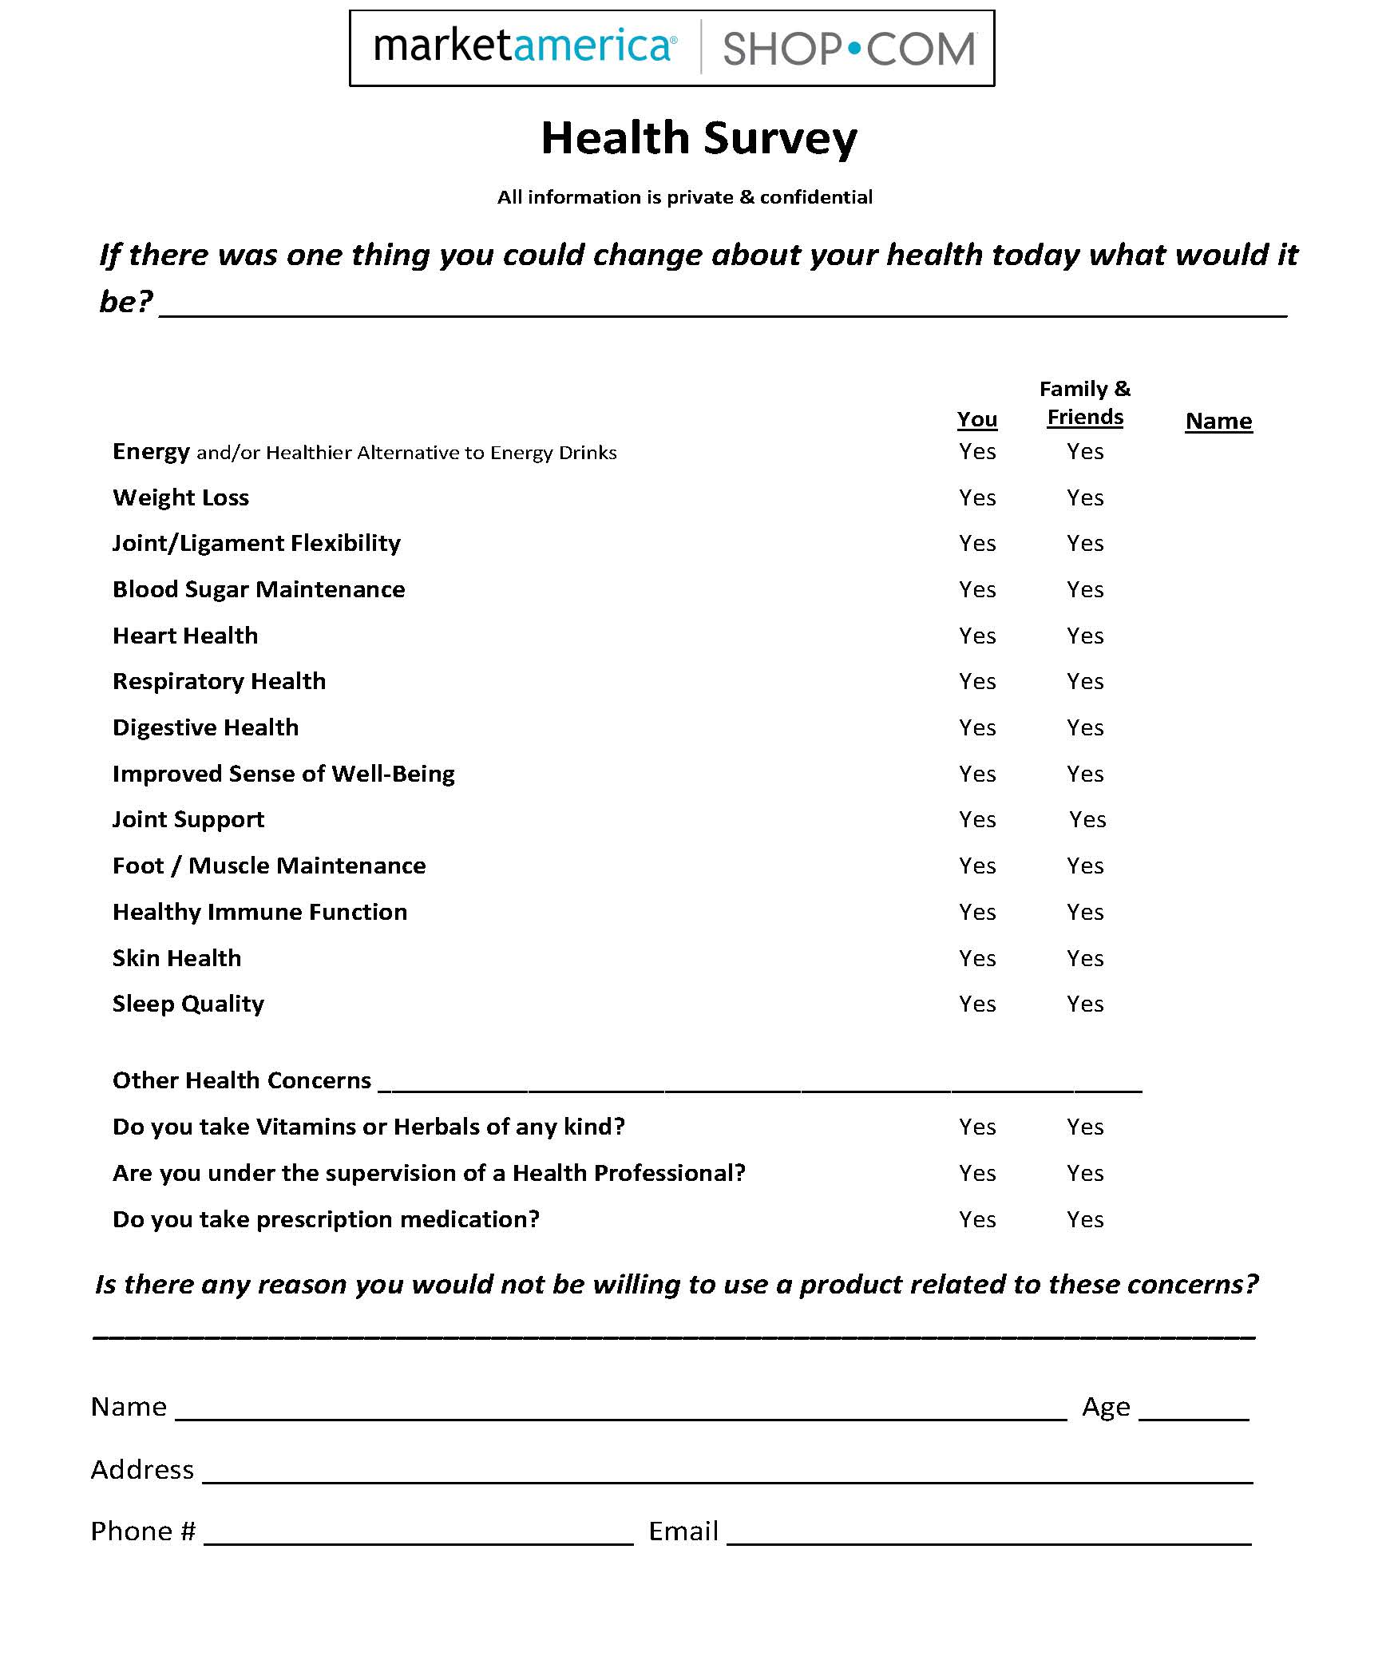

Slide 4








Industry Recognition
SHOP.COM is ranked the #36th largest global online marketplace in the 2019 Internet Retailer Top 100
SHOP.COM is ranked #65 in the 2018 Internet Retailer Top 1000
SHOP.COM is ranked #96 in the Internet Retailer Asia 500
SHOP.COM is the 18th fastest growing Internet Mobile Retailer
SHOP.COM ranked 11th in Newsweek Magazine’s 2020 Best Online Shops
Market America | SHOP.COM has an A+ Rating with the Better Business Bureau
Market America | SHOP.COM was ranked 16th in the 2019 Grant Thornton North Carolina Top 100® (NC100)
Market America | SHOP.COM received Triad Business Journal’s
2019 “Fast 50” award as one of the top privately-held companies for sustained growth, driving the area’s economy. This marks the 14th time the company has won this award.

Slide 5


Marketplace Ethics
Better Business Bureau 2013 & 2018 Torch Award Winner For Marketplace Ethics
This is the most prestigious award the Better Business Bureau can present to a BBB Accredited Business.
Recipients exhibit high standards of honesty, integrity
and transparency promoted by the BBB, while consistently demonstrating and integrating those standards into daily practices.

Slide 6
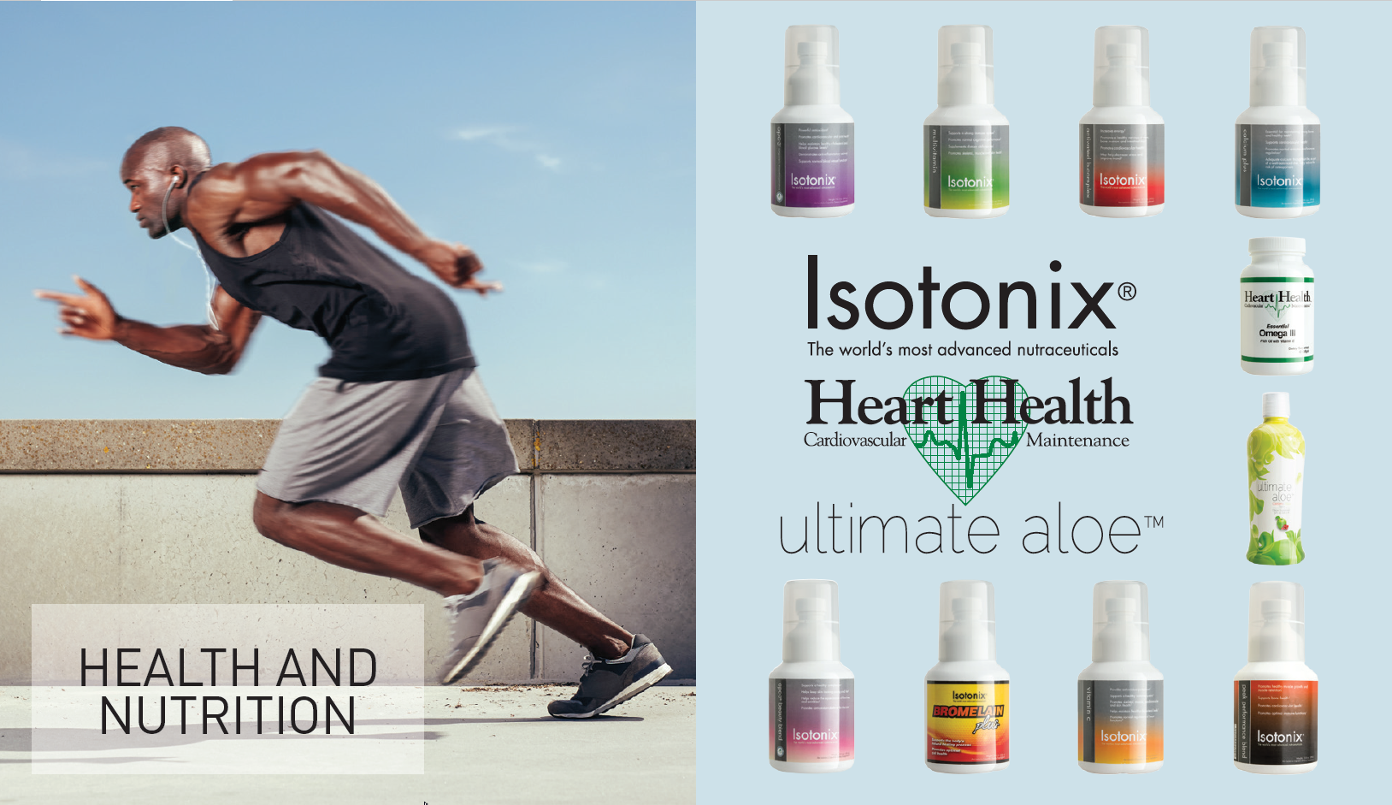

Slide 7


Slide 8

Today’s fruit and vegatables have…
59% less nutritious value than 40 years ago!

Slide 9
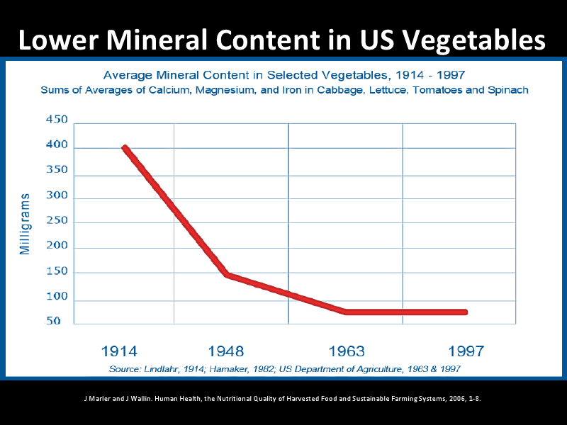

Slide 10
U.S. Department of Agriculture 2012.
USDA National Nutrient Database for Standard http://www.ars.usda.gov/ba/bhnrc/ndl
Statistically significant declines in 6 nutrients (protein, Ca, Fe, riboflavin, ascorbic acid)
Consider the fact that foods are shipped worldwide:
  Is this socially conscious eating?
  Is it the best use of the distribution network?
  What is the nutrient density of foods shipped worldwide?
Authors suggest declines are related to new breed varieties (if select for yield, grow bigger and faster but less nutrient uptake)

Slide 11
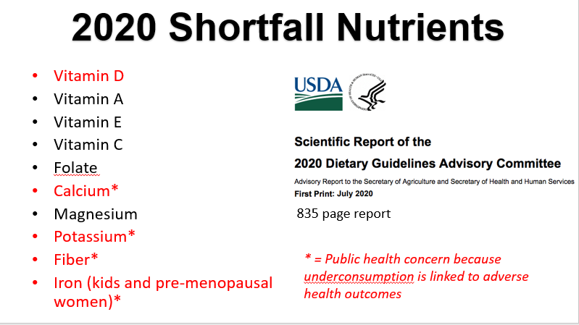

Slide 12
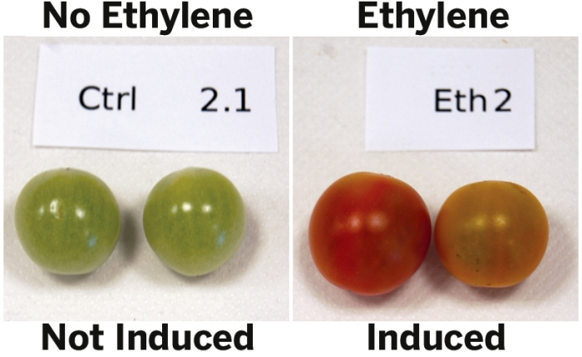

Slide 13


Slide 14


Slide 15
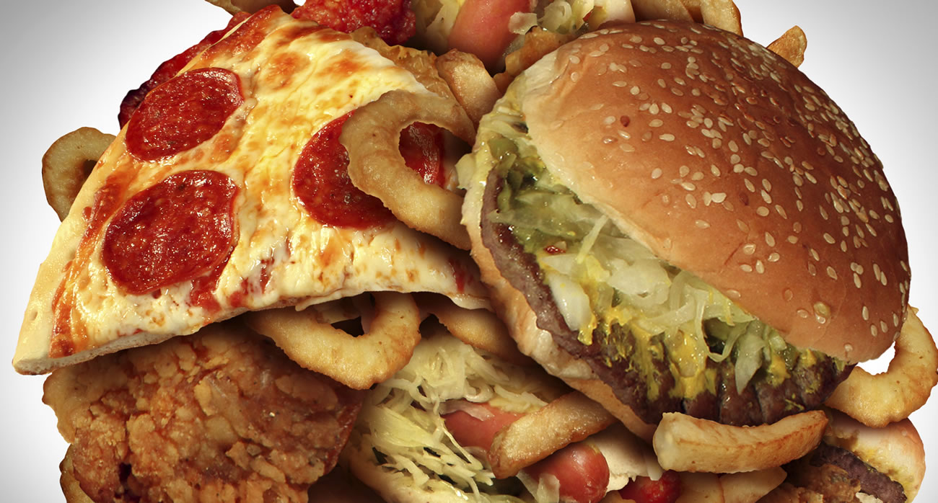
Standard American Diet

Slide 16
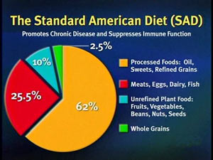
Why Supplement?
We need essential vitamins and minerals
The nutritional status of Americans highlights the fact we don’t get all the nutrients we need in the SAD (Standard American Diet)
Certain phytonutrients are impractical to obtain from food
Supplementation provides noticeable health improvements (energy, joint comfort, skin health, sleep)

Slide 17
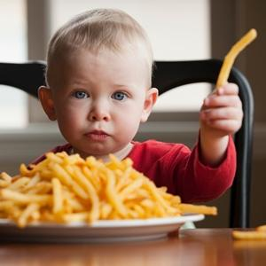
French fries were one of the three most common vegetables consumed by infants 9 to 11 months of age.
By 15 to 18 months, french fries were the most common vegetable.
PubMed.gov PMID: 14702014

Slide 18
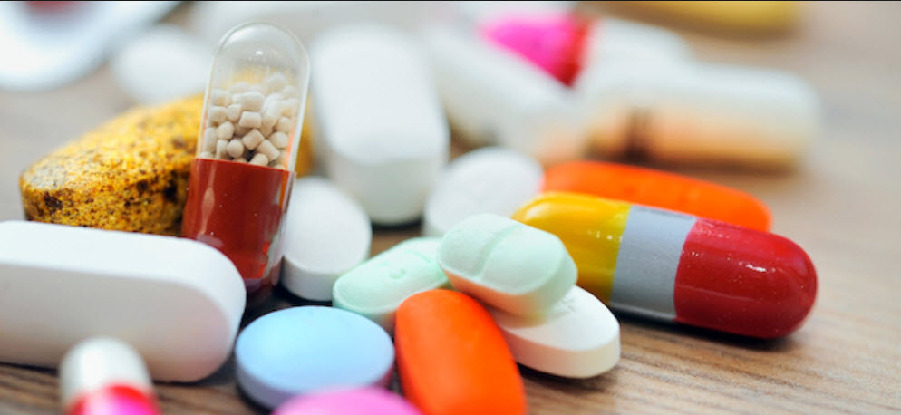

Slide 19
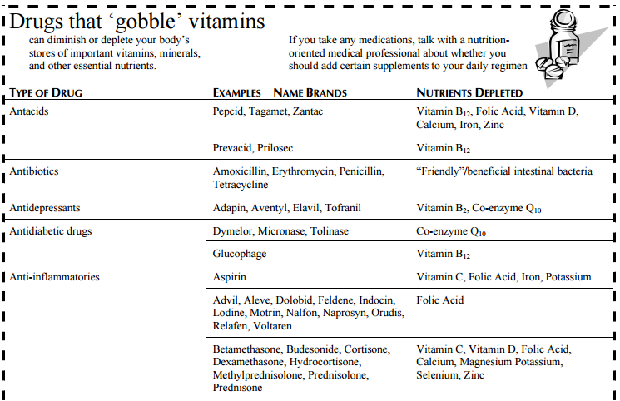

Slide 20
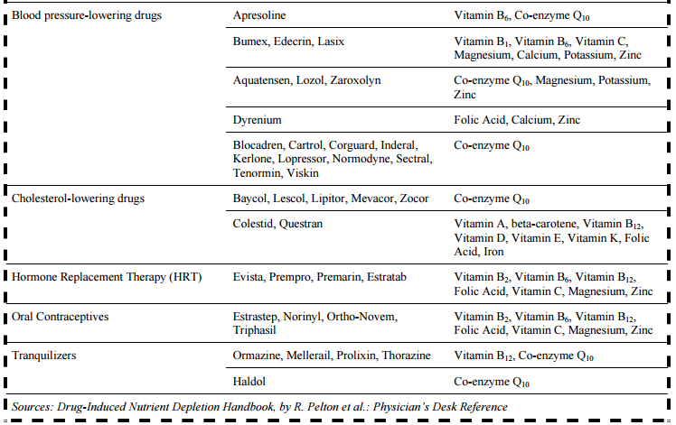

Slide 21

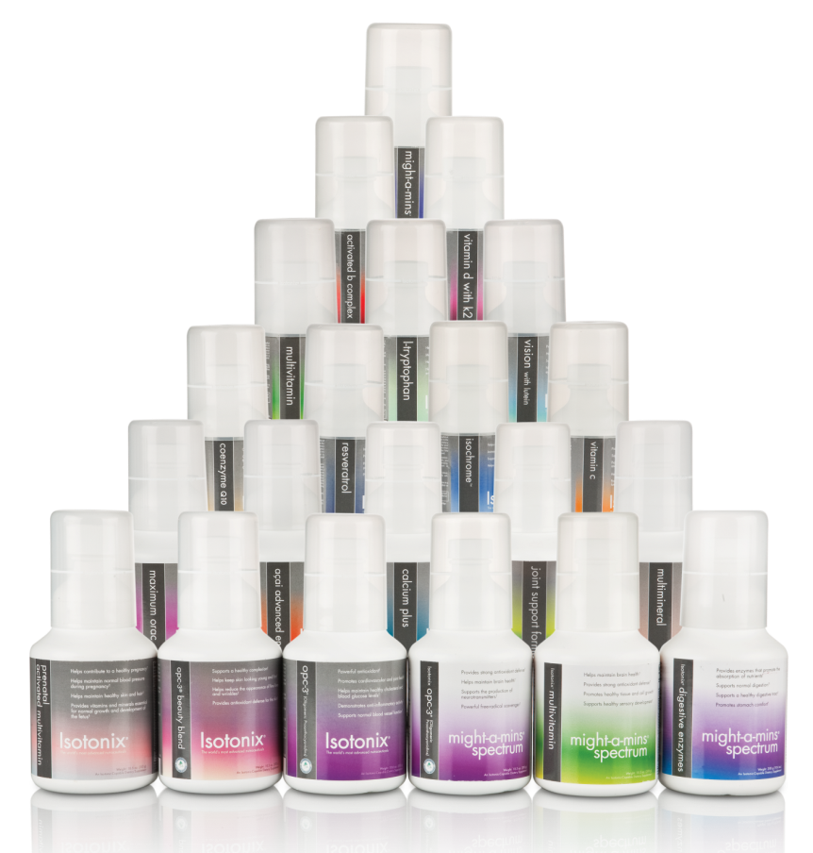
These statements have not been evaluated by the Food and Drug Administration. These products are not intended to diagnose, treat, cure or prevent any disease.

Slide 22
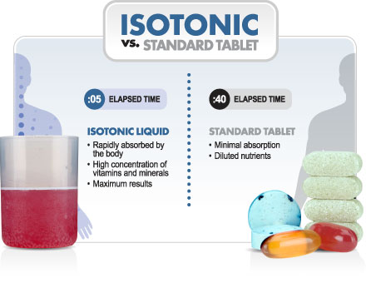
Not All Supplements are Created Equal

Slide 23
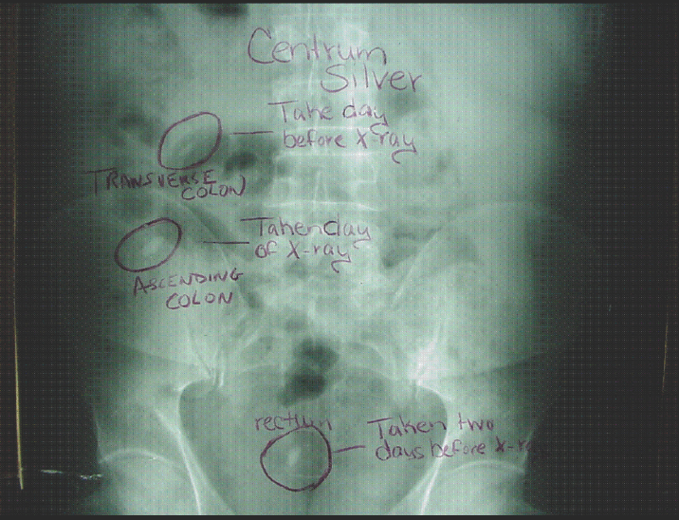

Slide 24
Isotonix® Advantage
Isotonix offers an alternative to pills.
Survey shows 40% of American adults have experienced difficulty swallowing pills
The survey of 679 adults (513 ages 18-64, 166 age 65 and older) was funded by the US affiliate of Germany's Schwarz Pharma.

Slide 25
Getting Started
Building a Healthy Foundation in 2021
Isotonix® Daily Essentials
  Isotonix OPC-3® (90 Servings)
  Isotonix Multivitamin (90 Servings)
  Isotonix Activated B-Complex (90 Servings)
  Isotonix Calcium Plus (90 Servings/45 Servings if taken twice daily)

Slide 26

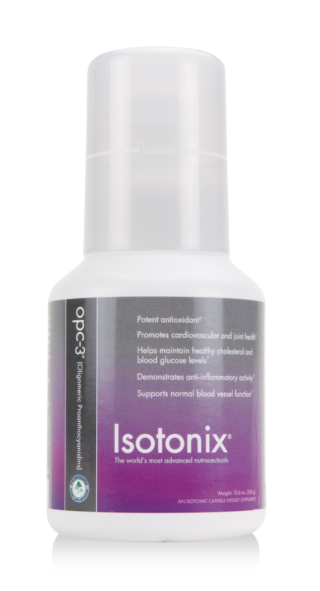
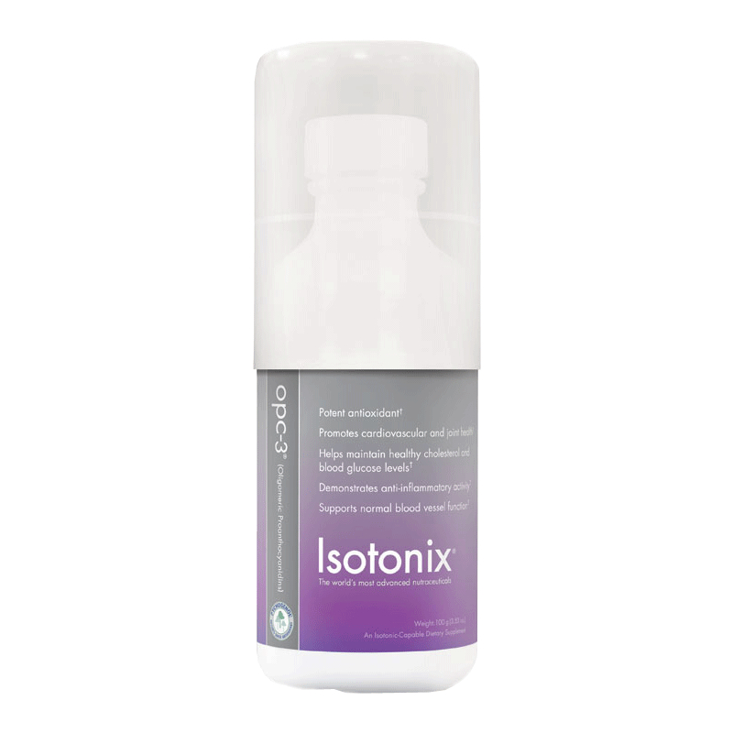
Isotonix OPC-3®
FEATURED INGREDIENT
Pine Bark Extract (Pycnogenol®)
Basic Properties
  Powerful Antioxidant
  Anti-inflammatory Activity
  Cardiovascular Health
  Skin Health
  Vasodilation and Circulation

Slide 27
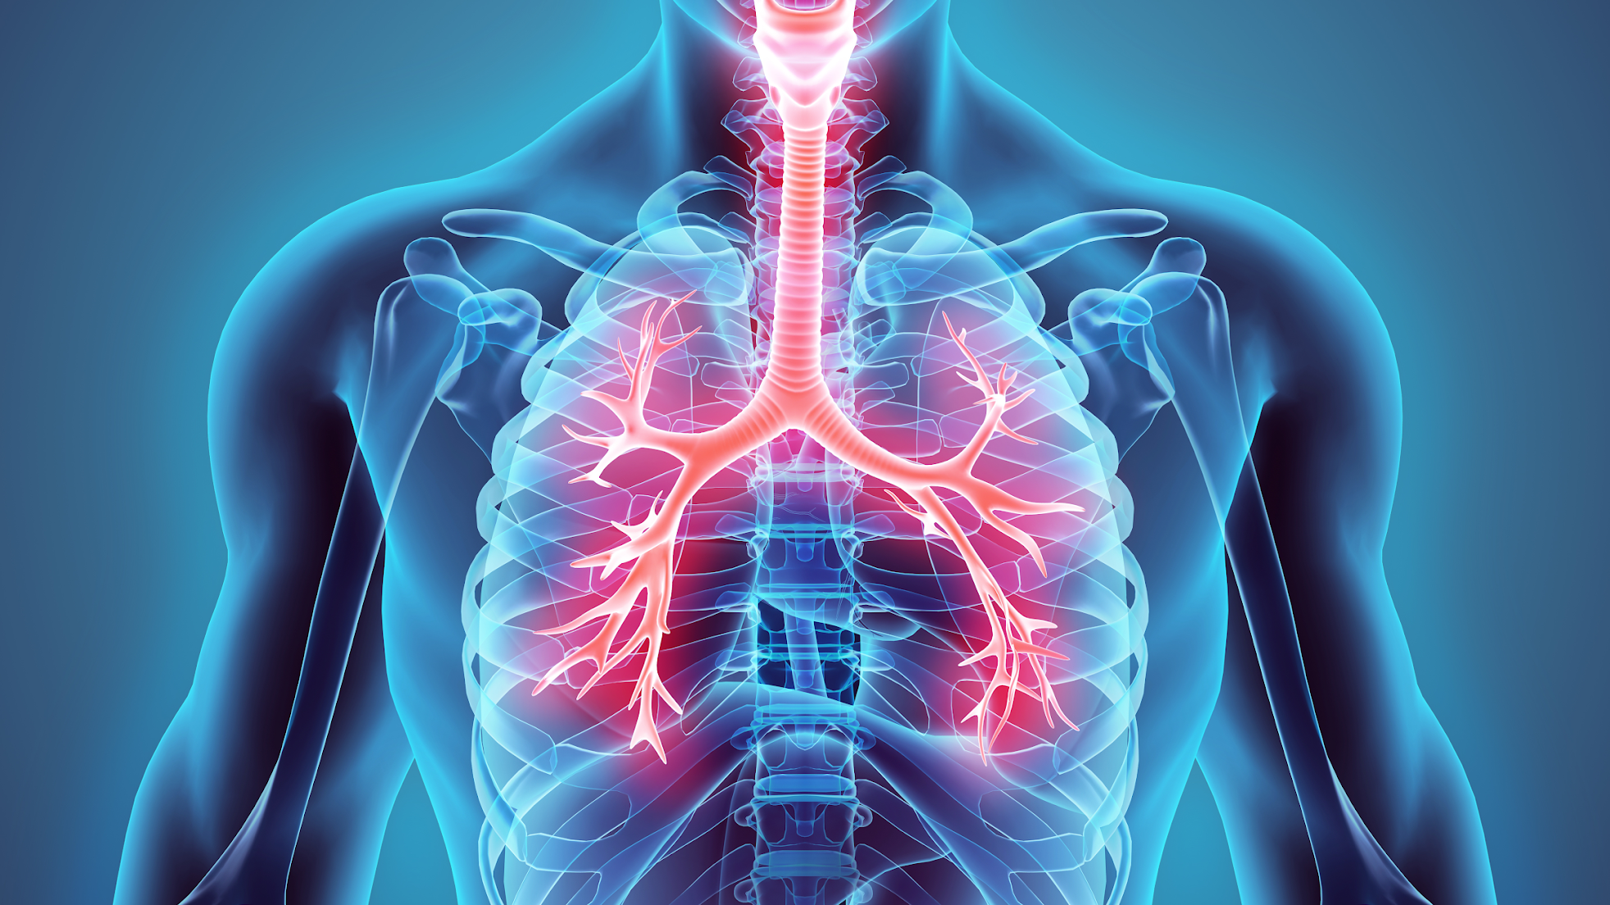
When You Want the Power Behind PYCNOGENOL®
Pycnogenol®, The Gold Standard Ingredient
The extract has been widely studied for the past 40 years, with more than 160 clinical trials and 420 scientific publications.
In a changing health landscape you want Powerhouse supplement with synergy!
  Women’s & Men’s Health
  Cognitive Health
  Physical and Cardiovascular Performance

Slide 28
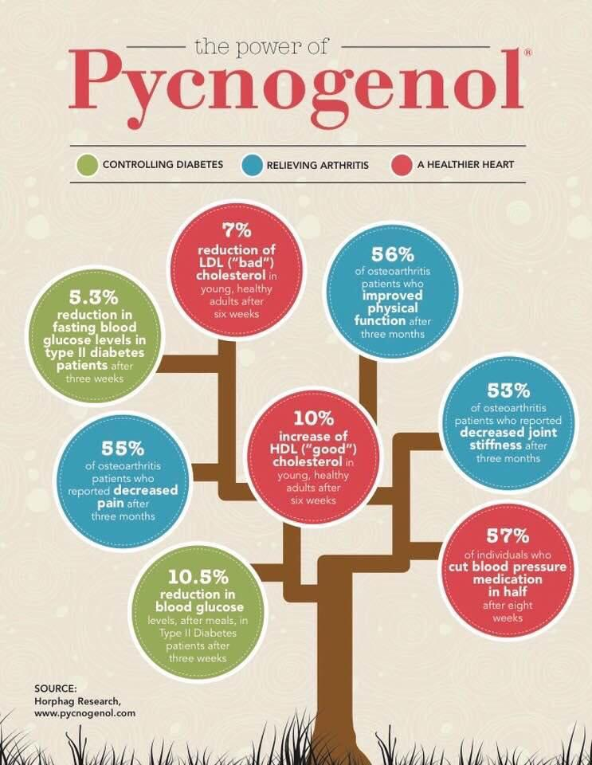

Slide 29
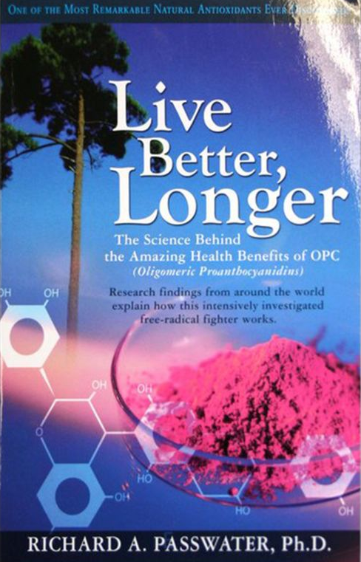

Slide 30


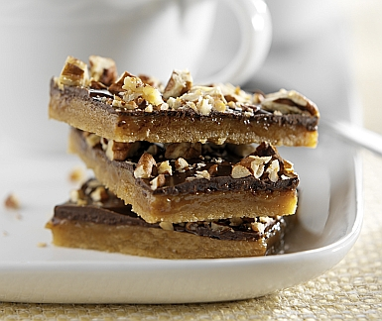


The Need for B Vitamins
B-vitamins are naturally depleted by:
Alcohol
Sugar
Coffee
Stress

Slide 31
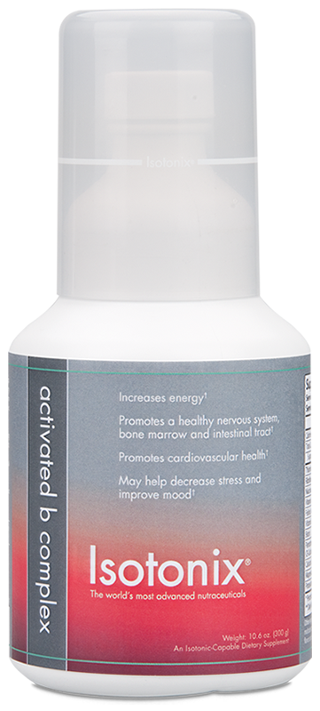
Isotonix® Activated B-Complex
Contains the metabolically activated
forms of critical B vitamins
Supports metabolism
Promotes nervous system
and immune function
Decreases stress
Increases energy
Supports heart health

Slide 32
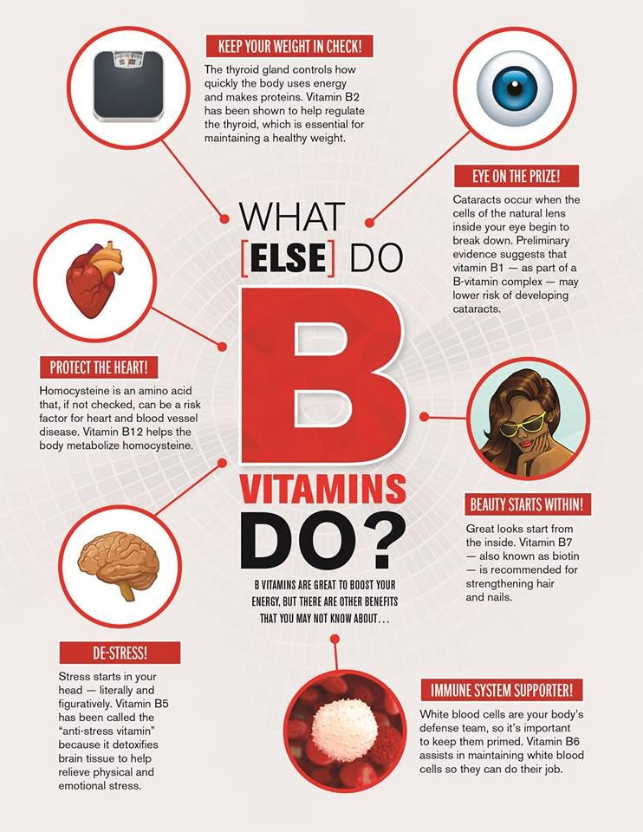

Slide 33
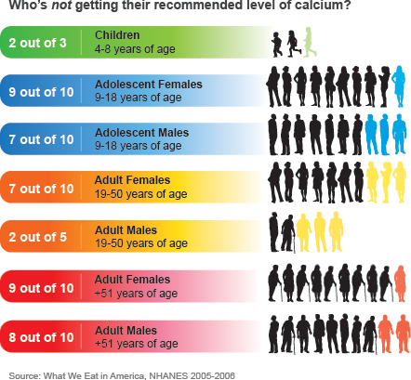
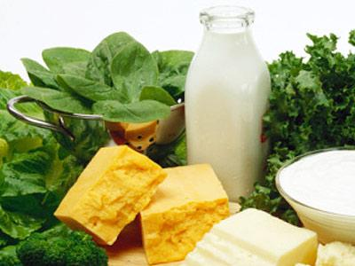
Getting Enough Calcium

Slide 34

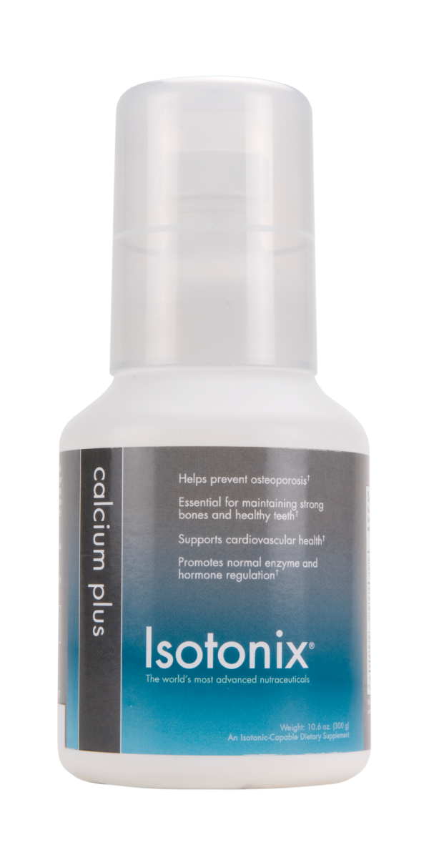
Isotonix® Calcium Plus
Calcium is essential for maintaining all aspects of health:
  Heart Health
  Bone Health
  Teeth and Gums
  Nerve Conduction
  Hormone Secretion
  Blood Clotting
  Body Weight
  Immunity
Does not contain excessive calcium per serving (you can only absorb ~400 mg at a time).

Slide 35

Isotonix® Multivitamin
100% of essential vitamins needed for proper nutritional balance.
Vitamins serve as cofactors and coenzymes for proper functioning of enzymes/metabolic reactions (required components).
Minerals are key co-factors for metabolic processes (required components).

Slide 36
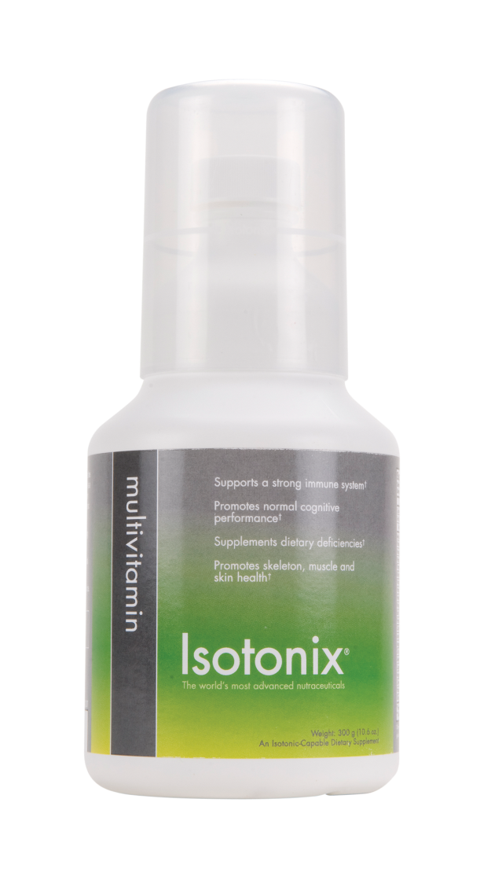
Isotonix® Multivitamin
Available with and without iron
Exceeds 100% DV for many important nutrients including:
  Vitamins A, C, D and E
  B Vitamins
  Zinc
  Selenium
  Copper
  Chromium
  Potassium
  And more!

Slide 37
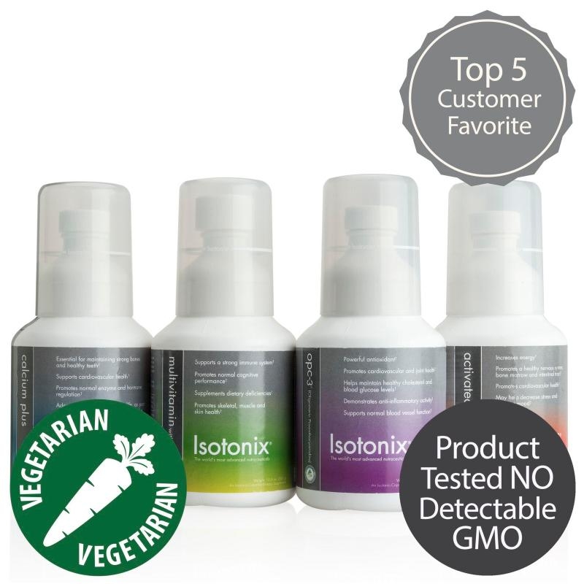

Isotonix® Daily Essentials Kit
Contains Isotonix OPC-3, Multivitamin, Activated B-Complex and Calcium Plus
  Provides Vitamins and Minerals
  Heart Health
  Immunity
  Energy and Mood
  Stress Management
Vegetarian, no added wheat, soy, yeast, gluten, artificial flavor, starch, salt, preservatives, or milk.

Slide 38
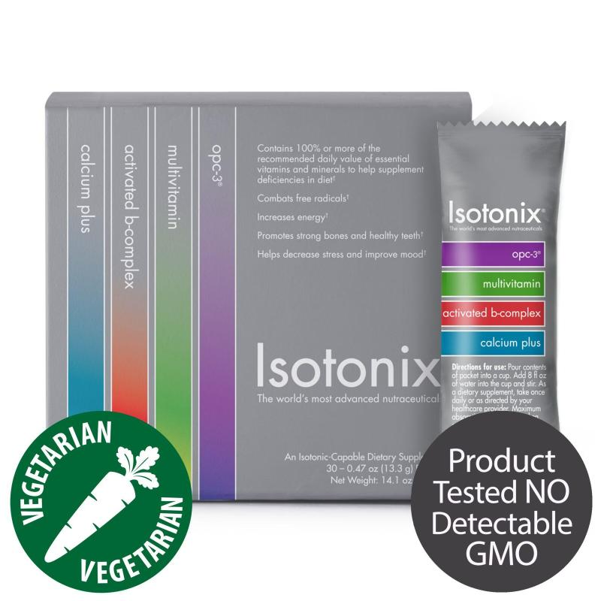
$2.57 per day
$2.00 per day

Slide 39

Product Standards
All of our products must pass not 1 but 2 tiers of quality control inspections before they are shipped to any customers.

Slide 40

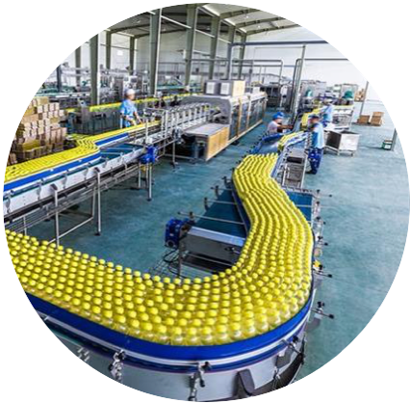
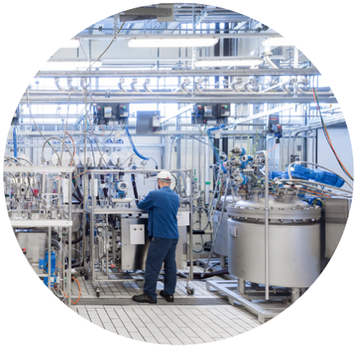

Tier 1
Manufacturer
All facilities are inspected by the FDA, Health Canada, Australia TGA.
They follow current good manufacturing practices (cGMP).
Each batch of product is tested for purity, potency and contaminants.

Slide 41

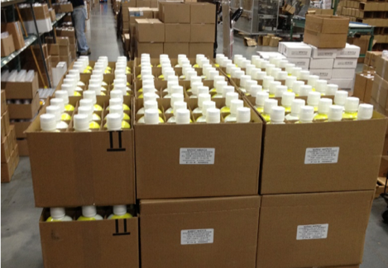

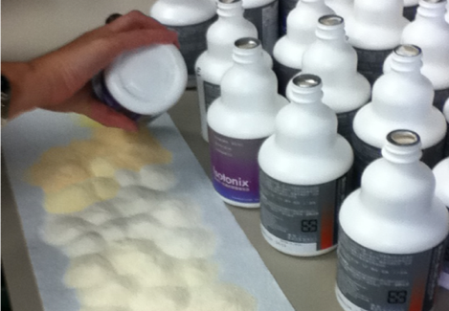
Tier 2
Market America/Shop.com
Shipments are carefully inspected by Market America upon receipt.
All paperwork is double checked (Certificate Of Analysis, Manufacturing Records, Lot Numbers, Shipping Docs).
Product is tested & validated in our lab & only released after meeting all specifications.

Slide 42
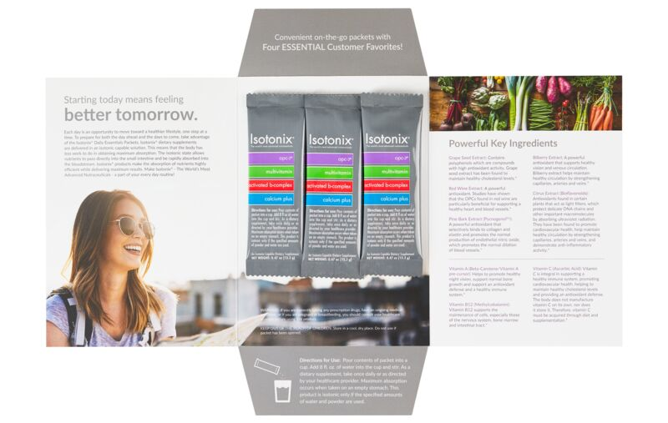


Slide 43
$2.57 per day
$2.00 per day

Slide 44
EVENT SPECIAL
10% OFF
FREE SHIPPING OVER $99

Slide 45


THANK YOU FOR ATTENDING!
WISHING YOU HEALTH & WELLNESS IN 2022!

