Slide 1
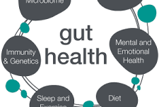
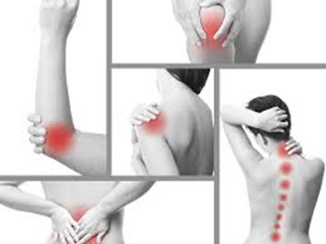
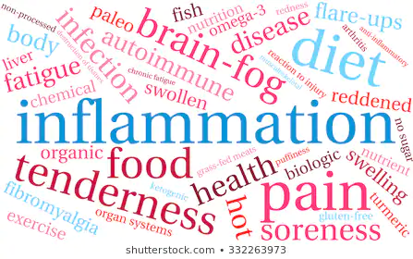

Welcome to
Wellness 101
Today is all about YOU!
It is all about giving you the information you need to make wise choices for optimal health
Notes:
Today is all about you and giving you information

Slide 2
INTRODUCTION TO WELLNESS
TODAY OUR GOAL IS EDUCATION
How to take better care of your body
Why quality supplementation is important
“Your body is talking, Are you listening?”
Disclaimer: We are not here to diagnose, treat, or cure any disease
Notes:
My name is…..

Slide 3
Building your immune system
Giving natural solutions for inflammation and pain and understanding the role of supplementation
Improving gut health
Notes:
Host goes over the slide then shares their “why”

Slide 4






About the company
Market America
Worldwide/Shop.com
Founded in 1992,
Based in Greensboro, NC
Product Brokerage and
Internet Marketing
Powered by People
Better Business Bureau Rating of A+
Torch Award for
Honesty, Integrity and
Customer Service
Multiple Divisions
Across Billion Dollar Markets
Notes:
This presentation is about our biggest division
Health and Nutrition, which also includes direct to health professional, age management, children’s health and weight management departments

Slide 5

Let’s learn about each of you
Please take 30 seconds and tell us your….
1. Name and Who Invited You
2. Where you Live
3. Your Biggest Health Concern
Notes:
“Today is all about YOU and getting to know you.”
Guest always share first
Business Owners share favorite product and BRIEF why (20 sec)
Host shares: Background and 2 min testimonial

Slide 6

If you don’t make time for your wellness, you will be forced to make time for your illness

Slide 7


So let’s go over a Quick Survey to determine your
Current Wellness

Slide 8
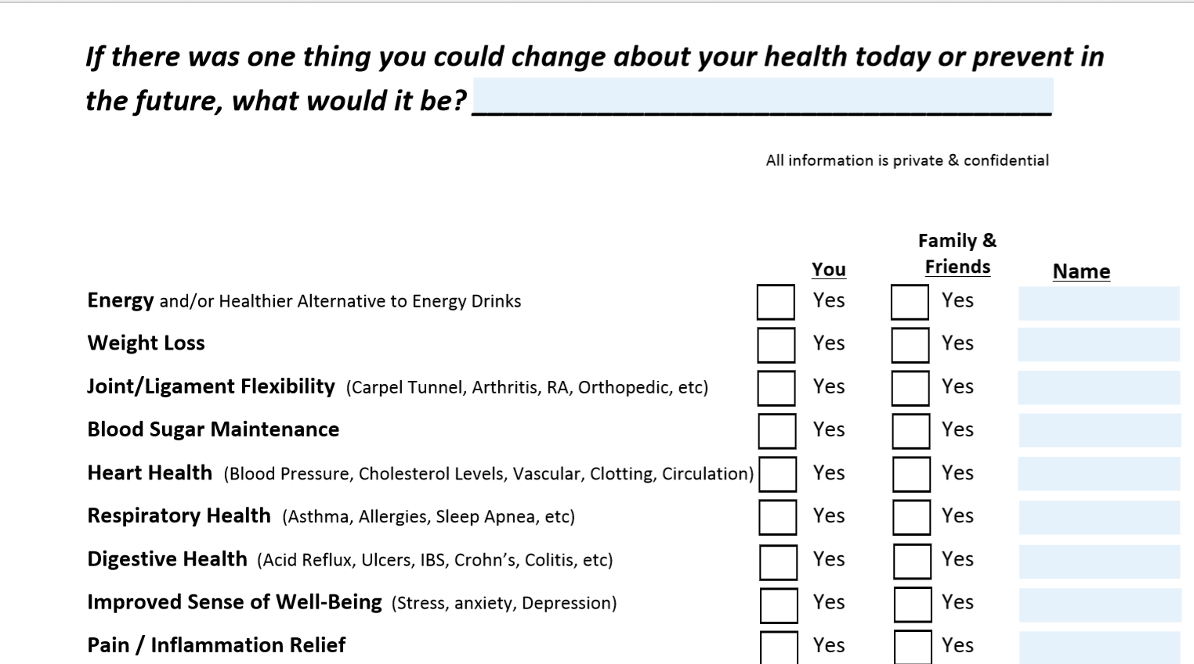
HEALTH SURVEY
Notes:
This Survey is emailed to all guests:
Host or Co-Host reviews this Health Survey going over each line and asking
“Who do you know” Family or Friend
“The person who invited you on this call will follow up to review your completed survey”

Slide 9
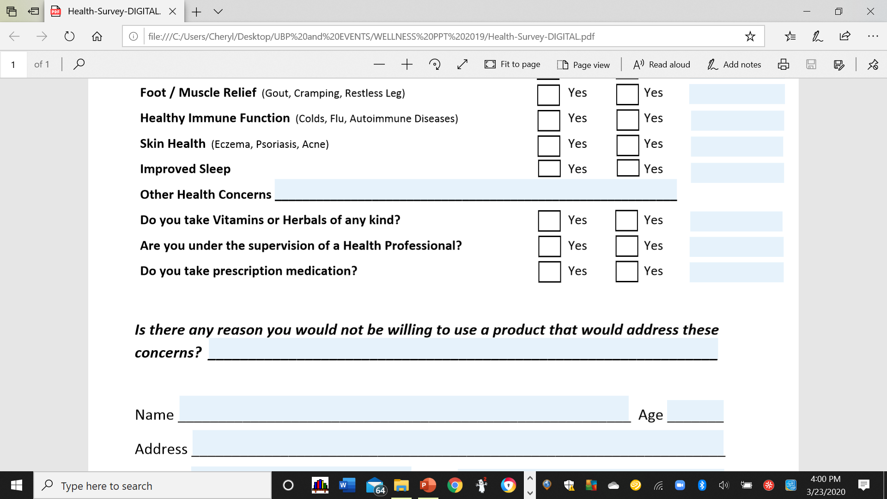

Slide 10
Why are so many People having health issues?
The American Medical Association (AMA) has determined that:
Insufficient Vitamin Intake and
A POOR DIET can be related to
CHRONIC DISEASE DEVELOPMENT and its PROGRESSION

Slide 11
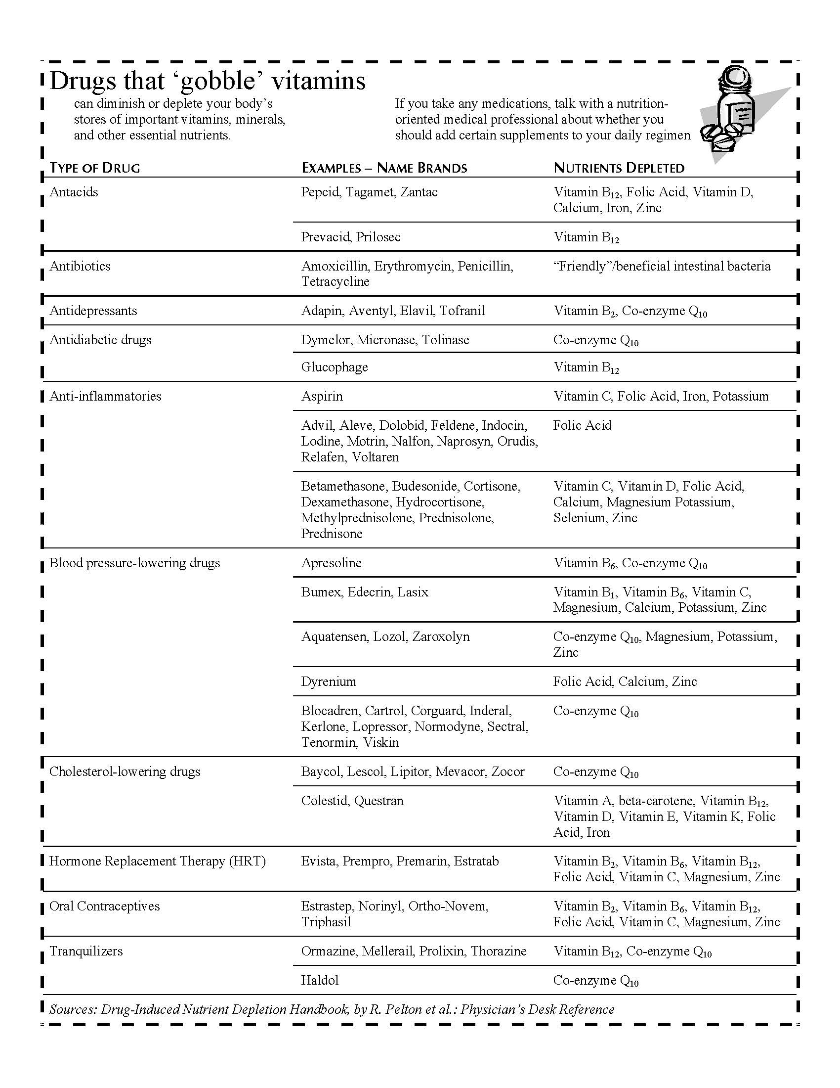
Pharmaceuticals CAN Deplete Critical nutrients
Physician’s Desk Reference
Anti-Depressants - Vitamin Bs, CoQ10
Ibuprofen and over the counter pain meds
Vitamin Bs, Vitamin D, Calcium, Magnesium
Birth Control – Vitamin Bs, Magnesium
Diabetic Meds – Vitamin Bs, Vitamin C, CoQ10
Antacids - Vitamin Bs, Vitamin D, Calcium
Notes:
When we get sick we have been taught to lean on pharmaceuticals
We need to be aware that they can deplete critical nutrients in our bodies.

Slide 12

Does it Matter
Which Supplements
We Choose?

Slide 13
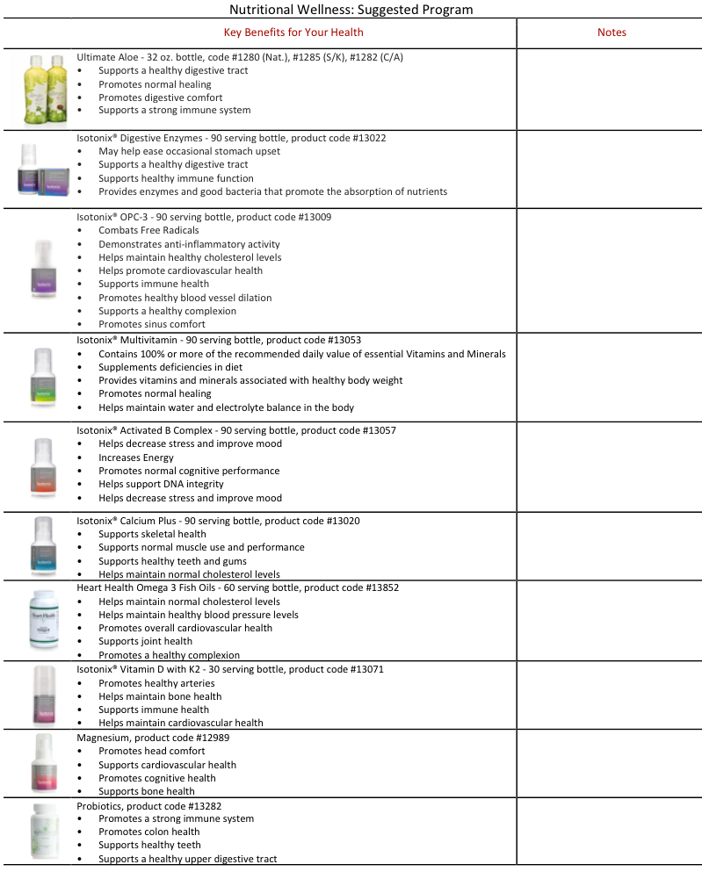
Wellness 101 Top 10 Supplements
Notes:
Each guest should have this list of products (Nutritional Guideline) emailed to them
Briefly mention the products on this page and the ones that will be covered in the video
Tell guests to take notes during presentation
Introduce the wellness101 video

Slide 14
Wellness 101 video.com
Notes:
2 Testimonials are planned ahead of time for any of the products mentioned in the video
We need to stop the video 4 times
After the Aloe at: 4:48 min.
B. Complex testimonial at 11:20
Food into energy at 14:33
OPC3 Testimony at 16:52

Slide 15

Wellness101video.com
Notes:
2 Testimonials are planned ahead of time for any of the products mentioned in the video
We need to stop the video 4 times
After the Aloe at: 4:48 min.
B. Complex testimonial at 11:20
Food into energy at 14:33
OPC3 Testimony at 16:52

Slide 16
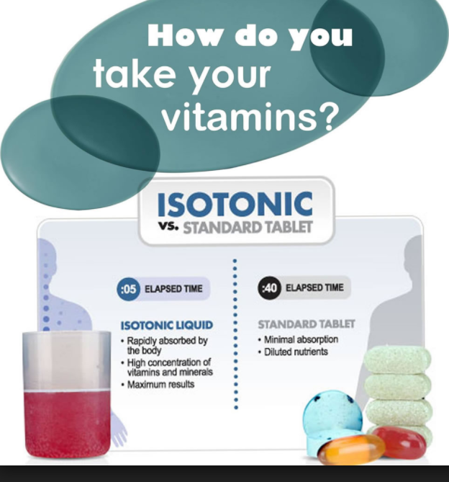

Slide 17
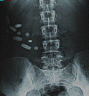
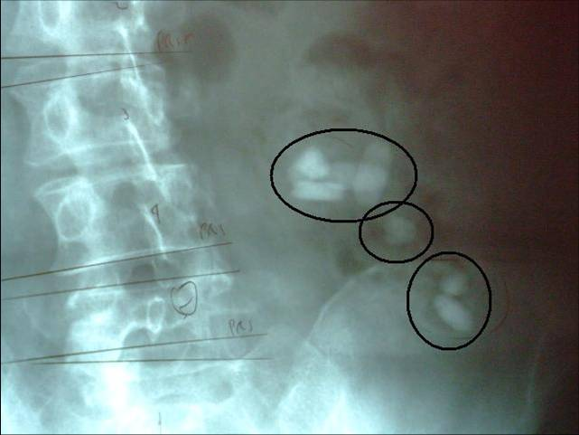
Absorption Matters!

Slide 18
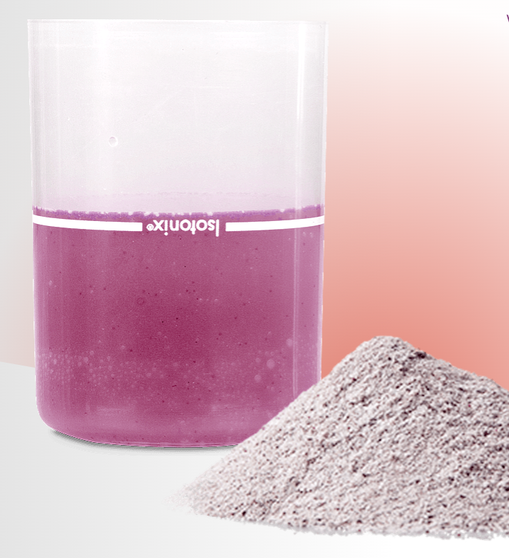
Isotonix Supplements are Effective, Simple, and Delicious!
Drinking your vitamins maximizes your absorption!

Slide 19
Do you know your Vitamin D levels?
Regulates bone metabolism
Critical role in modulating immune response
Deficiency related to decreased lung function and chronic lung disease
Low levels of Vitamin D can be a contributing factor to
C Cognitive Disorders
nic Pain in Muscles and Bones
Cognitive
Disorders
Chronic Back, Muscle Pain
Depressed Immune Function
Depression
Fatigue and Tiredness
Poor Wound Healing
Low Bone Mineral Density
Hair Loss and Alopecia
Cardiovascular
Disorders
https://www.ncbi.nlm.nih.gov/pmc/articles/PMC2706673/, https://www.nature.com/articles/srep45172
Notes:
A Co-Host can present Vitamin D with testimony
Vitamin D is actually a steroid hormone precursor
Without adequate Vitamin D, only 10-15% of dietary calcium is absorbed
++Highlight lung and respiratory support targets the lungs
*The Vitamin D-cathelicidin pathway (cathelicidins are peptides in the cells that are activated by Vit. D)
For optimal health, Intergrative practitioners recommend Vitamin D levels should be between 50-100 ng/ml (typical US tests at 3—40 ng/ml)
This can be determined by a simple blood test from your Health Professional
https://www.ncbi.nlm.nih.gov/pmc/articles/PMC2706673/
https://www.nature.com/articles/srep45172
https://www.medicinenet.com/vitamin_d_deficiency/article.htm

Slide 20
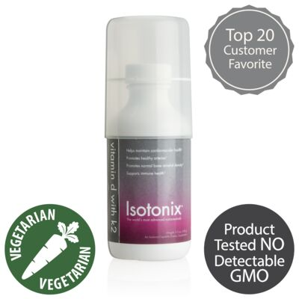
Vitamin D3 with K2
K2 works with D3 to support proper calcium absorption and utilization, helps maintain bone mass, promotes elasticity of blood vessels
Supports immune health
Helps maintain bone health and normal bone mineral density
Helps maintain cardiovascular health
Promotes healthy arteries
Promotes elasticity of blood vessels
Helps maintain normal blood pressure
Promotes healthy cells
5000 IU of Vitamin D3 per dose
Notes:
Obtained in 3 ways: Dietary intake ›Supplementation ›Sunlight
Dietary Sources (note how much more is needed to eat daily to have optimal intake level of 3-7,000IU/day ):
Salmon: 360 IUs. (mercury contamination)
Mackerel: 345 IUs. (high toxin levels)
Tuna: 200 IUs. (high toxin levels)
Sardines: 250IUs
Fortified Milk: 98 IUs (dairy not recommended for optimal wellness-inflammation, mucous,

Slide 21

We have a Complete Line of Science Based Supplements to support Optimal Health
Immune Support
Heart Health
Joint Health
Natural Stress Support
Healthy Blood Pressure Levels
Healthy Blood Sugar Levels
Weight Management
Vision Health
Children’s Health
Age Management
- and more
Healthy Weight Loss
Healthy Blood Sugar Levels
Natural Stress Support
Anti-aging
And Much More…

Slide 22
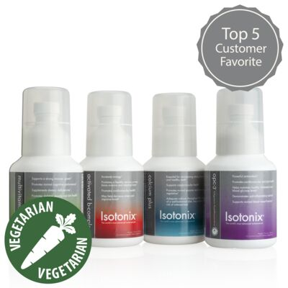
Isotonix® Daily Essentials Kit
Contains
Isotonix OPC-3, Multivitamin, Activated B-Complex, and Calcium Plus
  Provides Vitamins and Minerals
  Heart Health
  Immunity
  Energy and Mood
  Stress Management
  About $2.00 per day
Notes:
The suggested retail is …..
A special offer should be shared that we can guarantee this price by you going on auto-ship and include free shipping to ensure a great foundation and low price.
Remember, manually, you can offer an additional 5 to 10 percent discount for autoships from your back office.
This is just to remember for leverage because a customer on autoship is a guaranteed sale.

Slide 23
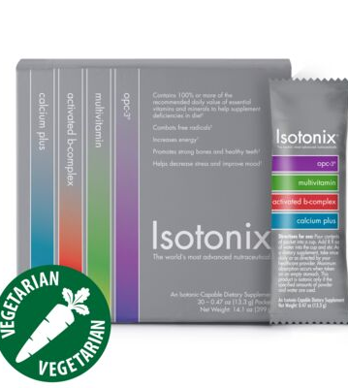
Each packet contains a serving of OPC-3, Multivitamin, Calcium, and B-Complex.
Just add one packet to 8 oz of water and Drink
About $2.50 per day
Daily Essentials Packets (30 packets)
Do you love Convenience and Simplicity?

Slide 24
Your Next Step is to
Contact the person who invited you to review your health survey results
1
2
3
Can you think of anyone in your life who could benefit from this information?
Let us know!
Get your Questions Answered
Order the Products of your Choice
We are conducting future wellness seminars. Would you like more information?

Slide 25
Notes:
The CLOSE is the key to helping people make a decision that is good for them
Review the top 3 choices:
Suggested Special for ordering TODAY: 10% discount for attending
A bottle of Aloe at half price when they order Daily Essentials Kit or Packets

Slide 26

Thank you for joining us
Questions?
If you don’t
make time
for your wellness,
you will be forced
to make time
for your illness!
Notes:
Thank you to our host

