Slide 1

Wellness 101
Jacque Birchman

Slide 2
Disclaimer
These statements have not been evaluated by the Food and Drug Administration.
The products discussed are not intended to diagnose, treat, cure, or prevent any disease.
No Recording of On-line Training Permitted

Slide 3

Think about it….
Perhaps it took you 10 years to develop some health challenges…
You get sick one cell at a time…
You get HEALTHY one cell at a time!
Notes:
3

Slide 4
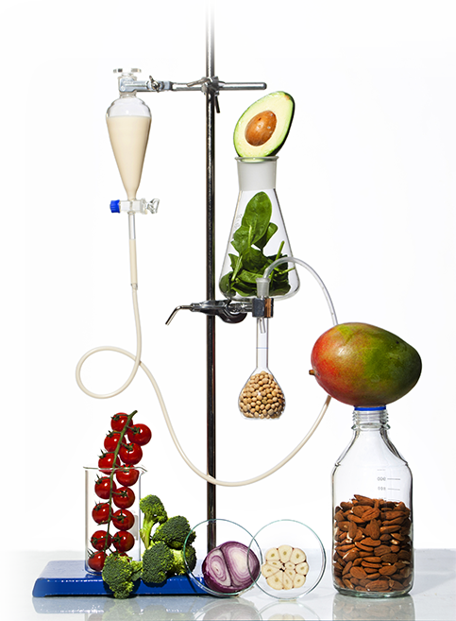
Supplementation is no longer a luxury
The real world has caught up to our health.
We eat more unhealthy foods – that is, when we remember to eat at all.
Our lives are filled with more stress – whether from work or at home.
Our environment – from the air we breathe to the ground we sow – is more toxic than ever before.
Supplementation is required to get
the nutrition you need.

Slide 5

The cheapest price you pay for wellness is today,
the price only goes up!
Notes:
5

Slide 9

Dr. Sheryl Digestion Connection

Slide 10

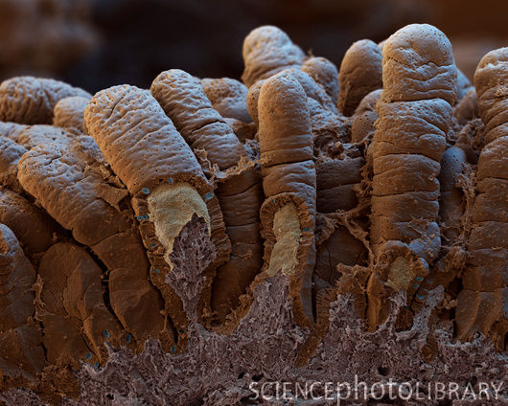
What Do Your Intestines Look Like?
If you are not eliminating at least once each day, your health may be at serious risk!
Healthy Intestine
You Gotta Poop!
Constipated Intestine

Slide 11

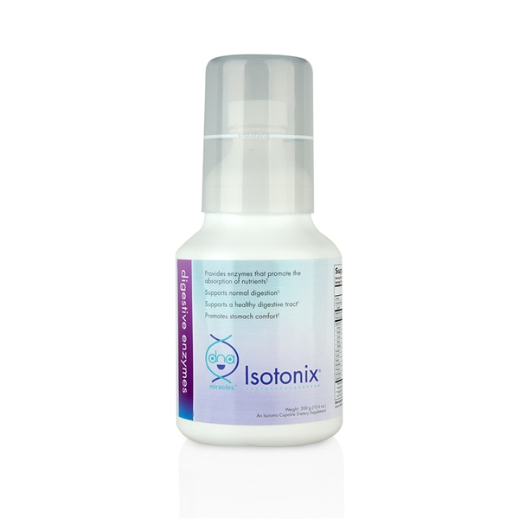

Taste Aloe & Digestive Enzymes
Isotonix Digestive Enzymes with Proboitics
DNA Miracles
Isotonix Digestive Enzymes
Ultimate Aloe Juice

Slide 12
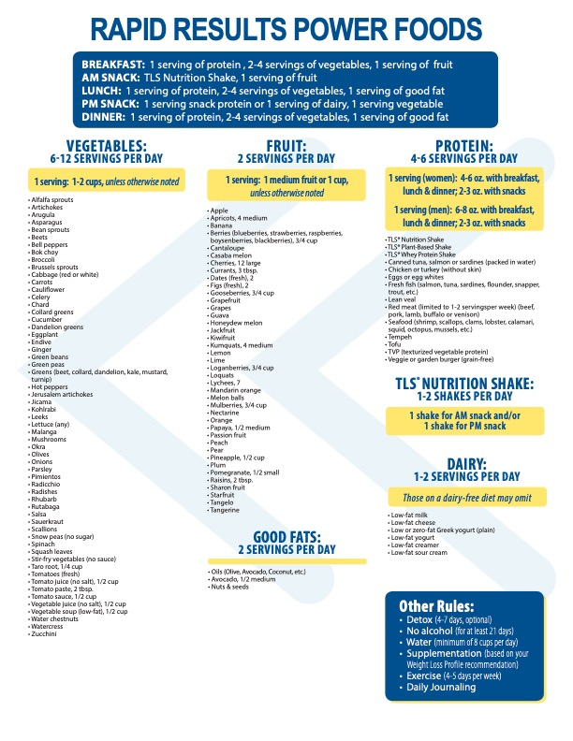

Slide 14
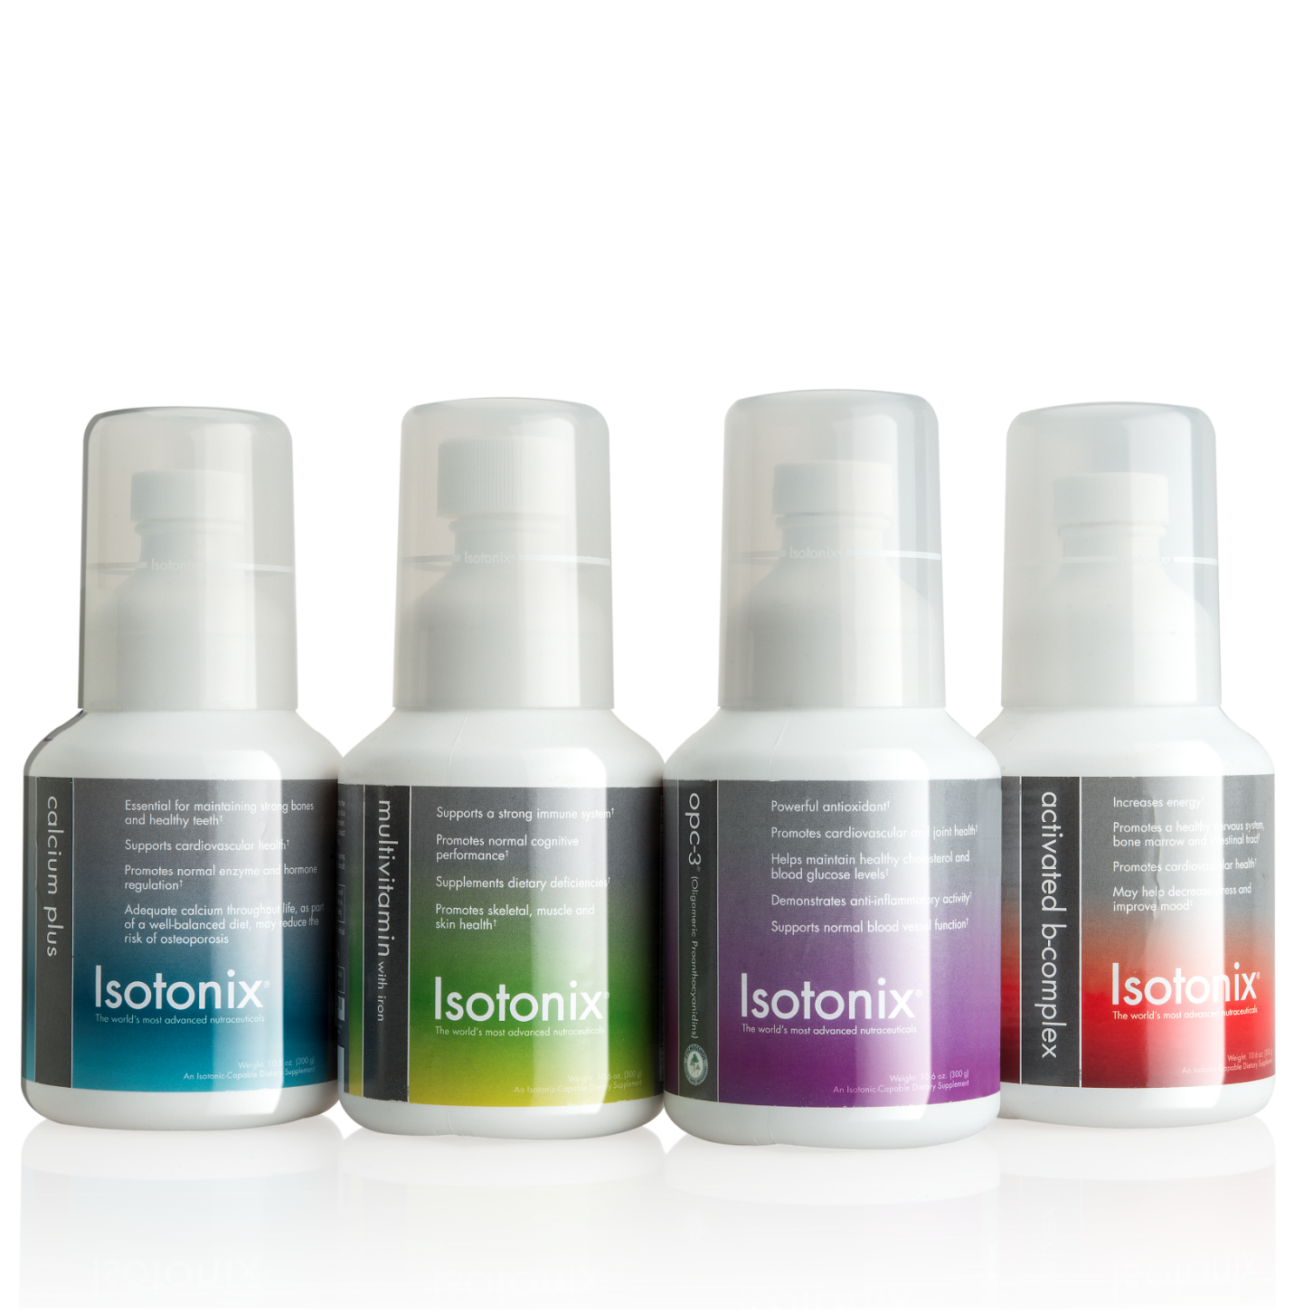
Isotonix Daily Essentials Kit

Slide 15

Discover the Power of Isotonix with Dr. Duchess

Slide 16
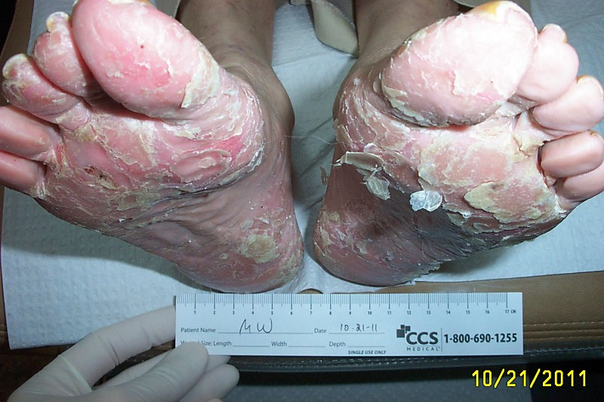
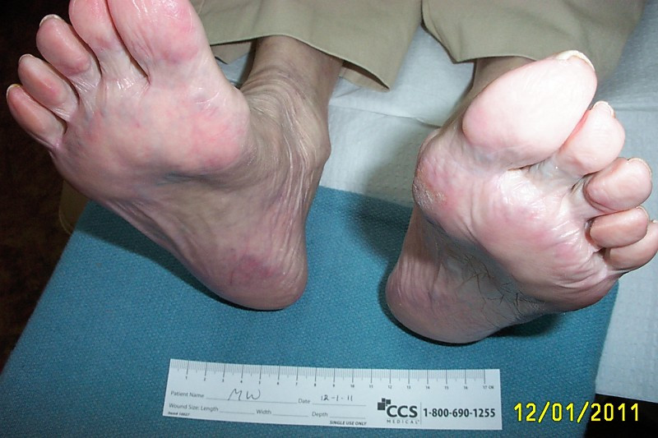
Initial presentation of patient on 10/21/2011.
OPC-3 started for treatment of psoriasis.
6 weeks after beginning OPC-3, the patient’s psoriasis is remarkably improved !
Her condition is maintained with 2caps of OPC-3 daily.

Slide 17
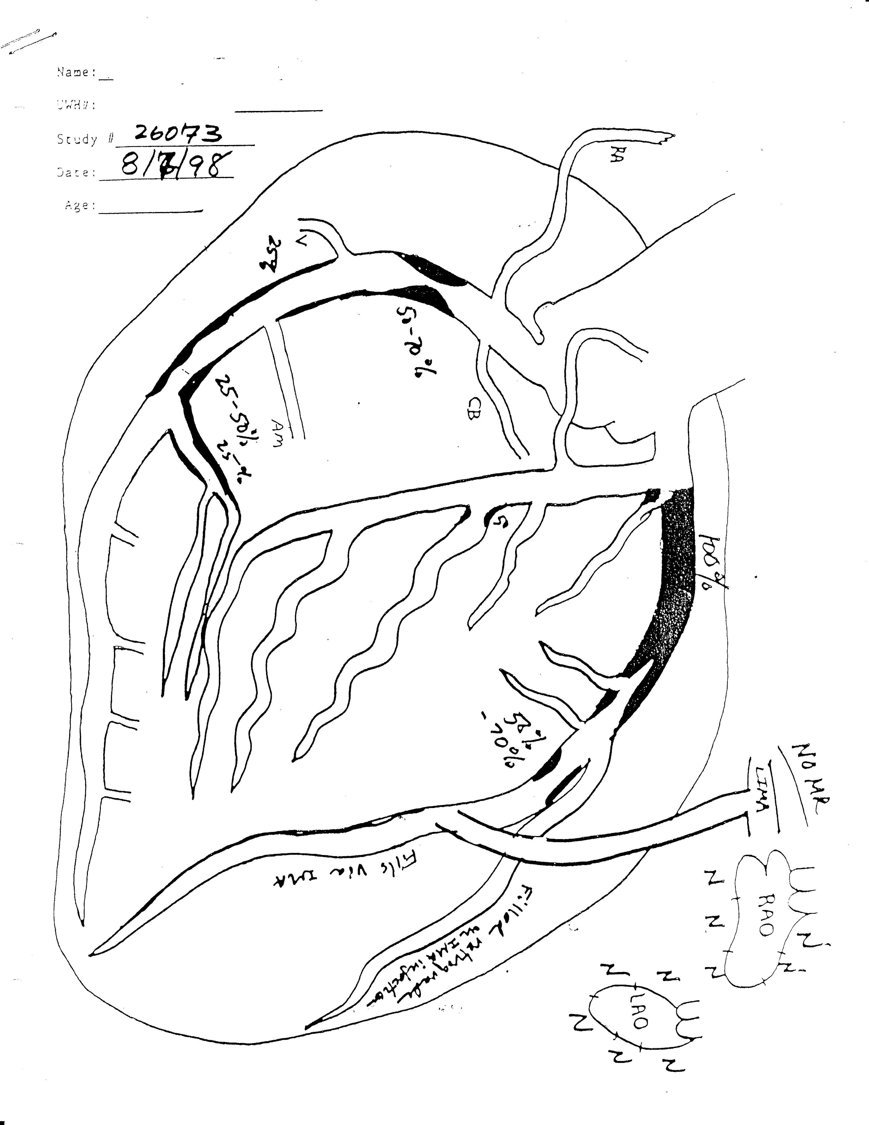
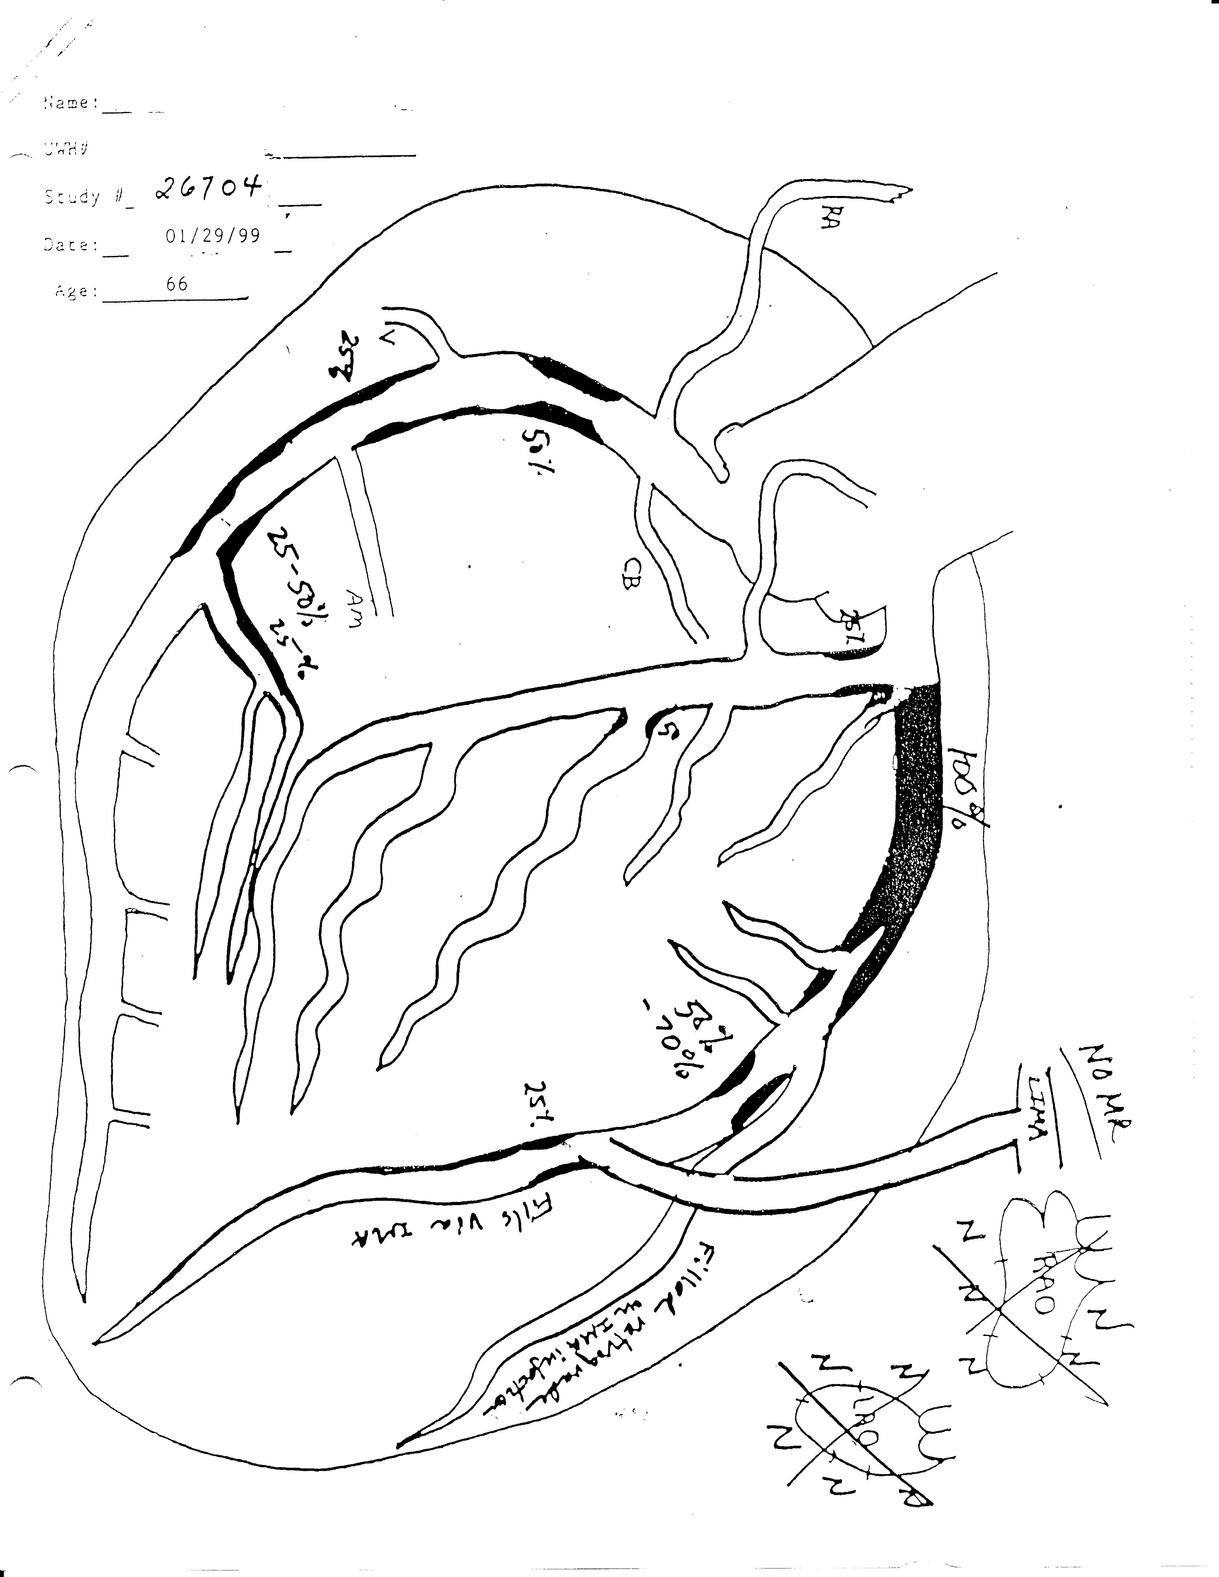

Slide 20
“If you do not make time for your wellness, you will be forced to make time for your illness.”

Slide 21
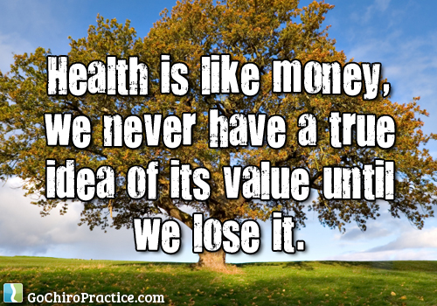

Slide 22

You don’t have to be a wreck. You don’t have to be sick. One’s aim in life should be to die in good health. Just like a candle that burns out.
- Jeanne Moreau

