Slide 1
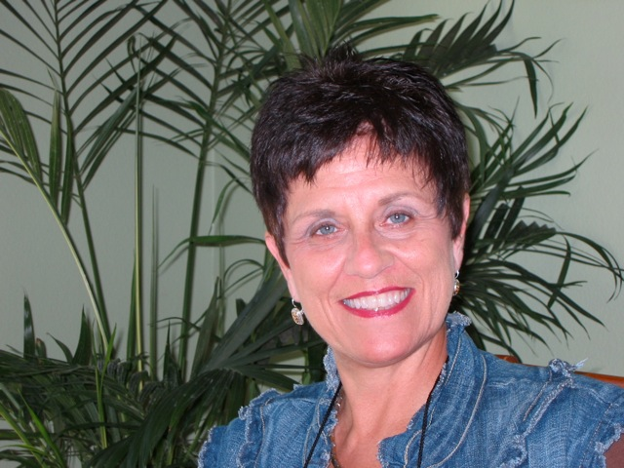
Twin Cities Welcomes
Jacki Blasko Field Vice President
($36k - $45k 4-wks)
Certified Trainer Advisory Council Member Million Dollar Club Member District Coordinator (retired) Gold UFO
1998 Fastest Growing Distributor Multiple Presidents Challenge

Slide 2
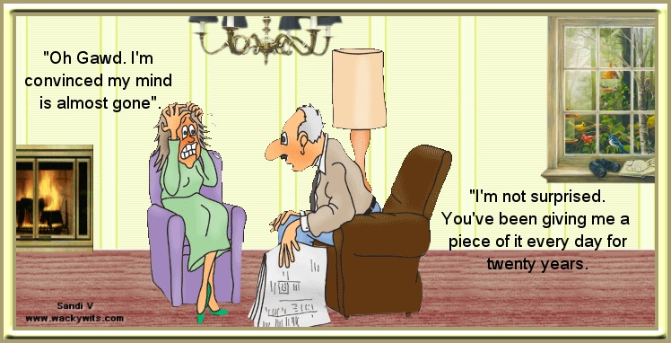
DAVE AND JACKI BLASKO (after 50 years) PEOPLE ARE “FASCINATING" or Frustrating! IT IS A CHOICE! Beep! Beep!
Notes:
JUST IN CASE YOU ARE THINKING WE ARE PERFECT AND EXTRAORDINARY…PLEASE KNOW THAT WE ARE VERY AVERAGE PEOPLE WITH MANY PERSONAL CHALLENGES FROM HEALTH & FAMILY TO LIFE IN GENERAL!
WE ARE JUST LIKE YOU…WE HAVE SIMPLY BEEN IN THE BUSINESS LONGER AND HAVE HEARD MORE ‘NO’S
MY BIGGEST GOAL IS TO HELP YOU SEE THAT WE ARE “REAL” ….ONLY SPECIAL BECAUSE WE ARE CREATED IN HIS IMAGE AND HAVE LEARNED HOW TO LOVE PEOPLE!
AREN’T PEOPLE FASCINATING???? I LOVE PEOPLE BECAUSE I CHOOSE TO THINK THEY ARE FASCINATING….
NOT FRUSTRATING!!!

Slide 3
I SPECIALIZED IN “PEOPLE”!!!
and
OPC-3
(Retailing System)
Notes:
I REGISTERED MY BUSINESS….SENT IN JOHN’S PAPERWORK AND BROUGHT AS MANY AS POSSIBLE TO THE
2ND LOOKS AND LOCAL WITH ME!!

Slide 4
A mind is like a parachute… It only works when it is open!
THESE WERE MY QUESTIONS…
CAN I TRUST THE PEOPLE / COMPANY?
DO THESE PRODUCTS WORK?
HOW CAN I DO THIS BUSINESS? What do I do?
WHAT DO I DO TO FIND TWO PEOPLE WHO WILL DO THIS BUSINESS?
5. WHAT DO I DO TO HELP THESE TWO PEOPLE MAKE $1500 EVERY WEEK?
Notes:
YES, IN 1996I WAS A PROSPECT, … BUT VERY CLOSED MINDED AND SKEPTICAL!...TRUST WAS A BIG ISSUE FOR ME.
OPENING THE MIND TO A HOME BUSINESS REALLY IS A PROCESS, RIGHT?!
HOW MANY HERE WERE IMMEDIATELY OPEN-MINDED WHEN YOU WERE INTRODUCED TO MARKET AMERICA?
WHEN MY SPONSOR APRROACHED ME …. I SAID NO 3 TIMES.
BUT HE WAS PERSISTANT AND CALLED ME BACK THE 4TH TIME AND OFFERED ME A TICKET TO LEADERSHIP SCHOOL IN SANDIEGO CALIF. WHERE MY MOM’S FAMILY LIVED…COUSINS, AUNTS, UNCLES…I COULDN’T SAY NO TO THAT…SO I WENT… AND I STARTED TO BELIEVE AGAIN AS I WATCH JR AND DENNIS TRAIN…. THE SYSTEM OF TRAINING GOT MY ATTENTION!
THESE WERE MY QUESTIONS AS I STARTED TO ATTEND THE TRAININGS!

Slide 5
BELIEF CURVE
Unfranchise Owner
10-
9-
8-
7-
6-
5-
4-
3-
2-
1-
0-
ACTION
EMOTION
Distributor
Preferred Customer
Act your way into FEELING!!
Prospect
Possibility
One on One
Two on One
HBP
Business Social
Product Show
UBP
Corings
CD’s
DVD’s
NMTSS Events
Coventions

Slide 6
One to One Marketing/Network Marketing is a
Relationship Business more than a Sales Business
Notes:
This business is 90% People Skill and Personal Growth! 10% Business Skill?????

Slide 7
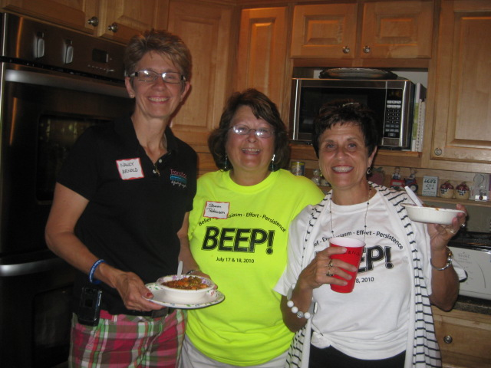
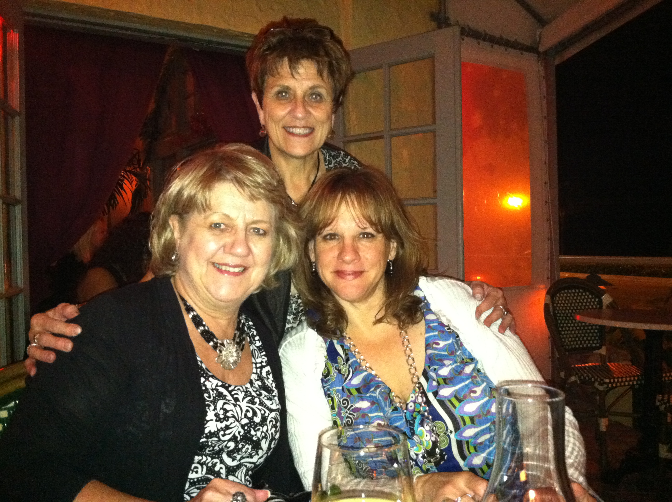
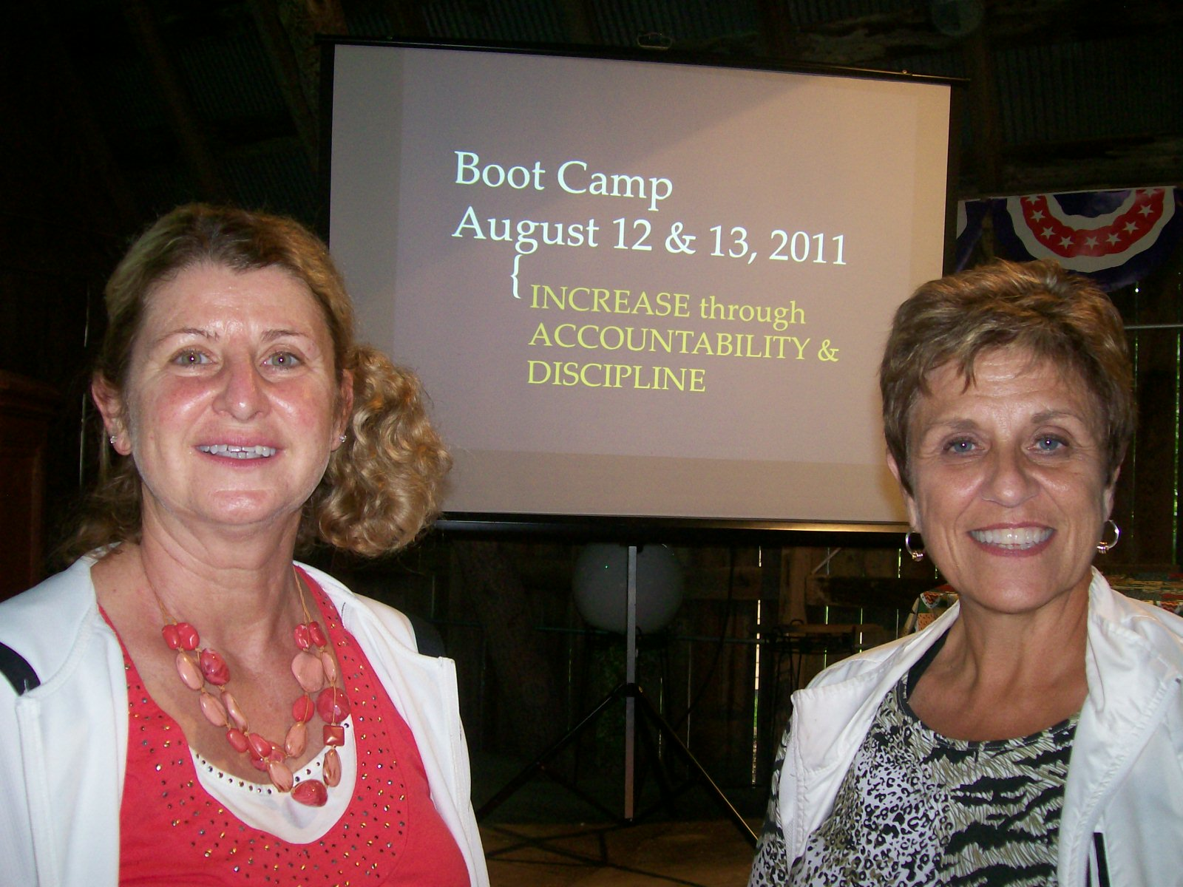
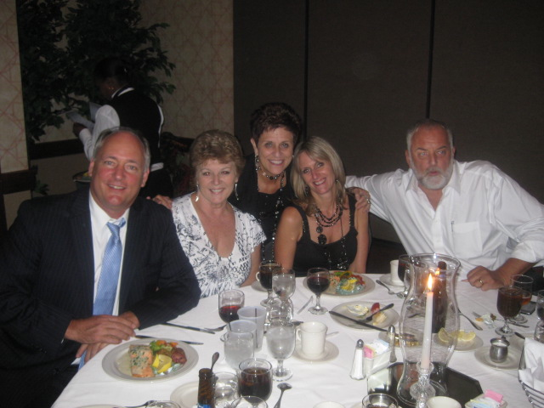
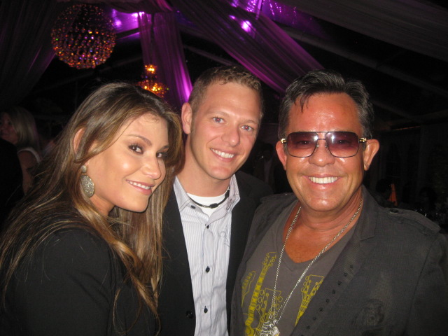
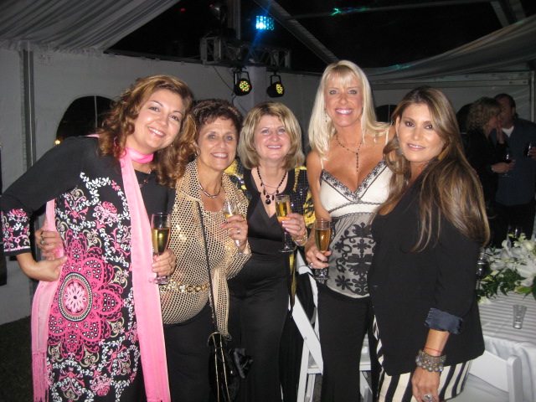
BUILDING RICH RELATIONSHIPS!
MA
F
A
M
I
L
Y
Notes:
HANGING OUT AND TALKING WITH NICE PEOPLE IN NICE PLACES!!
WHAT COULD BE BETTER!! LIKE MINDED PEOPLE WITH LIKE MINDED GOALS AND DREAMS!!
I love doing Workshops where we can really get to know each other…and Identify your NEEDS! One to One!!
“WHAT DO YOU FEEL YOU NEED MORE OF RIGHT NOW TO GROW YOUR BUSINESS…AND INCOME!

Slide 8
INVEST IN PEOPLE
This business is:
90% People Skills & Personal Growth
10% Business Skills

Slide 9
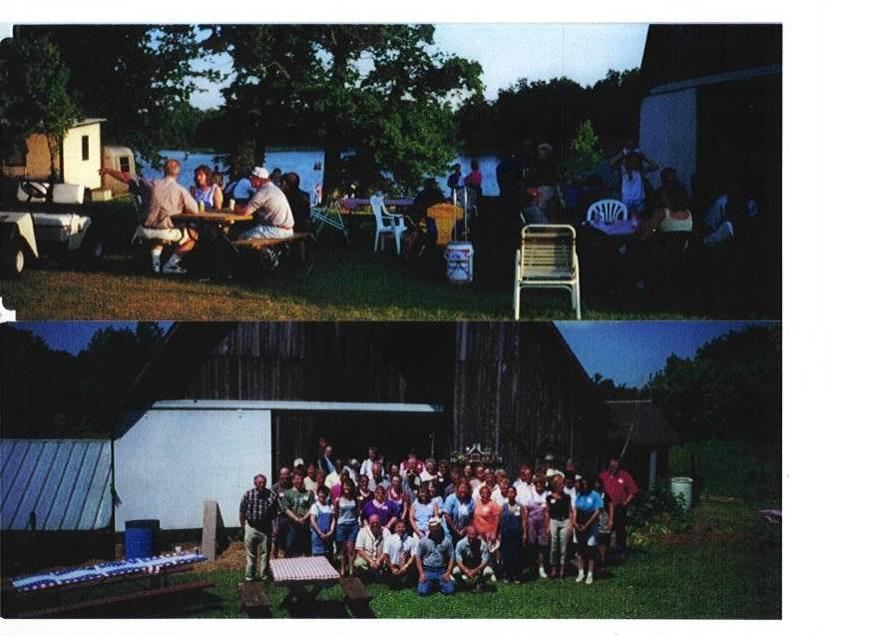
INVEST IN PEOPLE
WHEN YOU WORK FOR THE RIGHT PEOPLE,
MARKET AMERICA WILL PAY YOU RESIDUAL INCOME!

Slide 10
People Wear Two Signs
------MMFI
-------WIIFM
Take an Interest in PEOPLE!
ASK QUESTIONS!
Be Sincere with Enthusiasm!
Notes:
WHAT WOULD YOU CHANGE ABOUT YOUR LIFE IF YOU COULD? WHAT WOULD YOU CHANGE ABOUT YOUR HEALTH IF YOU COULD?
WHAT WOULD YOU CHANGE ABOUT YOUR JOB IF YOU COULD?
ARE YOU SERIOUS? WHAT HAVE YOU DONE IN THE PAST? HOW IS THAT WORKING FOR YOU?....REALLY …TELL ME MORE….
LOOK PEOPLE IN THE EYE! “HI MY NAME IS JACKI..WHAT’S YOUR NAME? NAME TAGS ALWAYS!!

Slide 11
“Treat people as if they were what they ought to be and you will help them become what they are capable of becoming” ~ Johann von Goethe
If our goal is to achieve INCREASE (performance / production) and enhance communication with the people we influence, then we must pay attention to these words of Goethe!

Slide 12
PEOPLE HAVE NEEDS
REAL NEEDS (Business)
Basic Five (What to do)
FELT NEEDS (Personal)
(Why & How)
“What do you feel you need more of right now to build your business?
What motivates you?
Notes:
REAL NEEDS= BUSINESS AND FELT NEEDS ARE PERSONAL.
PEOPLE COME INTO THE BUSINESS FOR MORE THAN MONEY
IDENTITY…STIMULUS….SECURITY!!! WHAT QUADRANT YOU ARE FROM WILL AFFECT THAT!!
THIS BUSINESS IS 95% PERSONAL GROWTH….FELT NEEDS MEET…NOW THEY MIGHT MAKE MONEY…IF THEY HAVE A HUGE WHY AND SET SMART GOALS!.... BELIEVING IN YOUR GOALS…IS MOTIVATION!

Slide 13
Felt needs vs. Real needs
Big
Pi
cture
Ri
sk
Taker
s
Cal
culated
Del iberate
Spontaneous
Detai led
Controller
Analyst
Task oriented
want to Control
PERFECTIONIST
Systematic
Independent
Accurate
Quality driven
Cautious
Exactness
DELIBERATE
LIKES:
To be in charge
To be respected
To be recognized
DISLIKES:
Being dominated Wasting time
LIKES:
To analyze
To be thorough
To be respected
DISLIKES:
Being rushed
Spontaneous change
Dominant
Results Oriented
Risk Taker//Driver
Competitive
Big picture
CONFIDENT
FEARLESS LEADERS
Team/Cause oriented
Loyal
Slow to Change
Steady
Loves a sure thing
EMPATHY
HEARTFELT HELPERS
Enthusiastic
Sociaable
Great presenter
Charming
Persuasive
Inspiring
DYANAMIC
BEST PEOPLE MOVERS
LIKES:
People/Family fun
Helping
DISLIKES:
Spontaneous change
Public recognition
Risk
LIKES:
People/stimulus
Creative process
DISLIKES:
Being Bored
Criticism
People oriented
want to Support
Promoter
Supporter

Slide 14
Major Strengths that each ‘style’ contributes to the TEAM
The Controller will make certain the team stays focused on the GOAL “the WHY”
The Promoter will strive to keep the lines of communication open
The Supporter will want to be sure the job gets done.
The Analyst will ensure that the project is completed according to the plan and specs!
A Productive Team needs all Four Styles!

Slide 15
HOW TO BE A PEOPLE MAGNET
“ How to Win Friends and Influence People”
~Dale Carnegie
1. Learn and remember everyone’s name.
2. Have a sincere enthusiastic personalized greeting every time.
3. Listen twice as much as you talk; listen for common ground.
(GOD gave us 2 ears and mouth for a reason!)
4. When you do talk, talk about them or something that they are interested in.
5. Never complain about ANYTHING!
6. POSITIVE (Always be positive about EVERYTHING!)
7. Give them something to admire.
8. Publicly recognize every achievement; no matter how SMALL!
9.Introduce them to everyone with PRIDE and ENTHUSIASM!
Always, ALWAYS MAKE PEOPLE FEEL SPECIAL!
“EVERY DAY ABOVE THE GROUND IS A GREAT DAY.”

