Slide 1
#shoppingannuity

Slide 2
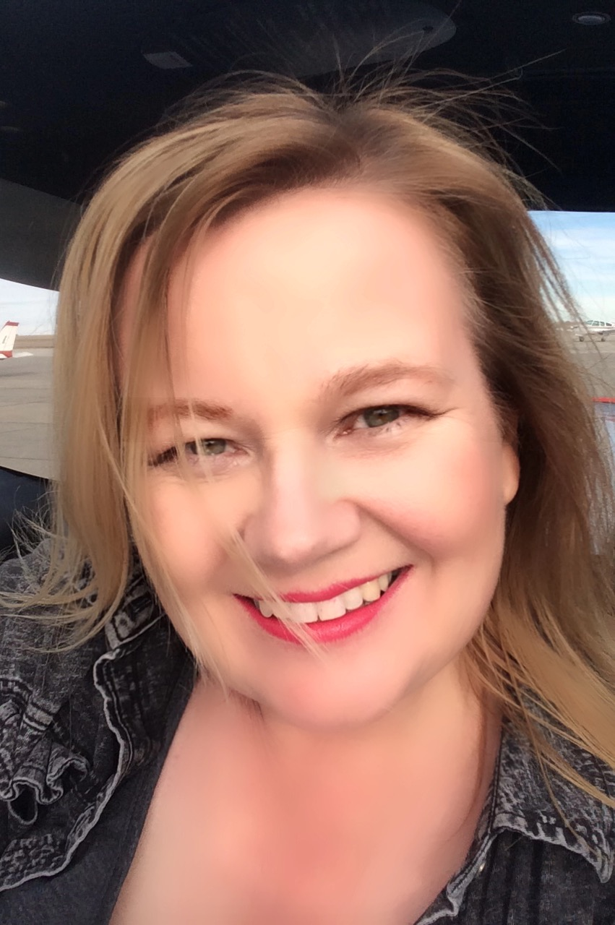

Slide 3
Ruth schadler
Master Coordinator
Unfranchise Owner April 2015
Master UFO 6 quarters
SABP 5 quarters
Presidents Challenge Winner
TLS Challenge Winner X 3
NE Regional Challenge Winner X 2
Northern Regional Challenge Winner

Slide 4
Why dream big
Mother to Derek – 26 years, Ashlee – 24 years, and Kelcee – 20 years
Wife to Jeff – 26 years
Family – nieces, nephews and extended family
MY Framily
MY CUSTOMERS
MY PASSION TO HELP OTHERS
And Myself

Slide 5
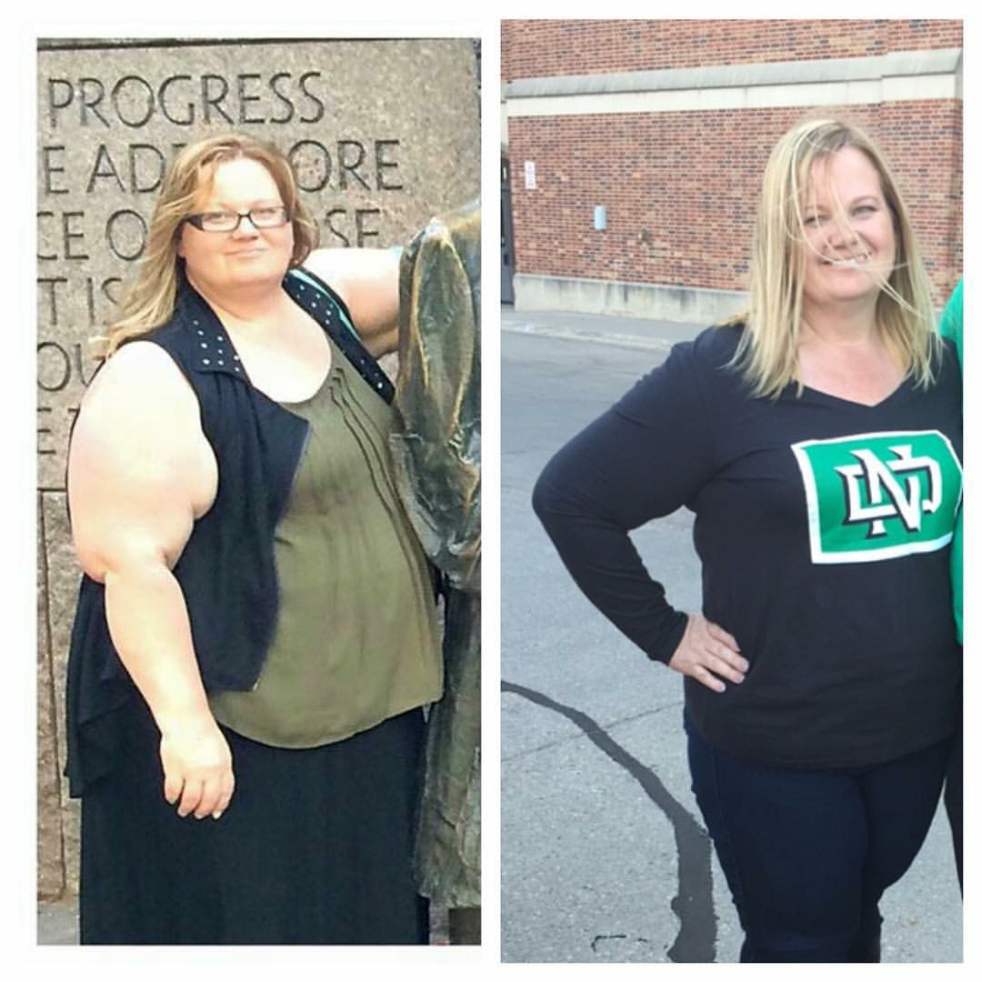

Slide 6
My Journey
My journey begins when I was born in a ND blizzard……
5 years old and my Mom leaves for the hospital …..she miscarried
12 years old I’m bullied non stop in school…..convenience store for lunch
14 I start making decisions to empower me…..
22 I marry and start a family
30 I’m close to 100 pounds overweight
45 I’m close to 200 pounds overweight
47 TLS comes into my life
48 I take on my life
49 – right around the corner

Slide 7
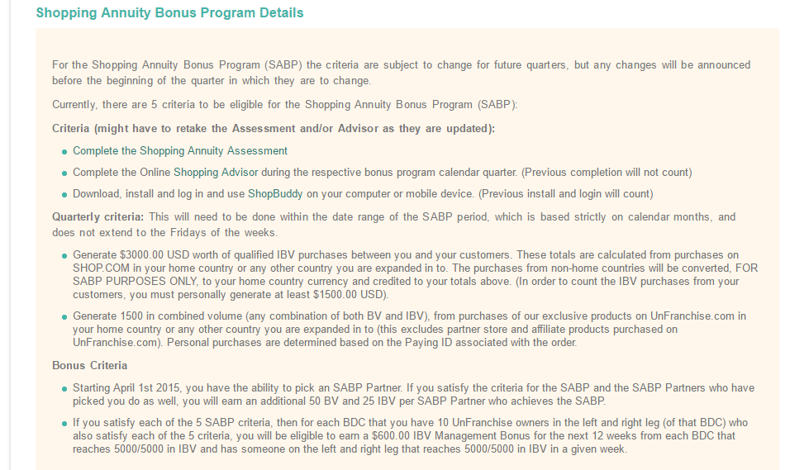
What is SABP?
Why GO For IT?
FREE Shipping
20% Back in Bonus IBV and BV
Grows Your Business

Slide 8
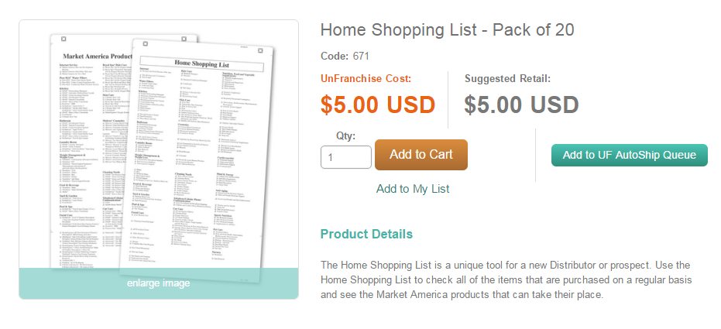
Convert spending into earning
Complete the Home Shopping List
Put a sticky note on all items in your household you will order from yourself when you need to restock!

Slide 9
BV PRODUCTS 1ST
Completing the Home Shopping List will show you which Market America Products you should buy instead of some other product
These are your anyways dollars – you and your customers can complete this
Take the Nutri-Physical Questionnaire on Shop.com & have your customers – offer 10% off to them if they go on and take the questionnaire
What can you buy for you? New makeup, super crème, skin care products
What about the home? Snap Cleaners, Plant Care, SOS Cleaner
Gifts? Marley Coffee, Lip Balm, Aloe Gel, Hair Care
Everyone or Samples you can write off? Daily Essential Packets, Aloe Packets, Digestive Enzyme Packets

Slide 10
Creating BV
Host a Wellness 101 and order the Daily Essential Kits ahead of time – people like instant gratification
Host a Motives & Martinis and order the top 10 products ahead of time – if they can touch it, they will usually buy it
Reach out to customers and offer a discount on products ordered through you – if they order on your site, the BV will not count toward your shopping annuity
Ask 10 Fluffy Friends to buy the TLS Journal and TLS Detox Kit – you will loose inches together – ask a senior business partner to help you (again – they need to buy from you and not on your site)
Remember – you can do this…..nobody knows if you mess up! The most important thing is to JUST DO IT –

Slide 11
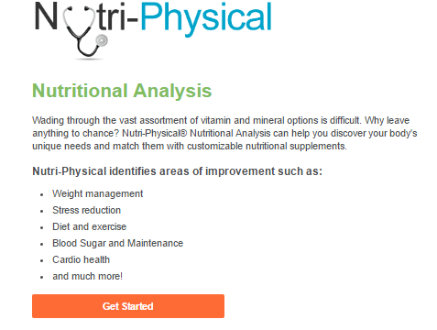
Nutri-physical

Slide 12
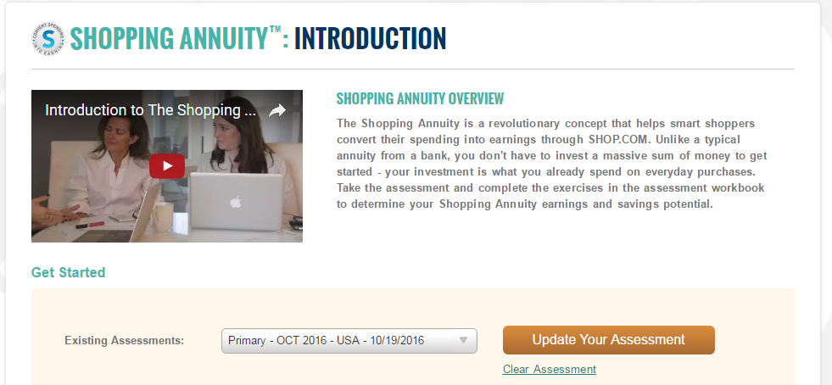
Shopping Annuity assessment
Unfranchise, My Account, Shopping Annuity, Shopping Annuity Assessment
Do this together with others in your household!!!

Slide 13
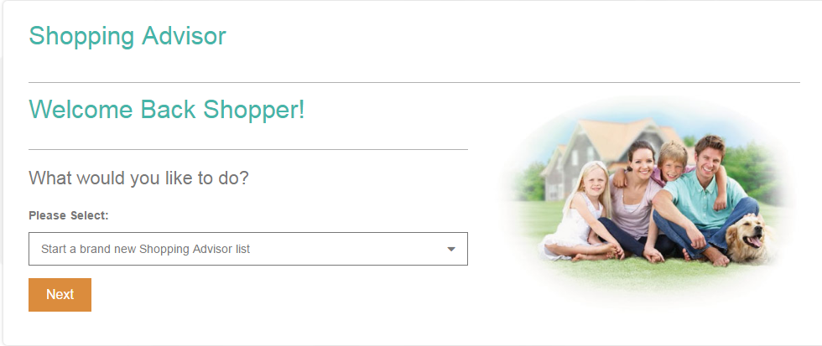
Shopping Annuity Advisor
Unfranchise, My Account, Shopping Annuity, Shopping Advisor

Slide 14
Shop.com platinum mastercard
Black – BV (1 BV per $100)
No bad choice! Choose either.

Slide 15
Store Conditions – look at them

Slide 16
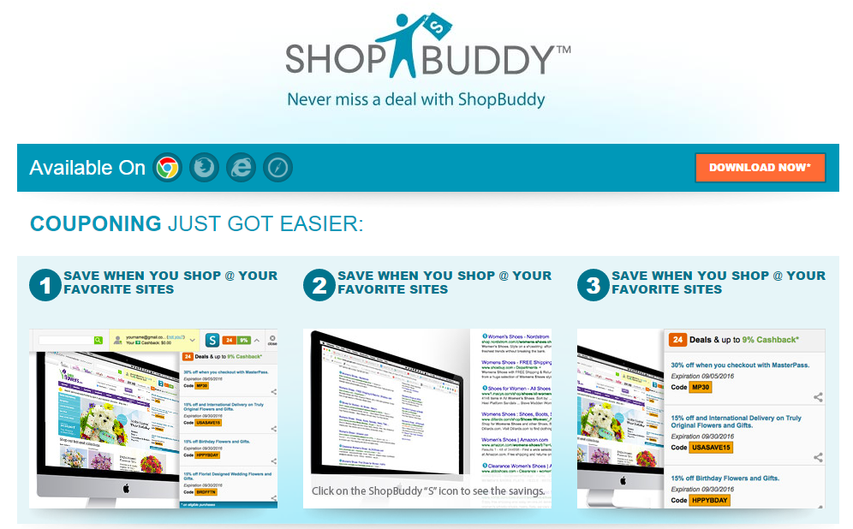
Shop Buddy
Go to Shop.com & Click on
Shop Buddy

Slide 17
Making shop Buddy Work for you

Slide 18
Shopping essentials
Shop Direct 2nd

Slide 19
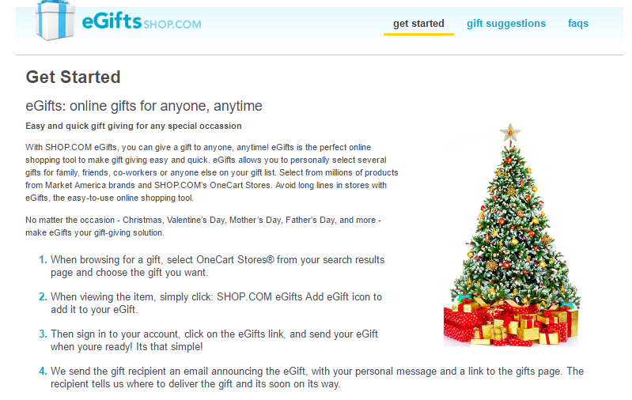
Simple things you can do……..
Using eGifts is a great option for long distance gift giving or last minute gifts.
Use the gift suggestions tab to find the best gifts for the difficult to buy for person.
One Cart Stores

Slide 20
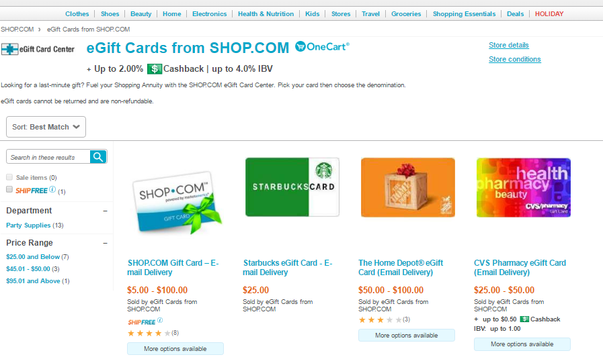
Simple things you can do……..
Buy Shop.com cards for gift baskets or customer appreciation.
Who doesn’t love StarBucks – great gift for teachers and More!
Many MORE to Choose from!!!

Slide 21
Simple things you can do……..
Start with your own home – switch to Marley Coffee!
Buy 8 or more for gifts this season!

Slide 22
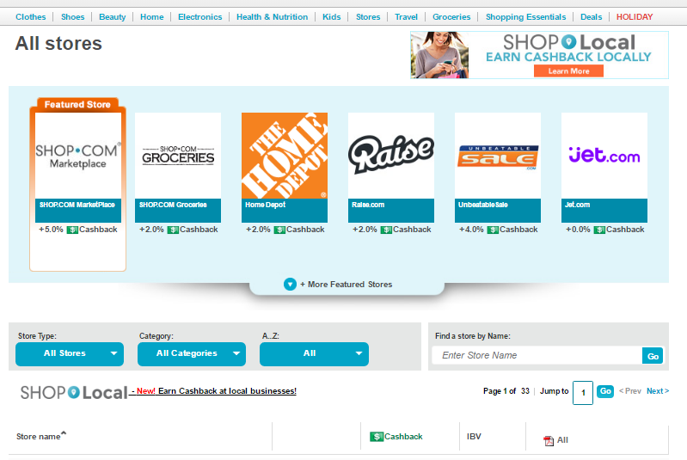
Find your favorite stores
Watch Store Conditions
Sort by CashBack or IBV
BV, Shop Direct, and then Partner Stores

Slide 23
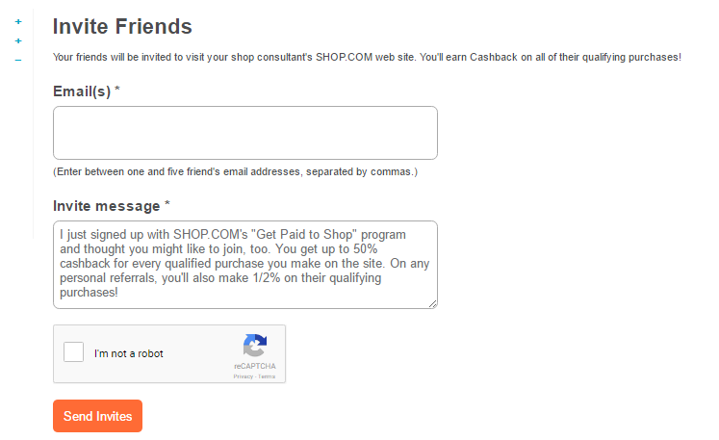
Invite your friends
Invite only a few at a time and call/text them ahead of time indicating you are going to invite them to your new shop site.

Slide 24
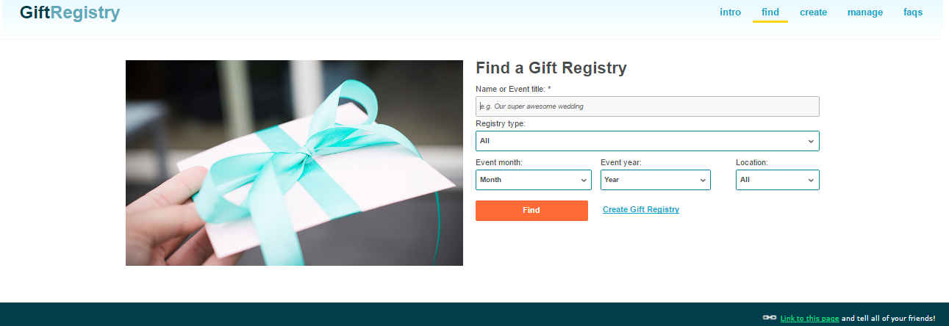
Brides & babies
Did you know we have a Gift Registry?

Slide 25
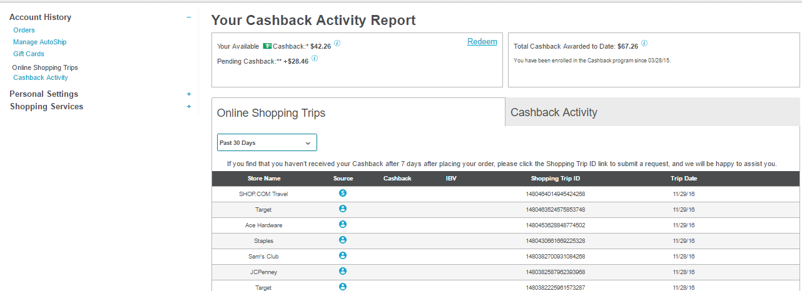
Tracking purchases

Slide 26
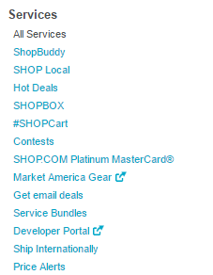
Simple things you can do……..

Slide 27
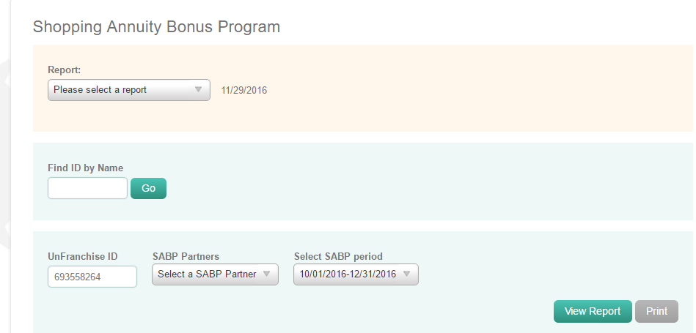
Follow your shopping annuity reports
My Organization
Reports
Management
Shopping Annuity Bonus Program

Slide 28
You don’t loose it – when you meet the sabp – any excess carries over to the next quarter

Slide 29
Stacking
Purchase $200 Visa Gift Card or AMEX Gift Card
Use $200 Gift Card to purchase a $200 Kohl’s Gift Card off of Raise.com Gift Card
Use $200 Kohl’s Gift Card to shop on Partner Store Kohl’s Web Site
$200 – Initial Purchase
$200 – Kohl’s Gift Card
$200 – Kohl’s Online Purchase
Total Shopping Annuity Bonus Pool - $600

Slide 30
Buying bv with gift cards
Purchase $200 Visa Gift Card
Use $200 Gift Card to purchase BV Products on Unfranchise
Purchase $200 AMEX Gift Card
Add as a payment method to your paypal account
Purchase $200 in BV purchases on your Unfranchise using paypal – select the AMEX card

Slide 31
Buying groceries with gift cards
Purchase $200 Visa Gift Card
Use $200 Gift Card to purchase a Walmart Gift Card from Raise.com
Purchase items in Walmart such as groceries or last minute items
Purchase items online at Walmart.com and have shipped to your door
Purchase Shop Direct Gift Card for Starbucks
Use at Starbucks.com and purchase cups/mugs for gifts
Or add to your Starbucks App on your phone and use when paying in store

Slide 32
Bills – fuel – or partners
Purchase $200 Visa Gift Card or AMEX Gift Card
Use $200 gift card to pay bills online
Purchase $200 Visa Gift Card or AMEX Gift Card and have a physical card delivered to your house
Use to purchase fuel or give as gifts – there is still time
Purchase $200 Visa Gift Card or AMEX Gift Card
Use to pay a business partner for tickets or hotel rooms
They may need to run through their square account – you will need to pay the fees associated with doing this

Slide 33
QUESTIONS

