Slide 1
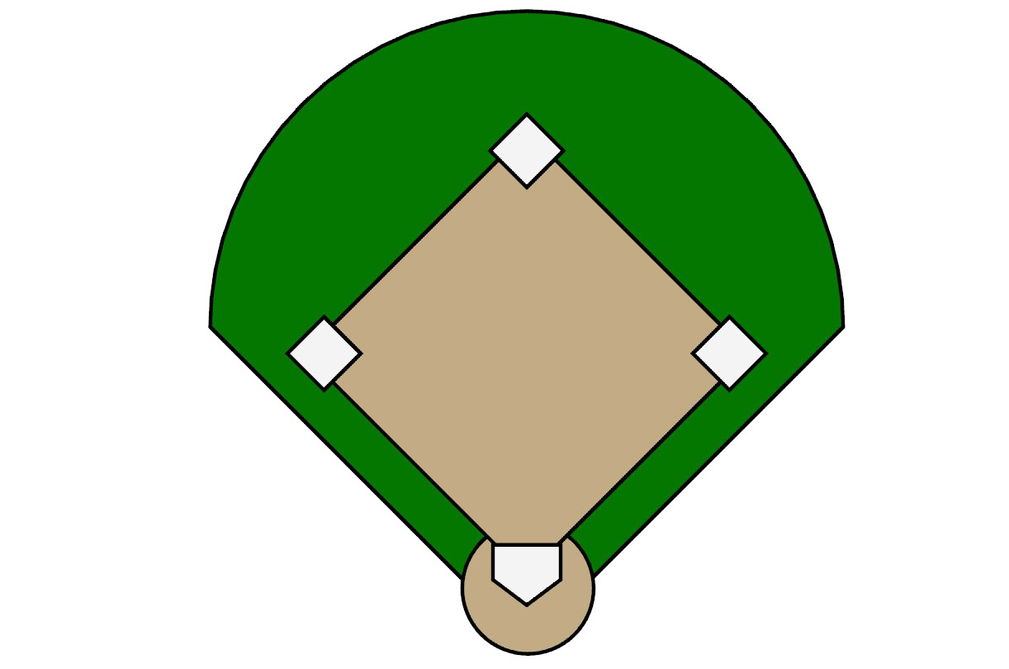
Scheduling and Bringing to an Event
Follow-Up and SHOW the PLAN
Plan their event(s) and attend a UBP/HBP if possible
Based on their goals – Show a game plan on how to achieve using GSG*/ Base 10, 7 Strong
Help them create a list of 30 names for product and 10 names for business – Plan 3-way calls
Register their Business using GSG*
Schedule FollowUp to Complete Getting Started Guide
Educate by Doing Demonstrating Duplicate the Process
Build Relationship Identify Their Need
From 2nd Base to Home should take no longer than 4 weeks
2nd Base
3rd Base
1st Base
Tell your story (your Why)
Find out their goals –(Why)
Use the Lifestyle Survey
Show Overview (Show Plan if 2 on 1)
Always:
Book a Follow-Up 3-way call with a business partner within 48 hrs
Schedule a follow-up meeting
Leave some samples to try
Support sites:
www.unlimitedlifestyles.com
www.marketamerica.com
www.wellness101video.com
www.beautypaysyou.com
www.helpnpo.com
Establish customer base & prospects at events or 2 on 1’s
Health Survey
Lifestyle Survey
Home Presentations of;
Wellness 101
Beauty Basics
It’s All About Skin
HBP
Home
Duplication Begins
Repeat Steps and Use Resources
www.gonowresource.com
www.unlimitedlifestyles.com
Stay with them repeating over and over for 90 days to create Base 10, 7 Strong
*GSG = GETTING STARTED GUIDE

