Slide 1
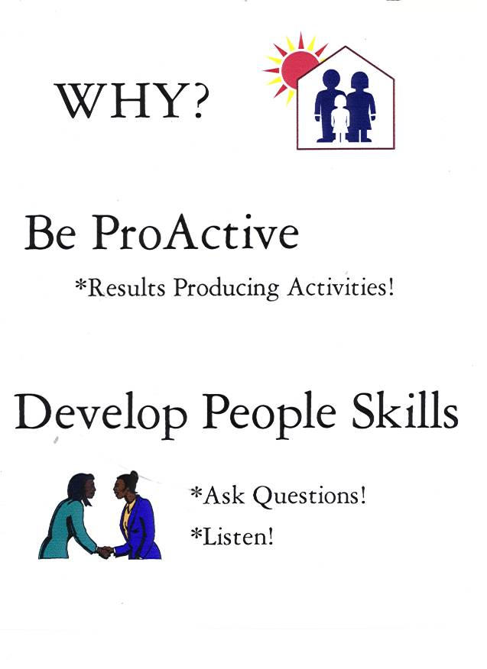
3 SUCCESS PRINCIPLES
For LIFE
DO YOU HAVE A
HUGE WHY?
2. ARE YOU PRO-ACTIVE IN YOUR RESULTS PRODUCING ACTIVITIES? (B5)
3. ARE YOU DEVELOPING PEOPLE &
BUSINESSS SKILLS?

Slide 2
Things You Can Control!
Your MIND (Attitudes) PMA PME
Your TIME! (What You Do Every Day)
How many people you talk to everyday!
Notes:
IF YOU WANT CHANGE…
YOU MUST BE DISCILINED TO DEVELOP THE RIGHT HABITS
THERE ARE ONLY 3 THINGS THAT YOU HAVE TOTAL CONTROL OVER! YOU MUST DECIDE TODAY…
YOU CAN CONTROL YOUR ATTITUDE. IT IS A DECISION! GOOD MORNING LORD OR GOOD LORD IT’S MORNING!
HOW MANY PEOPLE YOU TALK TO. ….YOU CAN NOT CONTROL WHAT THEY SAY…PRACTICE IT WILL GET BETTER…MORE YES’S
WHAT YOU DO….EVERYDAY….PRIORITIES…
LET’S LOOK AT YOUR TIME!!!

Slide 3
urgent vs. important
BE PROACTIVE
      RESULTS PRODUCING ACTIVITIES
80%
168 hours
- 50 hours Work
20%
- 50 hours Sleep
- 24 hours Rest
44 hours/6= 7 hrs
“Where does your time go?”
Notes:
Urgent vs important effective is doing the right things efficient doing the right thing right Is this going to get me to my goal every call you get everything that comes up if not, don’t do it. Everything I do takes me toward my goal or farther away.

Slide 4
12 Hours Per Week
Activity | Basic 5 Step | Up to Executive Coordinator | Executive Coord. & above
Sell Business | 4. Prospecting, Recruiting and Sponsoring | 6 Hours (50%) | 8 Hours (67%)
 | 5. Follow Up and ABC Pattern of Building Depth
Sell Products | 3. Retail | 4 Hours (33%) | 2 Hours (17%)
Sell Tickets to Events | 1. Attitude and Knowledge | 1 Hour (8%) | 1 Hour (8%)
Clarify and Read Goals | 2. Goals | 1 Hour (8%) | 1 Hour (8%)

Slide 5
Allocating Your Time with
Each Type of Distributor
WAITING - Communicate with them monthly about meetings and new product releases. Love them!
STABLE - Sell them tickets to the next event.
GO NOW - Mentor them, attend events with them and help them get what they want!

Slide 6

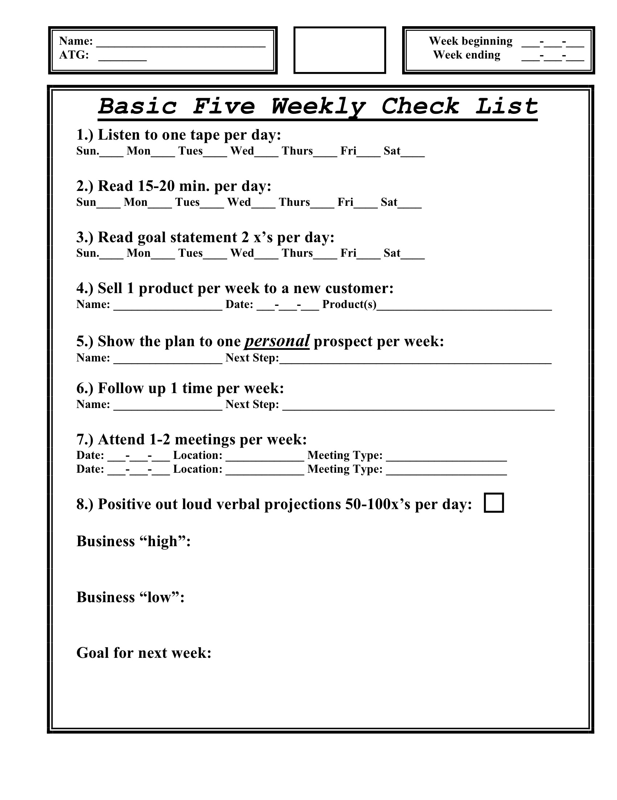
BE ACCOUNTABLE
1. FIND A MENTOR
Sponsor or Sr. Business Partner
2.* WEEKLY CONF. CALL
WEBINAR / CORING
3. GETTING STARTED GUIDE
4. B-5 DAILY CHECKLIST
LOCAL CHALLENGE
CELEBRATE SUCCESS!
HAVE FUN!!!
BE CAPABLE

