Slide 1
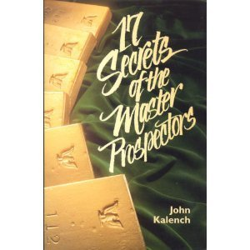
17 Secrets of the Master Prospectors
John Kalench

Slide 2
Do you really want to be a Master Prospector?
Prospecting is the lifeblood of your business.
And, as you know, it’s impossible to survive – much less, propser – in Network Marketing without good, healthy blood.

Slide 3
Network Marketers the world over invariably fall into one of three categories
Group One
Those who like to prospect
Act of prospecting flows naturally and effortlessly
Group Two
Those who are uncomfortable with it but do it anyway
They do it no matter how uncomfortable
Soon graduate to group one
Group Three
Those who don’t like prospecting at all
Prospecting is unpleasant, even frightening so they choose not to do much of it
Success continues to elude them

Slide 4
Secret #1
Master Prospectors
don’t sit on their assets
Master Prospectors are never content with the status quo of what they know and do.
They are constantly stretching themselves, seeking new challenges and new learning opportunities.
The point of acquiring knowledge is to enable you to make more educated choices

Slide 5
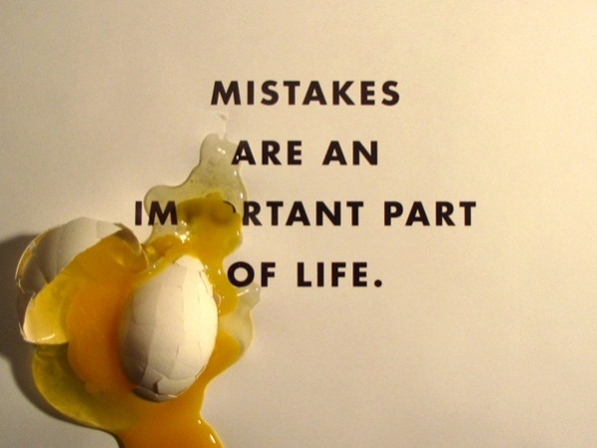
Secret #1
Master Prospectors
don’t sit on their assets
We make more educated choices by having more experiences
You’re going to make mistakes, make big ones, you learn quicker from big mistakes
It’s about taking BIG action!

Slide 6
Secret #1
Master Prospectors
don’t sit on their assets
The key to Secret #1 is taking action and putting yourself into motion and then having the wisdom to correct and adjust your actions to stay on course.
It’s during this process that you’ll discover the special prospecting techniques that work best for you
When you find one, remember to keep asking yourself, “What can I do to make this work bigger and bolder? What action can I now take to accelerate this entire experience?”

Slide 7
Secret #2
Master Prospectors
are consistently consistent
Master Prospectors have mastered one thing in both their attitude and their approach to the business: consistency. They are consistently consistent!
They don’t allow themselves to get caught up in the roller-coaster ride of other people’s emotions.
In the “science of attitude.” there’s a universal law stating that enthusiasm equals personal belief.

Slide 8
Secret #2
Master Prospectors
are consistently consistent
What personal beliefs are important in network marketing?
a belief in yourself
a belief in others
a belief in your company and products
a belief in your industry
Master Prospectors are constantly studying, learning and experiencing more, about themselves, others, their company and products, and their industry.

Slide 9
Secret #2
Master Prospectors
are consistently consistent
Create your own mastermind group. Surround yourself with leaders, a group of committed individuals who think and act with strong beliefs.
Connect with the mission of your company and make sure it aligns with your own values and beliefs.
When it comes to belief in your products, be your best customer. You will be able to speak from the heart.
Learn to love the industry as much as you love your company and products. The industry is providing you the opportunity.

Slide 10
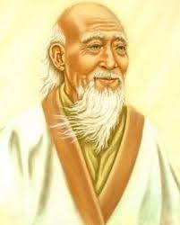
Secret #3
Master Prospectors
know what their job is, and what it is not
There is an old Chinese philosophy that says:
When you have been given a gift of great value, You are now obligated to return the favor many times over.
The reason the Chinese honor this philosophy is because they believe in the Law of the Universe:
What goes around, comes back around.
As the Law of the Universe states, the more good we share, the more good comes back.

Slide 11
Secret #3
Master Prospectors
know what their job is, and what it is not
The job of the Master Prospector is:
Share their gift – to return the favor that has been given them – with as many people as possible
The job of the Master Prospector is:
Not to judge who’s ready to receive this gift. That’s the prospects job. Master Prospectors just focus on doing their job – the sharing.

Slide 12
Secret #3
Master Prospectors
know what their job is, and what it is not
Master Prospectors share their gift. They don’t try to force it on people. They don’t try to convince people how valuable it is.
Why? Because that’s their job.
The job of the prospect is to say “Yes” or “No”.
Either answer your prospect gives is the right answer. Why? Because in their mind it’s right. And it will continue to be the right answer until they decide to change jobs!

Slide 13
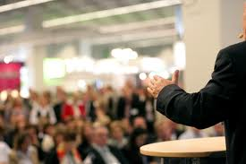
Secret #4
Master Prospectors
know what to marry
Successful speakers and trainers all witness a phenomenon in their audiences regardless of size that the audience divides into three groups:
The first group enjoys the event and get value from the message
The second group are processing what they heard and not sure what to think yet
The third group rejected what was said. They will leave and say things like, “Oh, I’ve heard all that stuff before. It doesn’t work. He’s just getting rich selling everyone his books and tapes.”

Slide 14
Secret #4
Master Prospectors
know what to marry
One speaker put it this way regarding the third group:
To think that a negative person would do anything else other than think and react negatively is pretty foolish, that’s exactly what they’re suppose to do. It’s kind of like their job.
These people will stay in that job – in attitude of being negative, until they are good and ready to change. And there’s nothing you or I or anybody else can do about it until then.

Slide 15
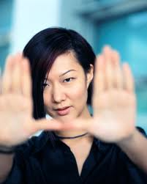
Secret #4
Master Prospectors
know what to marry
Does it make sense to focus on the things that you can control, release the things that you can’t, and be wise enough to tell the difference?
Of course it does. That’s the essence of Secret #4: Master Prospectors know what to marry.
You must not take a negative person’s words and actions personally – as difficult as that sometimes is.
Why? Because it’s not about you. You’re simply the messenger. It’s the message that they’re not ready for.

Slide 16
Secret #4
Master Prospectors
know what to marry
Two things you can control are: the quality and the frequency of your message. Marry yourself to the quality of your message.
Take every opportunity to improve the quality of your message
Use audio or videotape to review yourself sharing your message
Count the number of questions you ask and look for ways to ask more to get your prospect more involved.
Listen for “danger words” that you use like “sign-up”, “buy”, “cost”, “sell”, and so on.
Replace them with empowering words like “join, “invest”, “retail”, and the like.
Marry yourself to the frequency of your message as well. Commit to sharing your gift with someone every day!

Slide 17
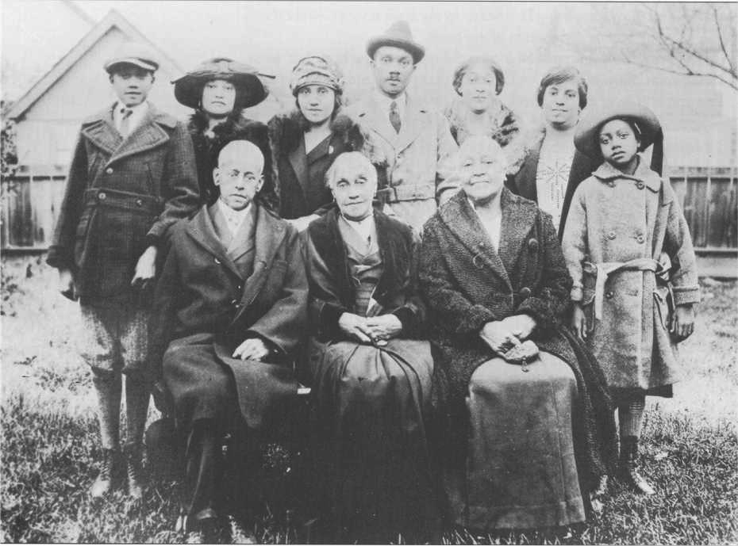
Secret #5
Master Prospectors
have a magical genie
It’s surprising how many new distributors believe that they are going to build a highly successful network based on the circle of influence (the people) that they already know: their family, friends and associates.
Unfortunately, for most of them, that’s not going to be the case

Slide 18
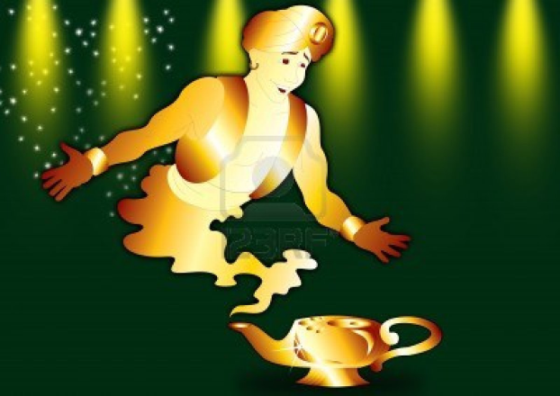
Secret #5
Master Prospectors
have a magical genie
If you found Aladdin’s magic lamp and the genie appeared to grant one wish. So you say, “Genie, my wish is for you to zap me three years into the future, I want you to show me the enormous network I will have built.
You see thousands of successful business builders. Hundreds of your top leaders and people building networks of their own.
You notice something very interesting:
There’s not one face there that you recognize!

Slide 19
Secret #5
Master Prospectors
have a magical genie
The magic of network marketing is the best business builders in your network three to five years from now are people you haven’t met yet! You have little or now idea who they are or where they’re going to come from.
A Master Prospector has the power of creating instant rapport and making positive first impressions with everyone they meet.

Slide 20
Secret #5
Master Prospectors
have a magical genie
Master Prospectors know that it’s hard to tell who’s going turn out to be a future leader or business builder.
Conversely, some of the most unlikely folks you’d ever meet have risen to the top of the Network Marketing ladder.
In Network Marketing, anybody – and really anybody – can reach the uppermost positions of success and accomplishment – financially, organizationally, personally, professionally – you name it!

Slide 21
Secret #5
Master Prospectors
have a magical genie
Rapport is a relationship between two or more people where each person present is open, comfortable, relaxed and at ease.
When you encounter someone with an unfriendly attitude, move on.
You can increase the open and friendly rapport with people using matching and mirroring techniques
Match posture
Match breathing
Eye movements
Speaking styles

Slide 22
Secret #5
Master Prospectors
have a magical genie
Master Prospectors are Master Communicators.
Master Prospectors can have strangers tell them their hearts desire in just a matter of minutes.
Master Prospectors are master communicators because they are experts at matching and mirroring others. It’s a key reason why they get so many more “yeses” than “nos”!

Slide 23
Secret #6
Master Prospectors
love to build bridges
Here’s a powerful truth that the Masters live by: A “stranger” is simply a friend you haven’t met yet.
Every Master Prospector has a creed
People don’t care how much you know
until they know how much you care.

Slide 24
Secret #6
Master Prospectors
love to build bridges
Too often, people new to our business are so anxious to get people into their network that the first thing they do when introduced to some is to blurt out, “Hi, my name is Anxious Archie. Wanna become a distributor?”
WRONG!
Make a friend first! The time you invest will work wonders.
When you’ve mastered the art of making friends, you never need to search for prospects!

