Slide 1

THE UNFRANCHISE® BUSINESS
Copyright © 2019 Market America Worldwide

Slide 2


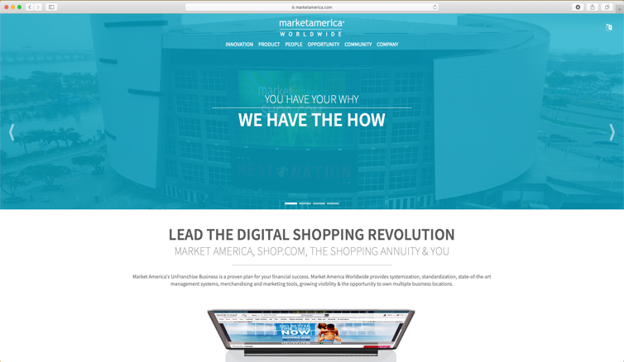
Market America | SHOP•COM
Market America | SHOP•COM provides a system for entrepreneurs to create an ongoing income and become financially independent while providing consumers worldwide with a better way to shop.
Through revolutionary technology
and the power of people – we are creating the economy of the future.
We’re powered by people just like you.
Notes:
DESIGN NOTE: Andrew Weissman will provide company mission statement to replace text. Keep the words “We’re powered by people just like you!”

Slide 3
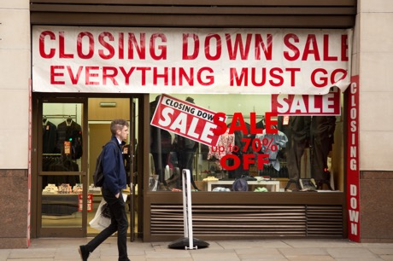



RAPIDLY CHANGING ECONOMY
Four major trends are taking place creating one of the greatest opportunities for those who have positioned themselves ahead of
these trends.
Market America | SHOP•COM is positioned to take advantage of all four trends with the UnFranchise® Business.
Retail Store Collapse
Rise in Online Sales
One-to-One Marketing
Replacing Mass Marketing
Rise in Entrepreneurship

Slide 4
THE UNFRANCHISE® business
Like a Franchise
Unlike a Franchise
Systemized, Standardized and Uniform
Proven Management Systems
Professional Marketing Tools
Standardized Training Systems
Market driven products and services
Branding and Increased Visibility
No Franchise Fees or Royalties
Minimal Startup Expenses
Potential Tax Advantages
No Large Monthly Overhead
No Territorial Restrictions
Part Time with Flexible Hours
Little Risk

Slide 5



THE COMPANY
Founded in 1992, Market America Worldwide is a Global Product Brokerage and Internet Marketing Company that specializes in One-to-One Marketing
Headquartered in Greensboro, NC and employs over 850 people globally.
Operations in:
United States
Canada
Australia
Taiwan
Hong Kong
United Kingdom
Singapore
Malaysia
2013 & 2018 TORCH AWARD
Trust • Performance • Integrity
A+ RATED
65
Notes:
DESIGN NOTE: Replace picture of the company building with an image that represents a global company.

Slide 6
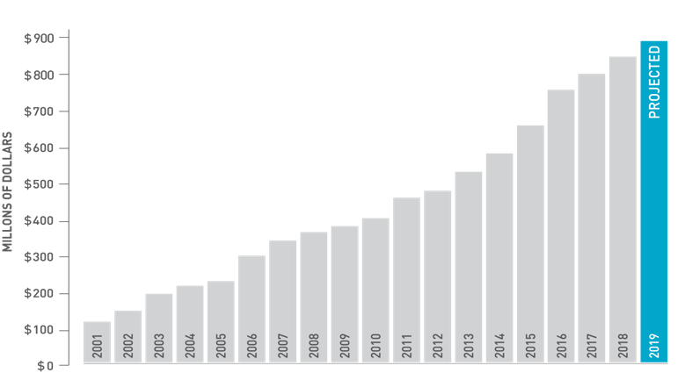
Worldwide Company sales and unfranchise® Owner earnings
Estimated Accumulated Retail Sales†:
$8,510,834,625
Thousands of UnFranchise Owners are earning
$300 to $3,600 per week
+
Total Commissions Earned:
$2,183,202,350
More than 500 UnFranchise Owners have earned in excess
of $1,000,000 in commissions
Total Estimated Retail Profits Earned*:
$2,225,106,442
Total UnFranchise® Owner Earnings**:
Adding New Million Dollar earners every month
= $4,408,308,792
**As of September 30, 2018 (since the company’s inception) *estimated retail profits based on suggested retail price
†estimated accumulated retail sales based on suggested retail price
Notes:
DESIGN NOTE: We want to eliminate the pictures of the millionaires and display the following facts in a creative way: Tens’s of 1,000’s people earning $300-$3600 weekly, Close to 500 have earned in excess of 1 million in commissions and Adding new million dollar earners each month.

Slide 7
The 45 year plan
95% of people spend up to 45 years of their lives making the other 5% successful.
They work a plan for someone else’s financial success – not their own.
5%

Slide 8

The 45 year plan
Do You Have Debt?
Student Loans, Credit Cards, Car Loans, Mortgage
Financial Security?
You would need to save $600,000 to earn an extra $1,000 a month (2% interest rate)
Is Social Security the Answer?
65% of people age 65 and over use Social Security as their primary source of income *$1,175 per month *www.socialsecurity.gov
Notes:
***Add footnotes to source where these figures came from as per current UBP slides

Slide 9

THE 2-3 year plan
A plan for your own financial success
Additional Income
Debt Reduction
Time Freedom
College Fund
Early Retirement
Financial Security
Potential Tax Advantages
Mortgage/Rent
Car Payment
Back Up Plan
Create a residual income

Slide 10
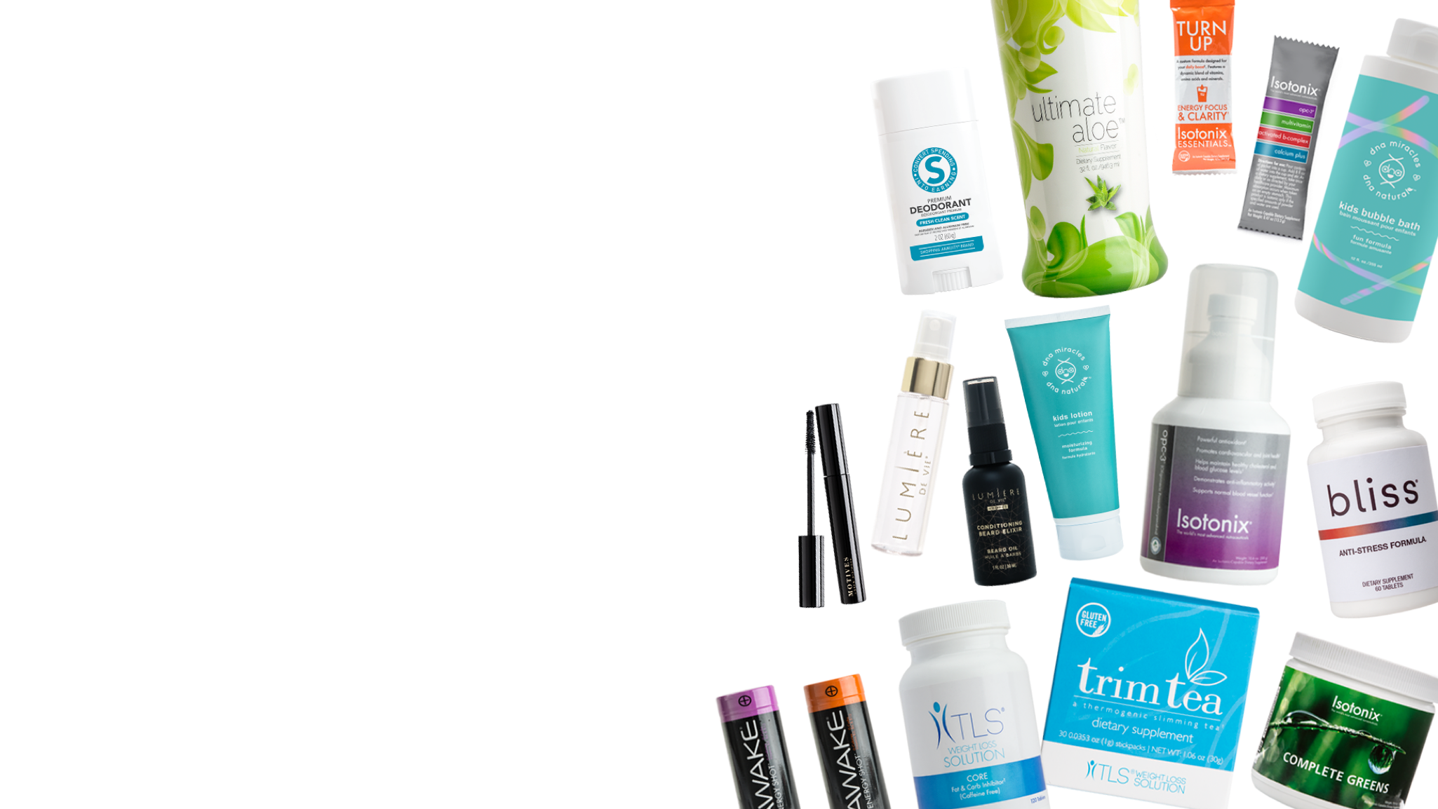
Product brokerage COMPANY
Hundreds of exclusive products and services
Does not rely on the sales of any one product or service
Access to multi-billion dollar markets
Identifies the latest market driven products
Eliminates the burden of manufacturing
Allows company flexibility to move with the market place

Slide 11










Product brokerage COMPANY
Health & Nutrition
Age Management
Baby & Children’s Care
Weight Management
Health Professionals
Cosmetics
Personal Care
Home & Garden
Automotive
$
Financial Services
Internet Services
Shopping Annuity Brand
COMING SOON

Slide 12

Internet marketing COMPANY
1,000s of partners stores with millions of products
Hundreds of exclusive products
No cost to register as a customer
Customers earn Cashback
Notes:
DESIGN NOTE: Andrew please finalize the text you want to be on this slide

Slide 13

The shopping annuity®
A revolutionary concept that helps people convert their spending into earning through the UnFranchise® Business and SHOP•COM.
All of your purchases from our partner stores and Market America exclusive products are tracked.
When you or anyone you lead to shops online, you get 100% credit for those purchases.
You are already spending it,
why not get paid for it.

Slide 14


WHICH DO YOU PREFER?
45 Year Plan
Continue Trading Time for Money
2-3 Year Plan
Invest 8–15 Hours Weekly • Earn $300–$3600 Weekly • Create a Residual Income
Would you like to see how the 2-3 Year Plan works?

Slide 15

5 steps to build an unfranchise® business
Step 1 Apply
Step 2 Create
Step 3 Qualify
Step 4 Activate
Step 5 Teach, Manage & Support Others

Slide 16
Step one: apply
Features | Sales Representative No Subscription Fee | UnFranchise® Owner Subscription Fee: $129.95
Earn retail profits with our exclusive brands
Global meeting, training and seminar system
SHOP•COM personal site
Additional websites to market your business
UnFranchise.com Management Reports
Participate in compensation plan and earn up to $3,600 in weekly commissions per business

Slide 17

Unfranchise® owner Subscription includes
Getting Started Guide
UnFranchise Manual
UFO Magazine
Training & Seminar System
Audio Training Series
UnFranchise.com Management Reports
SHOP•COM
GLOBAL•SHOP•COM
MarketAmerica.com
Additional Websites
Coaching and mentoring by experienced
UnFranchise® Owners
Notes:
DESIGN NOTE: Need a more creative visual way to showcase what the subscription includes. The current slide is too text heavy. We want to avoid the multiple website slide like in the current UBP (slide 48) and show these features in a visual, simple way.

Slide 18







Step TWO: create
BV: BUSINESS VOLUME
BV is the point value assigned to exclusive products to calculate commissions.
Health and Nutrition
Weight Management
Baby and Children’s Care
Age Management
Notes:
DESIGN NOTE: Slides 20-21-22: We would like this designed with 4 quadrants of products per slide like seen here. Instead of the current images can we use the brand name and category and display 2 to 3 or 4 products from each category so that we can have room to make the brand names and product images much larger? The idea is to showcase the brands and a visual of just a few products. Keep in mind the purpose od slides 20-22 is to explain what it means to create BV. To do that we do not need the slides to look like a product catalog. Just need a few products from each category.

Slide 19







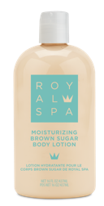





Step TWO: create
BV: BUSINESS VOLUME
BV is the point value assigned to exclusive products to calculate commissions.
Cosmetics
Personal Care
Skincare

Slide 20







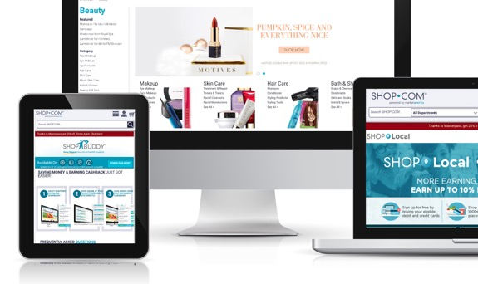


Step TWO: create
BV: BUSINESS VOLUME
BV is the point value assigned to exclusive products to calculate commissions.
Home and Garden
Entertainment
Internet Services
Financial Services

Slide 21




















Step TWO: create
IBV: INTERNET BUSINESS VOLUME
IBV is the point value assigned to any of our Partner Stores products or on Shop Local
Notes:
DESIGN NOTES: Andrew can you figure out the top 30 partner store companies to feature in this slide? We like how this slide animates – we just need 30 of the most popular and current logos (From Andre

Slide 22
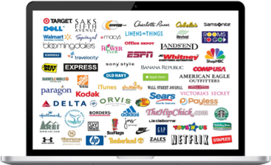
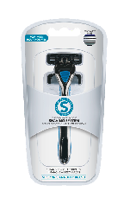










Ways to create BV and IBV
Personal Use and Shopping
Customer Sales and Shopping
One-to-One Marketing
1,000s of Partner Stores
ShopBuddy
Convert Your Spending
Trial Size Marketing
Online Orders & Reorders

Slide 23
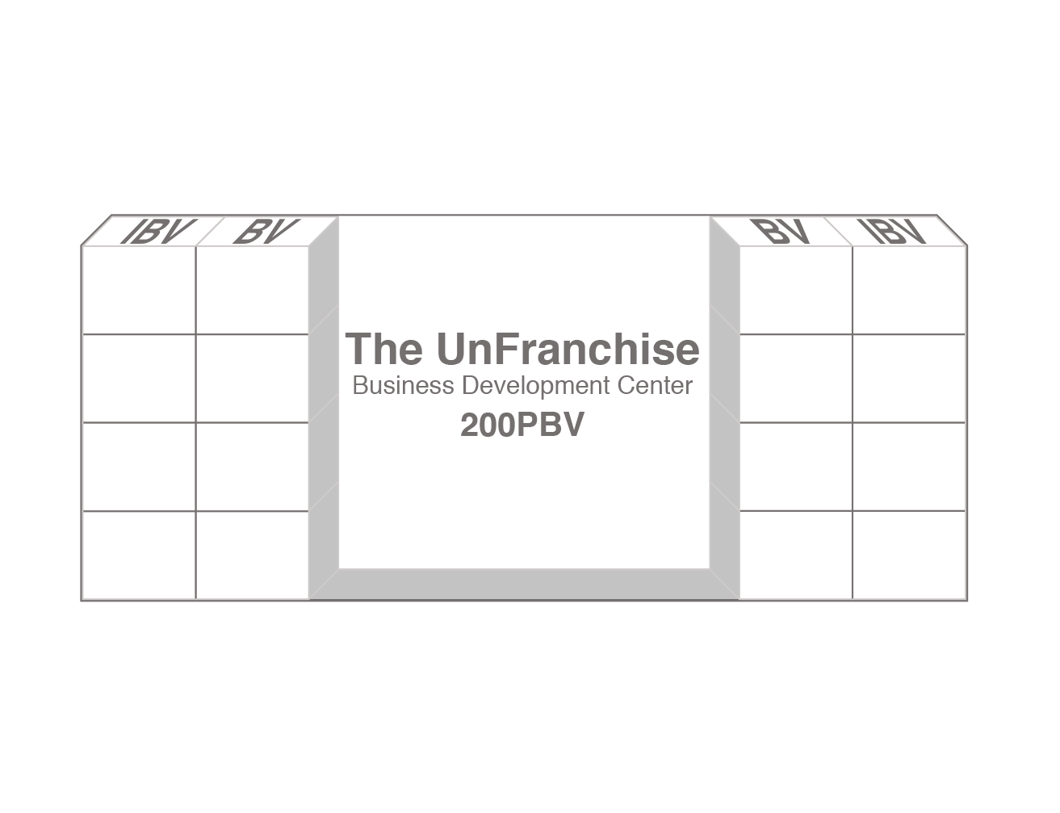
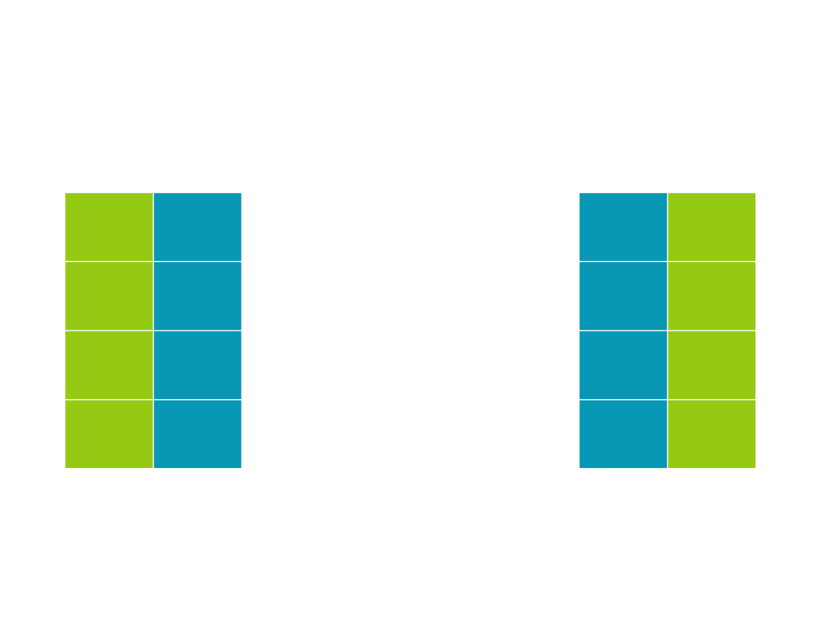
Step three: qualify
Qualify your Business Development Center (BDC) with 200 BV which opens both your left and right BV and IBV banks.
Once your Business Development Center has been qualified (200 BV) it will begin to accumulate BV and IBV.

Slide 24



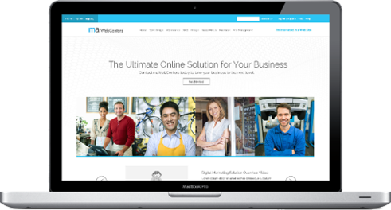
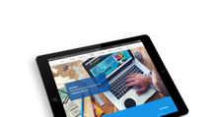
Step three: qualify
Fast Start Program: $399 + Tax with Free Shipping (Includes $129.95 Subscription Fee)

Slide 25

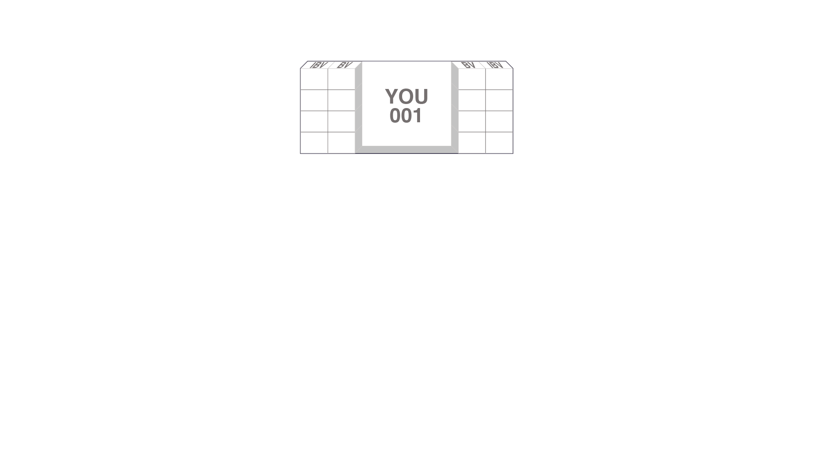

Step four: Activate
Personally partner (sponsor) and place one qualified UnFranchise® Owner in your left and right organizations to be eligible to earn commissions.

Slide 26


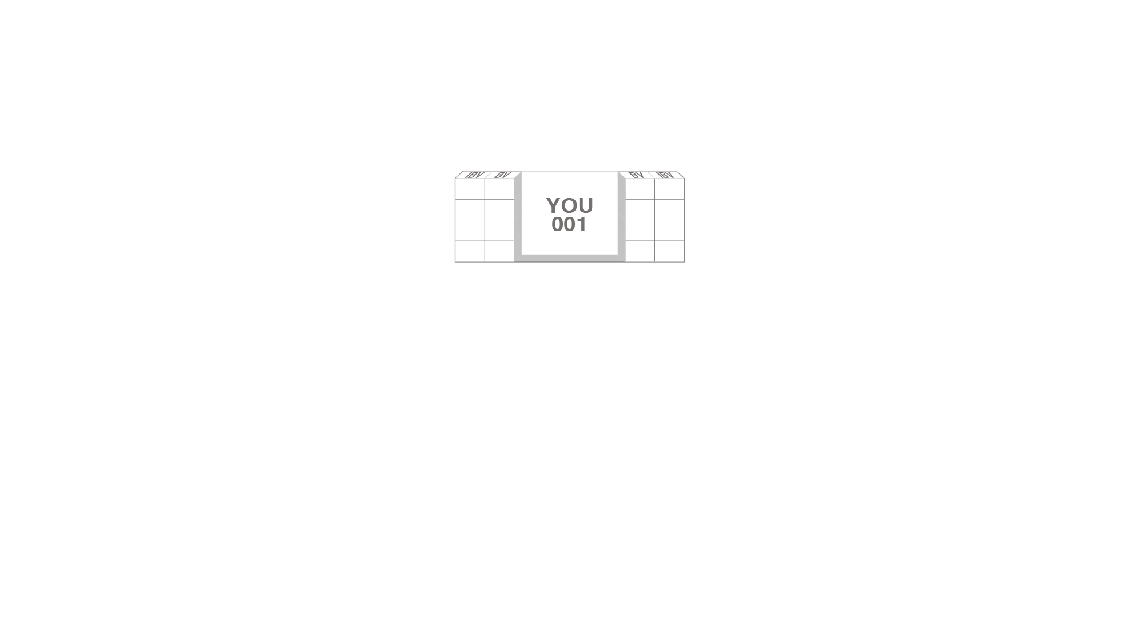
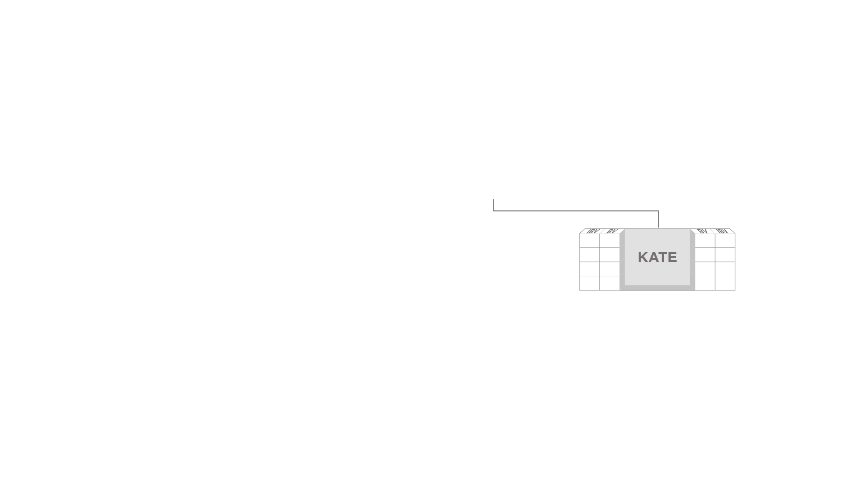
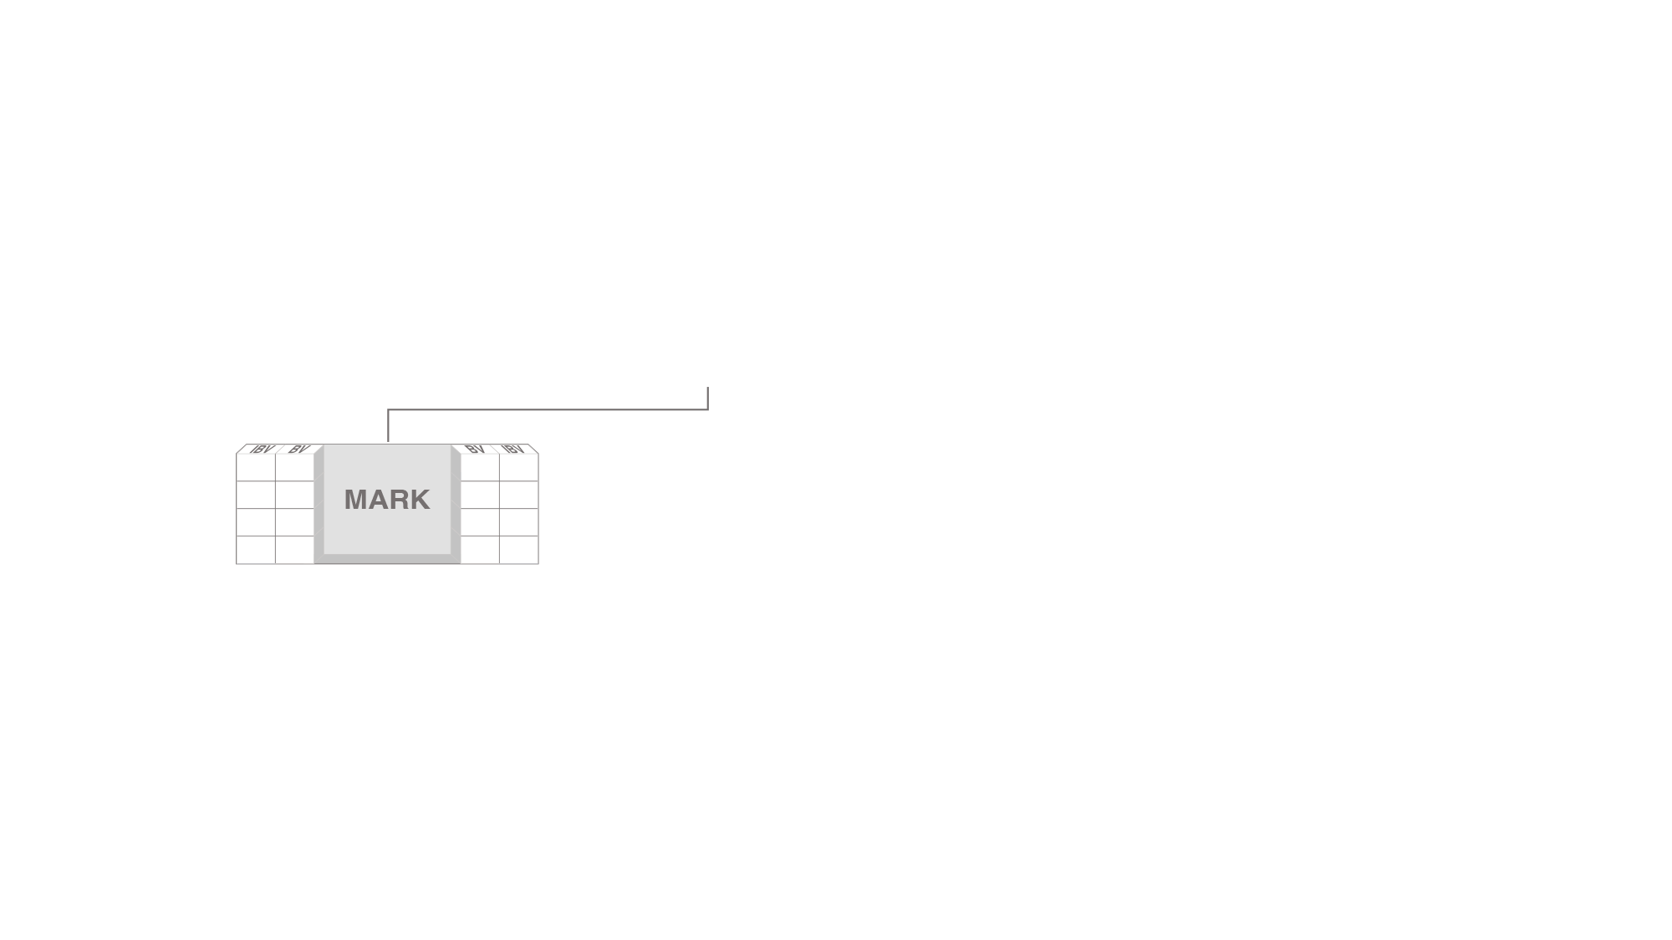


STEP 5 – TEACH, MANAGE AND SUPPORT OTHERS
1. APPLY
2. CREATE
3. QUALIFY
4. ACTIVATE
Gray indicates personally sponsored UnFranchise® Owner

Slide 27
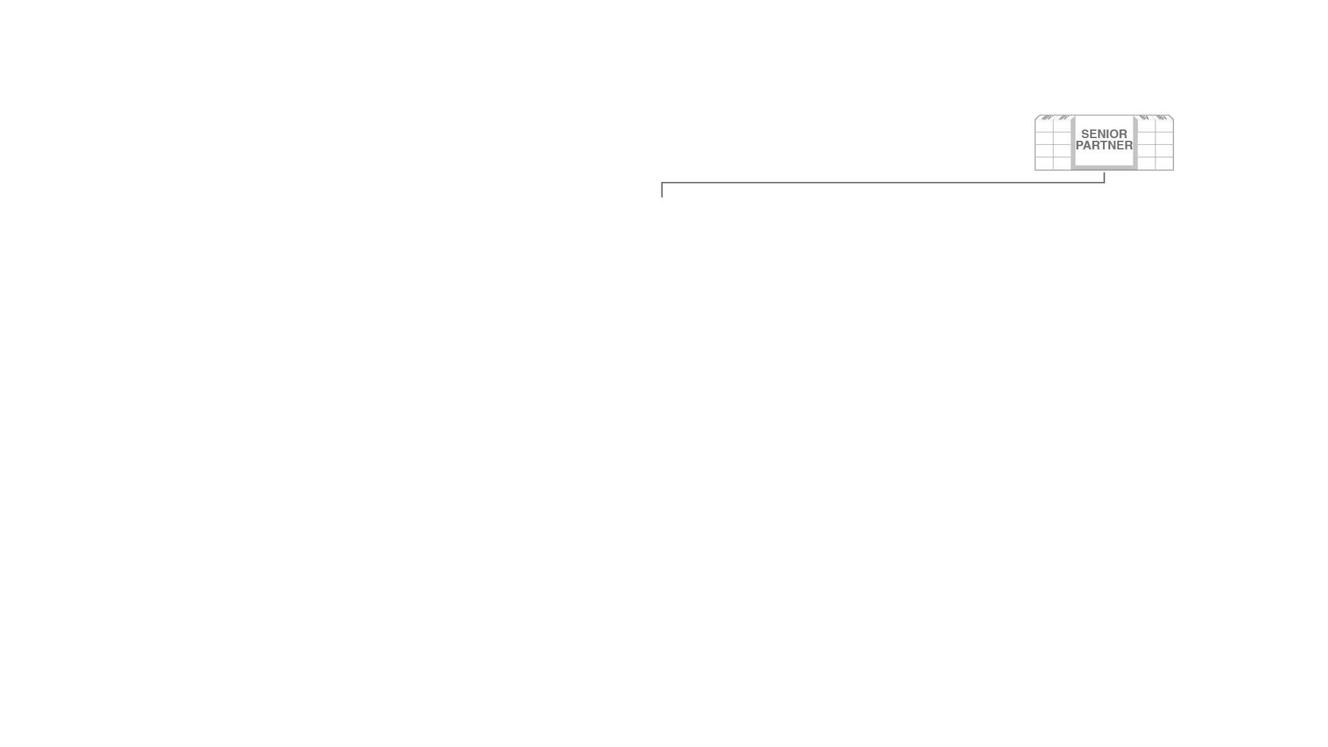
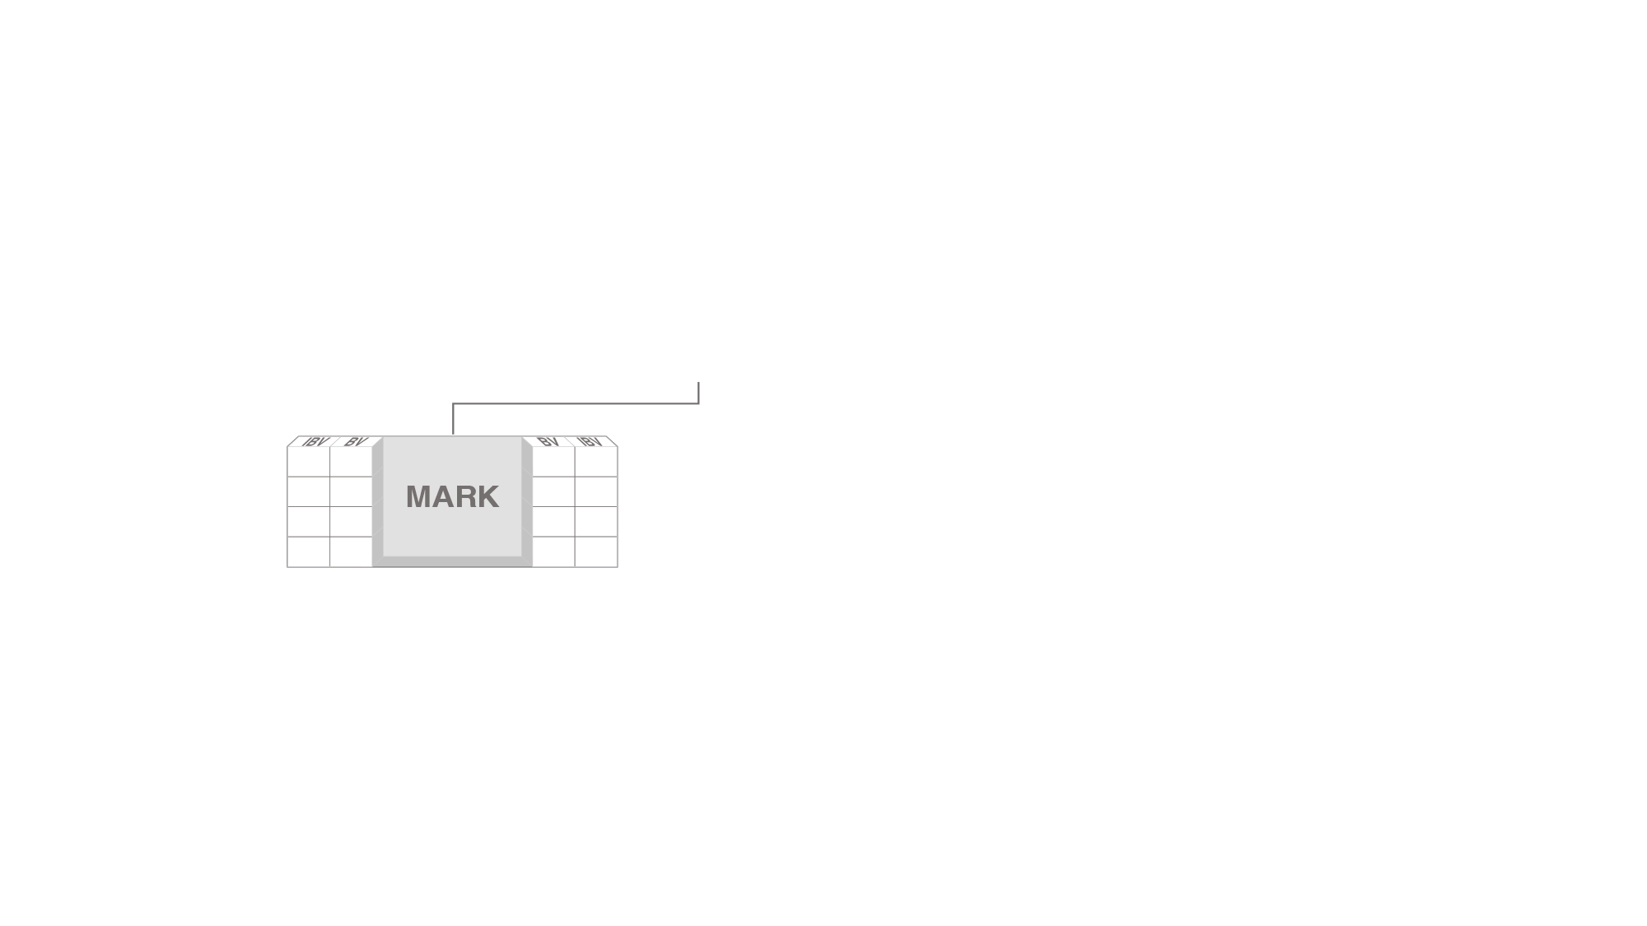
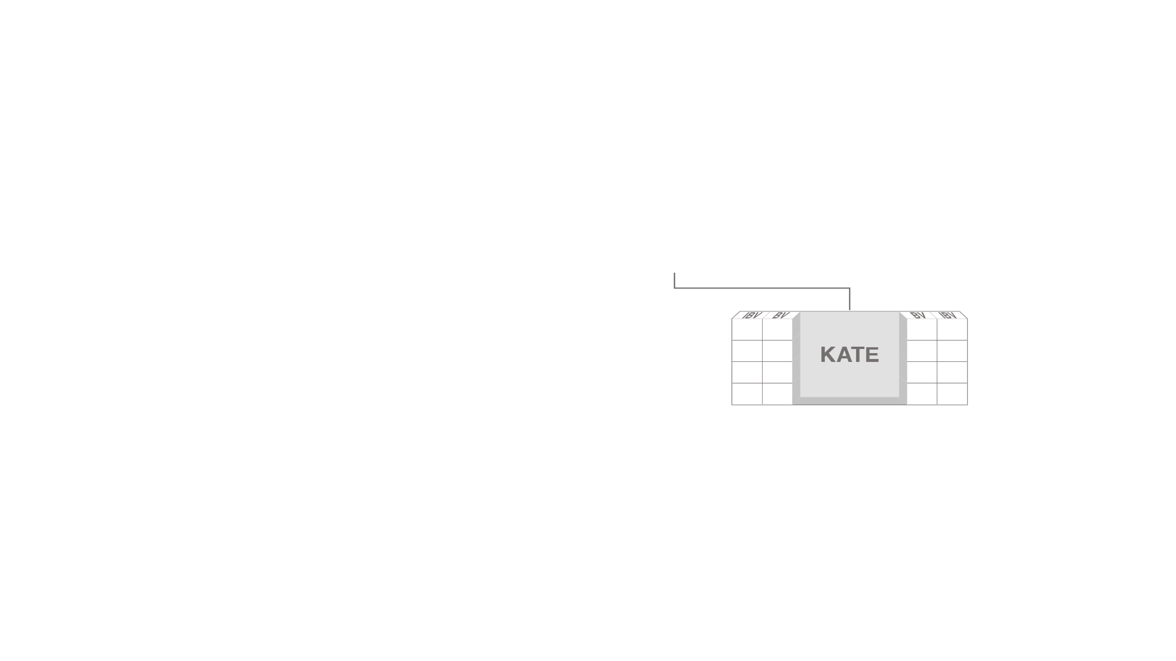
















People lead to people
Gray indicates personally sponsored UnFranchise® Owner

Slide 28
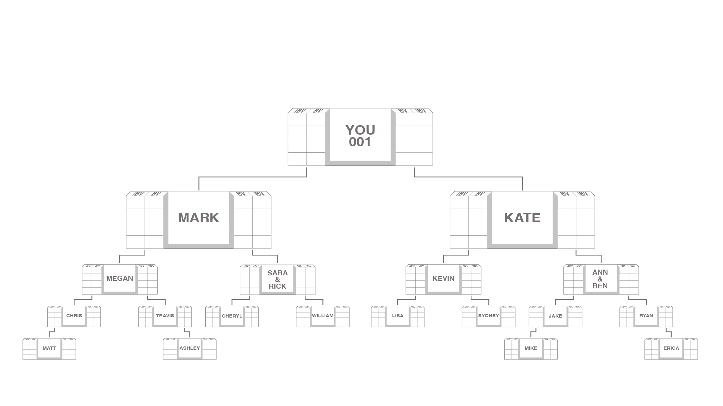







OUR TRACKING SYSTEM SEARCHES DAILY TO INFINITY
The system tracks purchases and sales made by you, your customers and your team.
You receive 100% credit for all volume generated within your organization.
Customer Order
Retail Profit: $30
Personal Use
BV: 63
BV: 40
IBV: 7

Slide 29
disclaimer
The income levels mentioned in the following presentation are for illustration purposes only. They are not intended to represent the income of a typical Market America UnFranchise® Owner, nor are they intended to represent that any given UnFranchise Owner will earn income in that amount.
The success of any Market America UnFranchise Owner will depend upon the amount of hard work, talent and dedication which he or she devotes to building his or her Market America business.

Slide 30
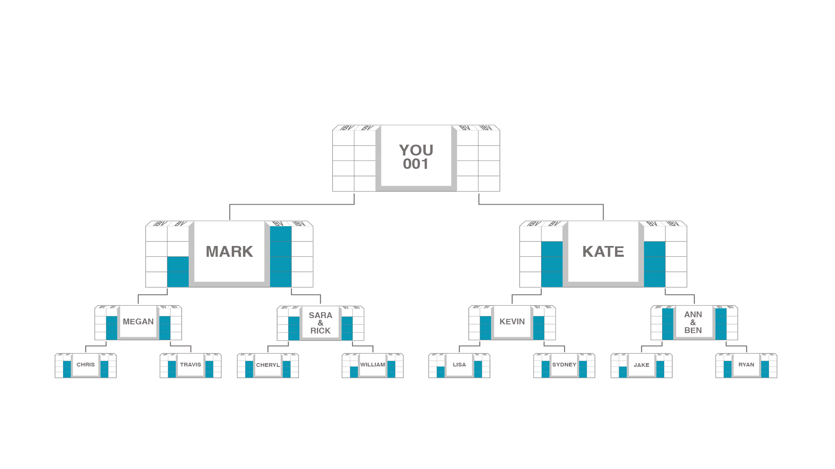








How commissions are earned
BV is tracked daily and commissions are calculated weekly.
5000/5000 = $600
5000
5000
3600/3600 = $300
3600
3600
2400/2400 = $300
2400
2400
1200/1200 = $300
1200
1200
BV: $1,500
Total weekly potential $1,500 per BDC

Slide 31
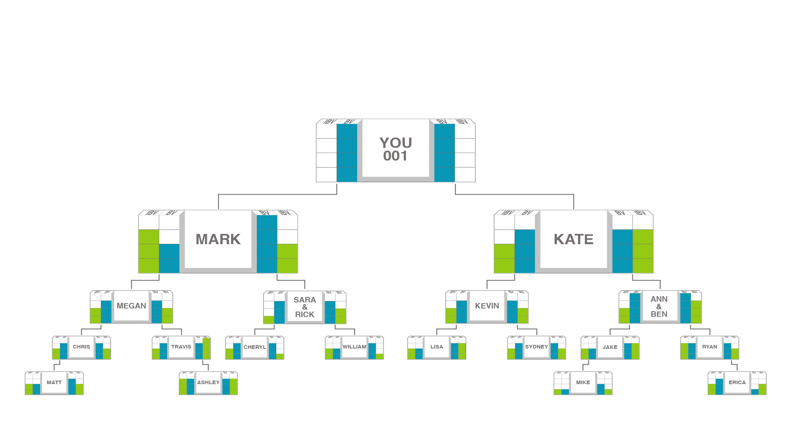








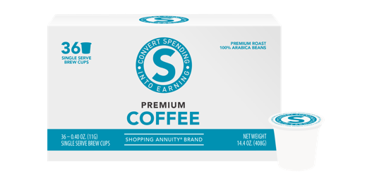

HOW COMMISSION ARE EARNED
IBV is tracked daily and commissions are calculated weekly.
5000/5000 = $600
5000
5000
5000/5000 = $600
3600/3600 = $300
3600
3600
3600/3600 = $300
2400/2400 = $300
2400
2400
2400/2400 = $300
1200/1200 = $300
1200
1200
1200/1200 = $300
BV: $1,500
IBV: $1,500
Total weekly potential $3,000 per BDC

Slide 32
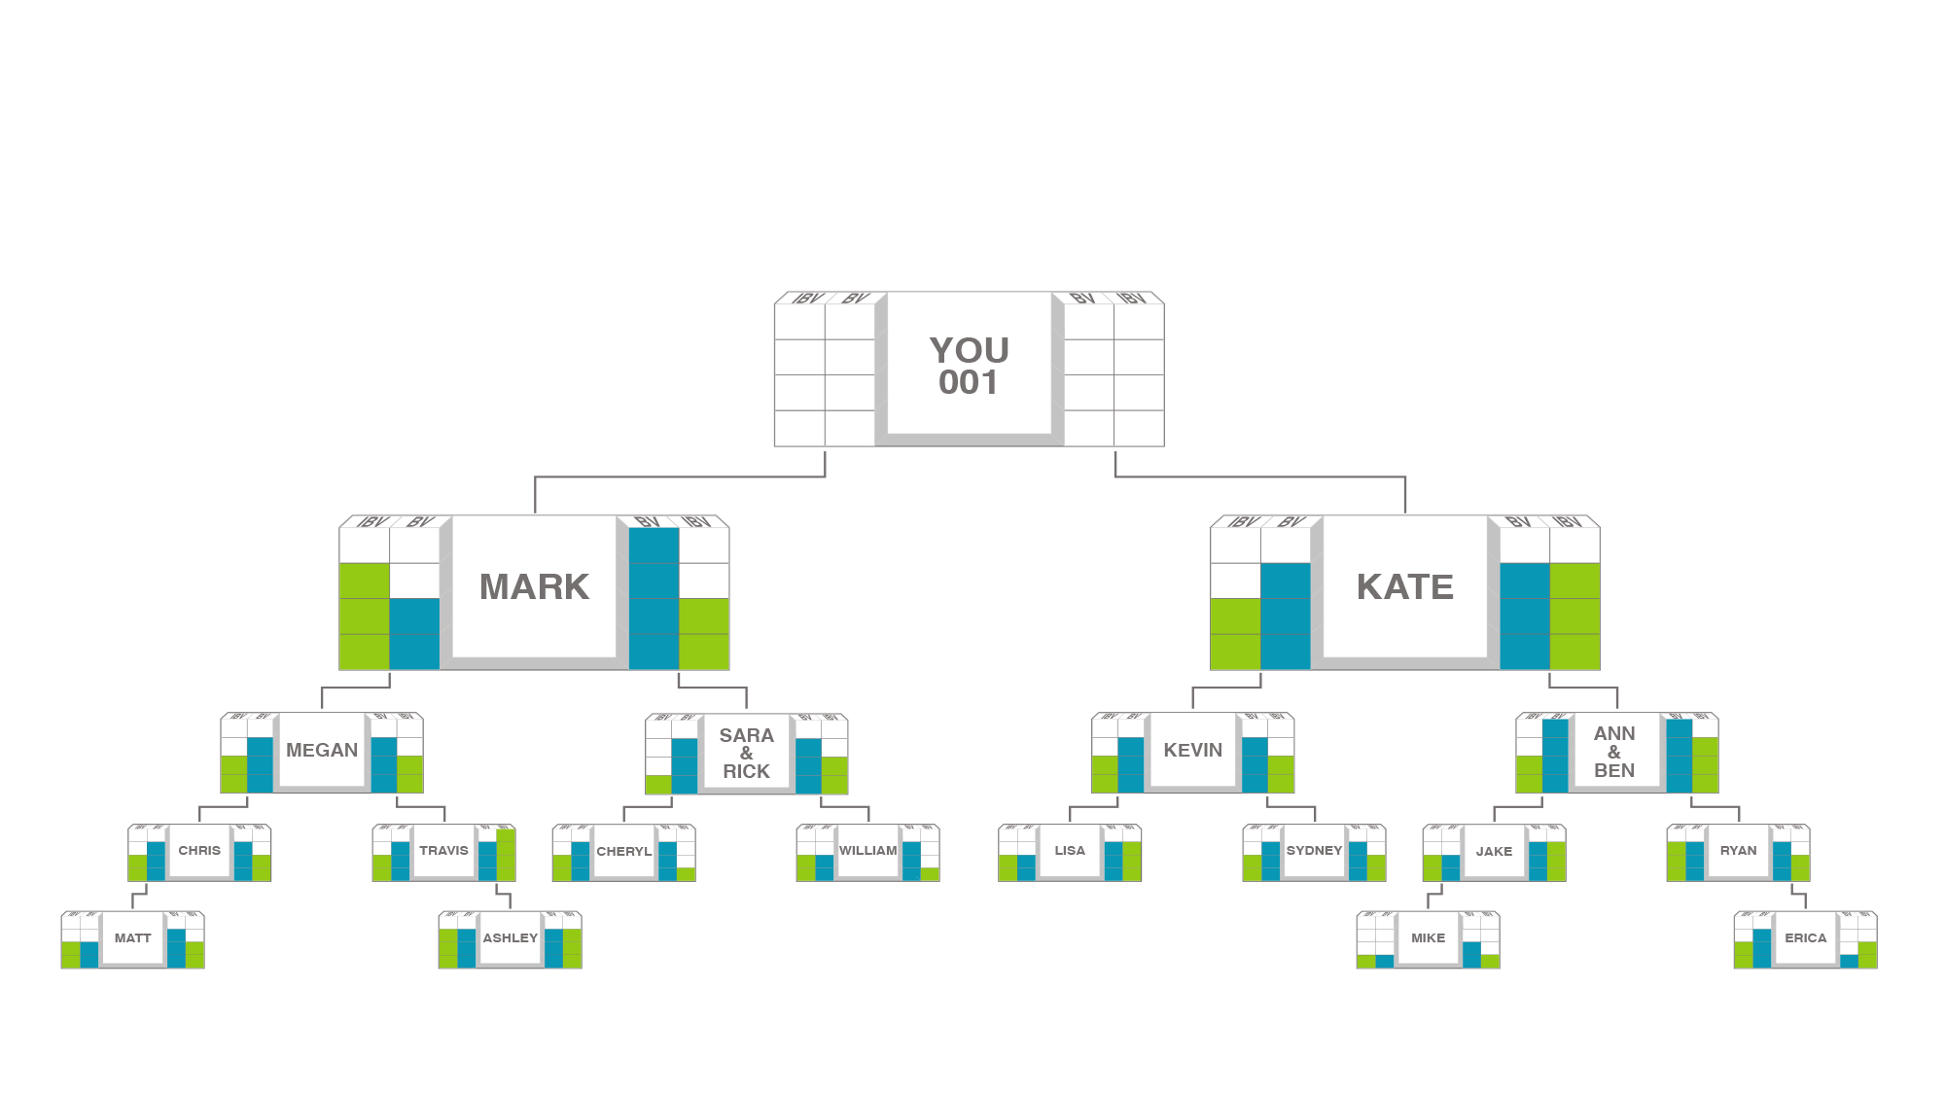
As your organization expands
The frequency of commissions earned increases until it occurs weekly.
5000/5000 = $600
5000
5000
5000/5000 = $600
3600/3600 = $300
3600
3600
3600/3600 = $300
2400/2400 = $300
2400
2400
2400/2400 = $300
1200/1200 = $300
1200
1200
1200/1200 = $300
BV: $1,500
IBV: $1,500
Total weekly potential $3,000 per BDC

Slide 33
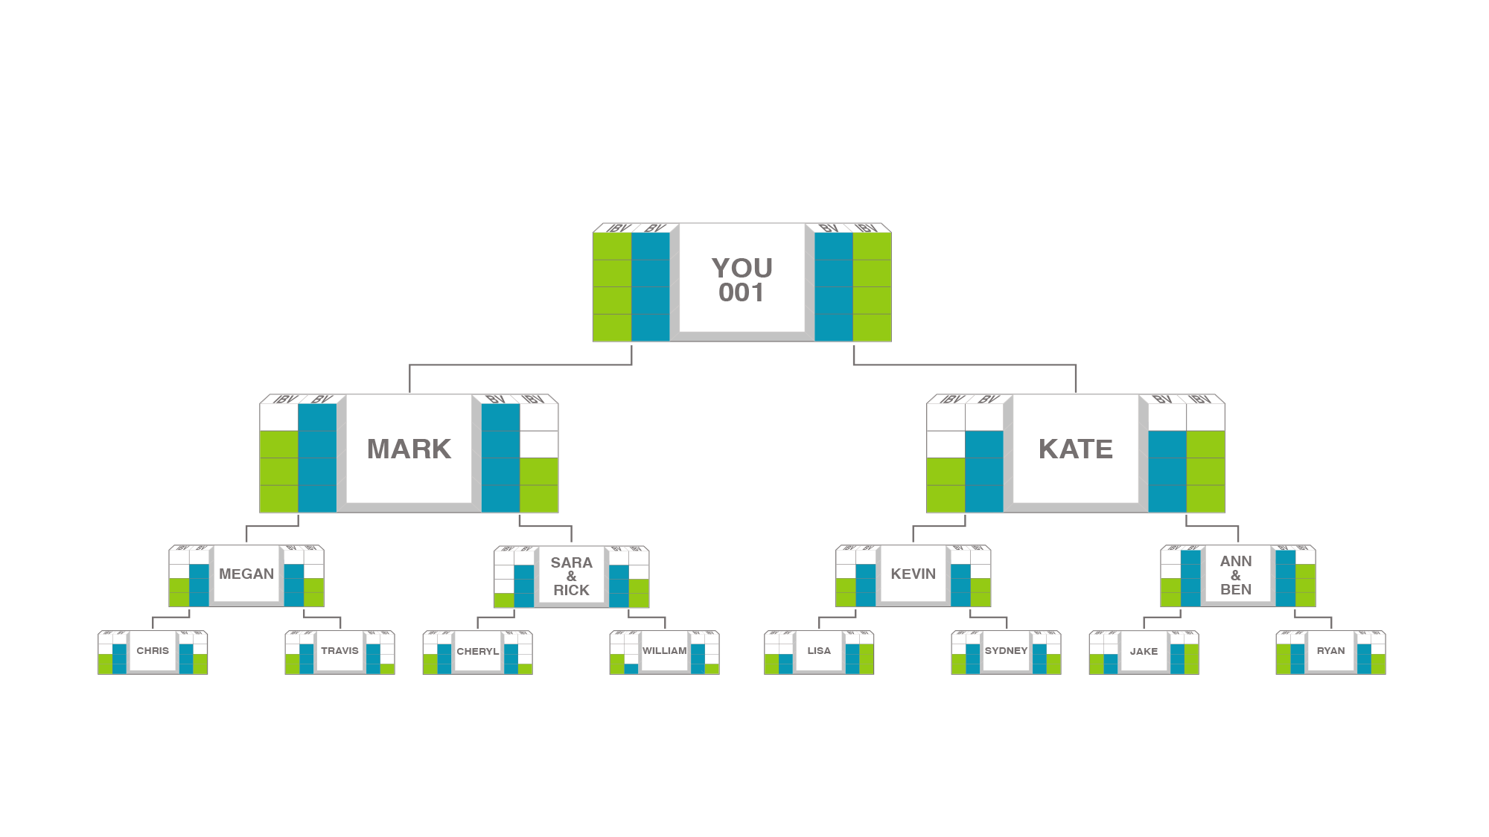
How management bonuses are earned
Each time you and any BDC in your left and right sales organization completes the BV commission cycle in the same week, you receive a management bonus of $600.
5000 BV
5000 BV
5000 BV
5000 BV
5000 BV
5000 BV
$3,000 + $600 Management Bonus = Total weekly potential $3,600 per BDC

Slide 34


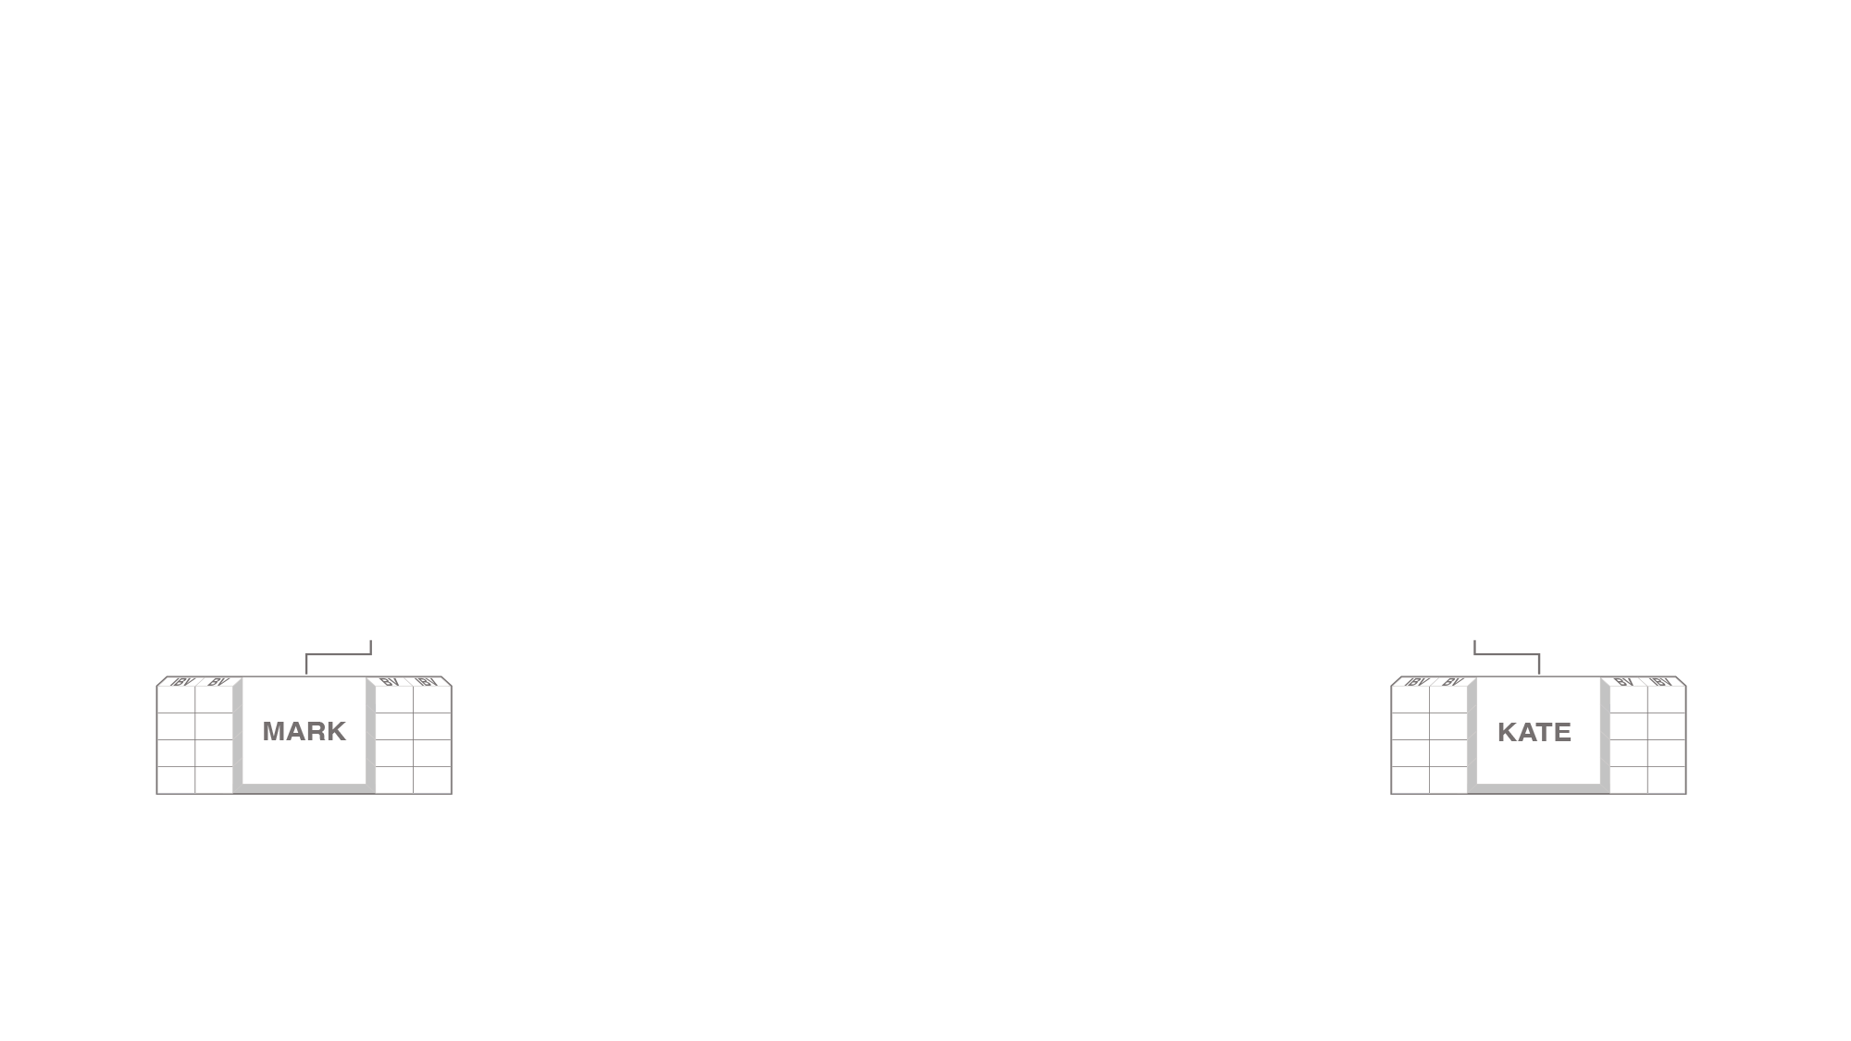
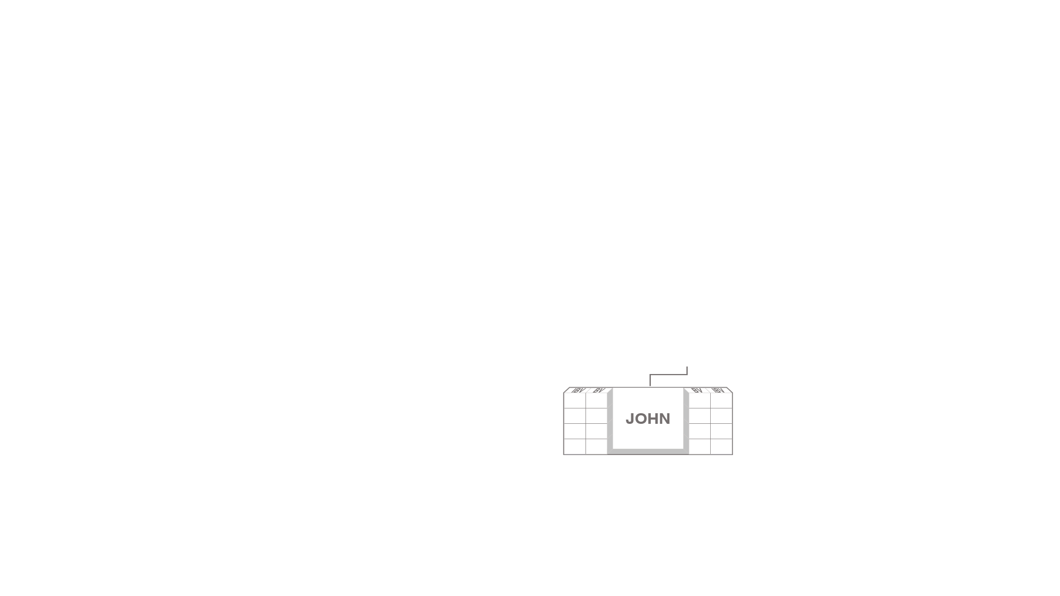




Earn more income
Each UnFranchise® Owner starts with three Business Development Centers.
Each Business Development Center has a weekly earning potential of $3,600.
Total weekly potential $3,600 per BDC

Slide 35
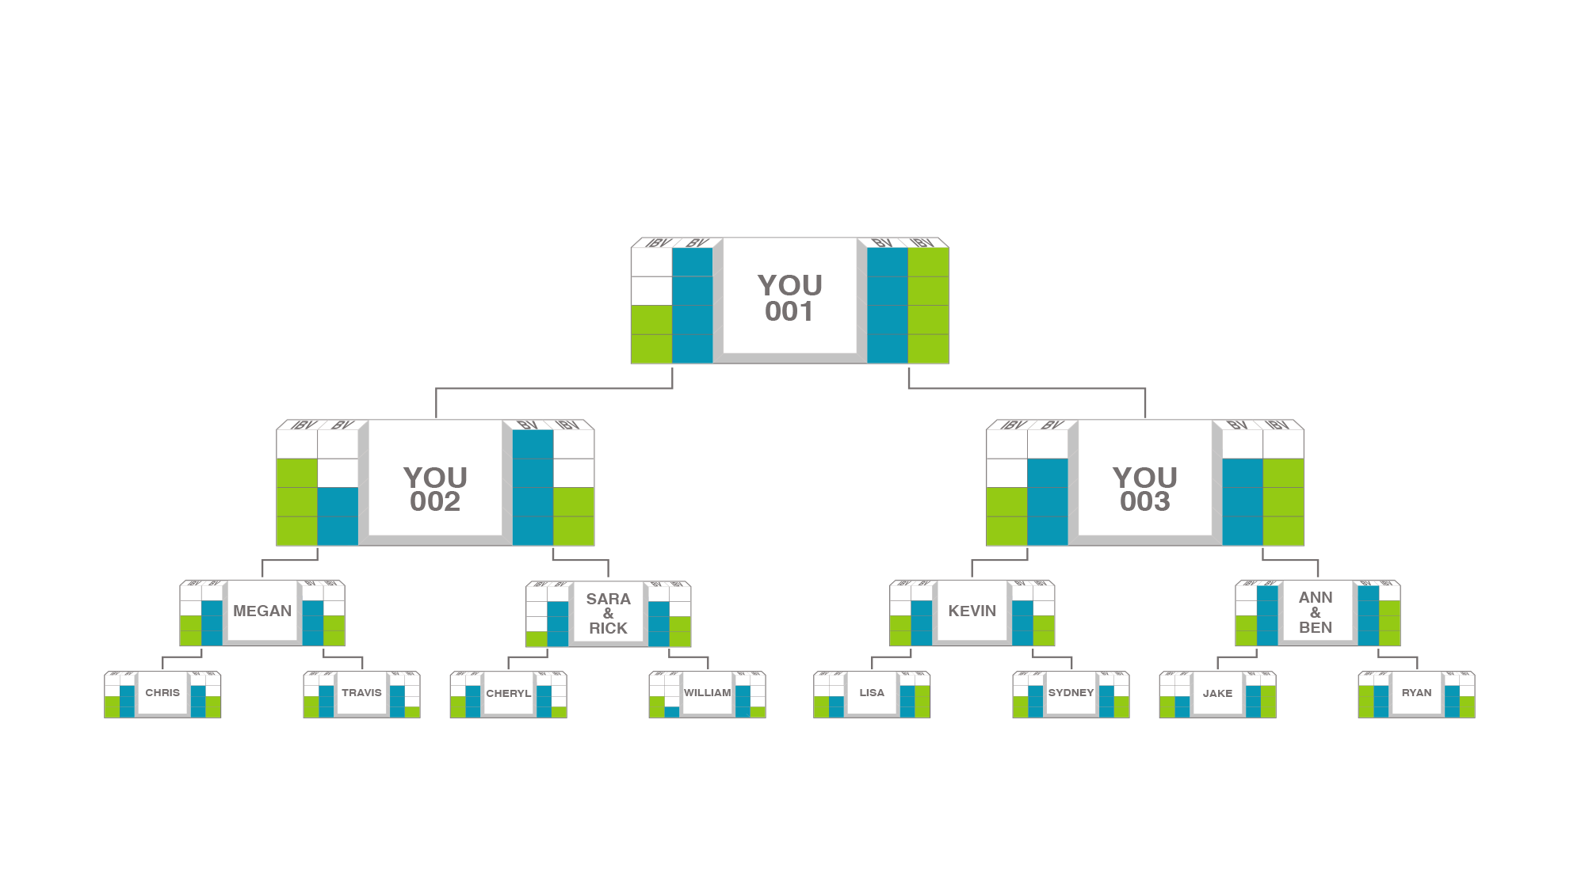



Earn more income
Open additional Business Development Centers to increase your commissions.
5000 BV
5000 BV
200 BV
Total weekly potential $3,600 per BDC

Slide 36

You’re probably thinking…
“Can this work for me?”
I’m thinking…
“Are you right for
the business?”

Slide 37

ONE GUARANTEE:
If you don’t try anything,
then everything will stay the same
Next steps:
Schedule a follow appointment
and get your questions answered
Try some products, register
as a customer and earn Cashback
Give the UnFranchise® Business a trial run

Slide 38
THE UNFRANCHISE® BUSINESS
Copyright © 2019 Market America Worldwide

