Slide 1

7 Steps in the PROCESS to Sponsor!
KISS
(Keep it Simple 4 Success)
90 DAYS?
1 YEAR?

Slide 2
7 Steps in the PROCESS to KISS!
Repetition + Emotional Involvement (YOUR Goals, Why) = RESULTS (Monthly Income)
Become a Business Owner
Leverage
SHOW THE PLAN! (MPCP)
Base 10, Seven Strong ($300 a month)
Getting Started Guide
Focus on 3 Products (top 10 for 10 PC) & Plan YOUR Home Events
*You have the CAKE (BV) now.. Put the Icing on with IBV!

Slide 3

MASSIVE ACTION (Repetition) + Emotional Involvement = RESULTS
1
YOU taking Responsibility for YOUR business/success
SPONSOR YOURSELF!
Your WHY is your emotional reason for doing this business and is key to your success
Must develop some short range and long range goals
  Personal Goals
  Business Goals
MASSIVE ACTION = RESIDUAL Income

Slide 4
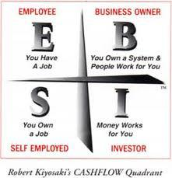
Become a Business Owner/UFO
2
Must make the mind shift from employee to Business Owner
( 12 Months)
Leverage your time
Money grows exponentially
Income continues
Creating true wealth
Total time freedom
Creating a lifestyle

Slide 5
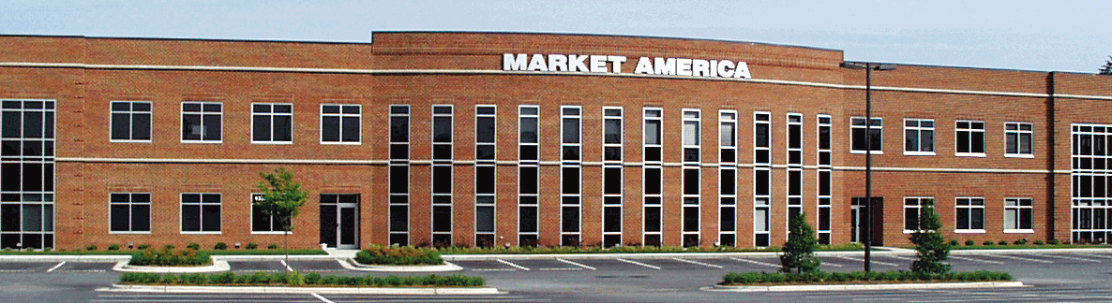
Choose YOUR Major at Market America University
BUSINESS BUILDING 101
NMTSS/ UTOPIA SBBS
BASIC-5 (RECRUITING &
RETAILING)
  TOP 10 PRODUCTS!
  HOME EVENTS
ANTI-AGING
TLS
PRODUCT SPECIALIST
MOTIVES
NUTRAMETRIX
WEBCENTER
Notes:
5
Talking Points
Based in Greensboro, NC
Financially Strong
Experienced Leadership
Proven Record of Success
Positioned for Explosive Growth

Slide 6
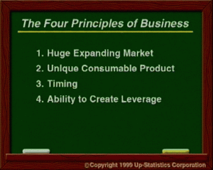


Leverage
3
NMTSS
TeamWork with Leaders
Recruiting Website
www.unlimitedlifestyles.com
www.marketamerica.com
FaceBook! You Tube!!!!!!!!!!
Plug & play with the DVD’s

Slide 7
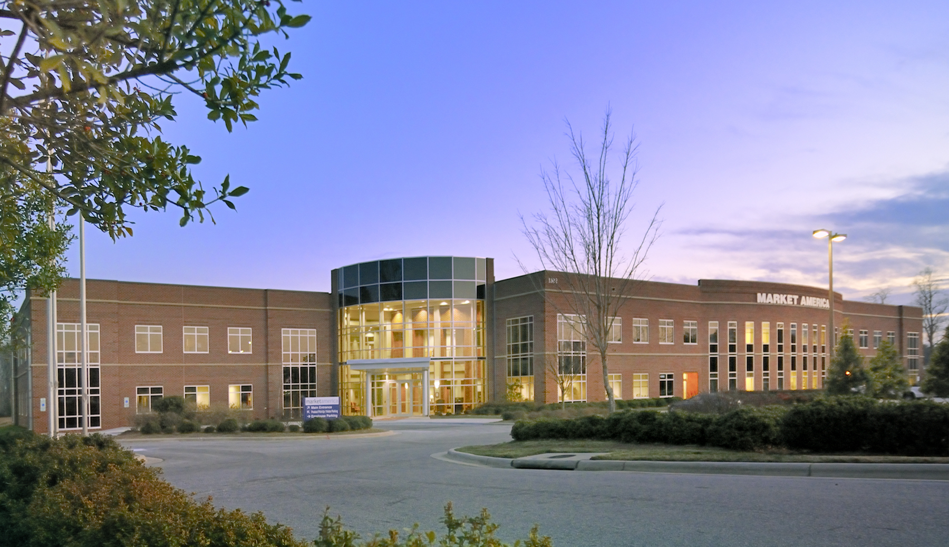
SHOW THE PLAN! (MPCP)
4
Founded in 1992, ma® is a Product Brokerage and Internet Marketing company that specializes in Social Shopping.

Slide 8
Recruiting is a numbers game! Until people become involved then it is a people game!
The People who develop the SKILL of
Recruiting always make the most money!
SHOW THE PLAN!
Notes:
Massive Action….It is a number’s game! FLIP THE PAGES OVER AND OVER….YOU WILL GET BETTER!
#’S AND ACTION BUILDS CONFIDENCE!!

Slide 9
Base 10, Seven Strong ($300 a month)
5
Establishes the Foundation to Your Business

Slide 10
New Getting Started Guide for Duplication
6
Your Guide to go from $300/month to $3,000/month +
Your Business Plan for the first year
Step by step guide on important activities
You and your coach can measure progress and adjust activities to achieve your business goals

Slide 11
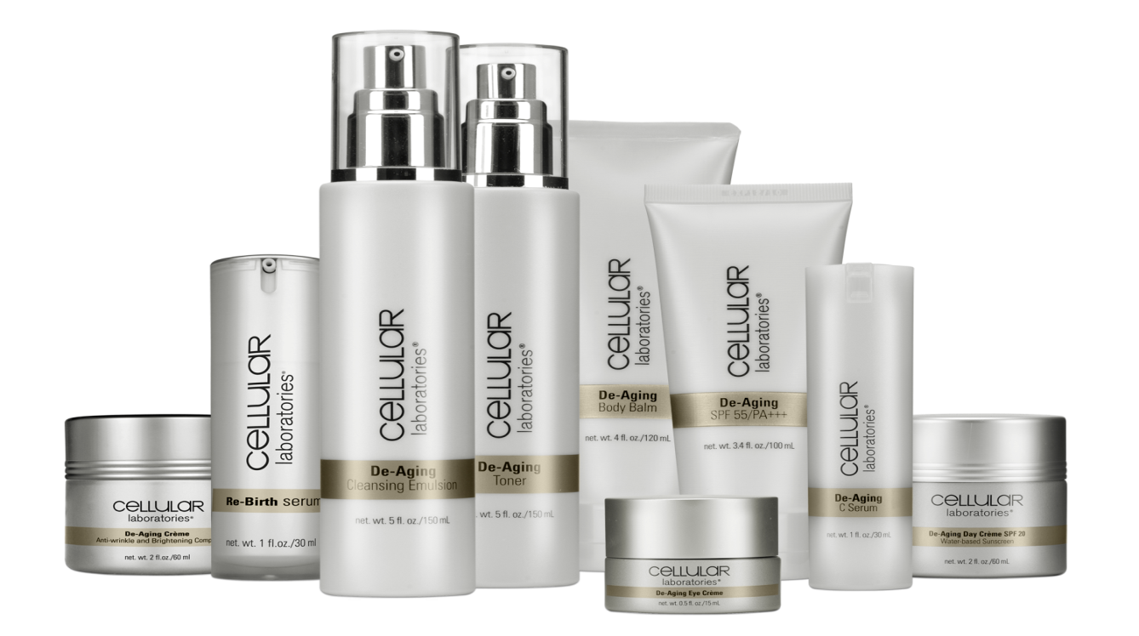


Focus on 3 Products (top 10)
7
To begin, learn all you can about 3 products
  Read the product info on shop.com
  Watch the product videos
  Make sure you are taking the product
  Focus on the top 10 Health & Nutrition products
Use Home Shopping List
Use Health Surveys and Plan your Home Event

Slide 12
Home Product Preview or
Portal/Business Presentation
Step 7
The Key to BV and IBV!!

Slide 13

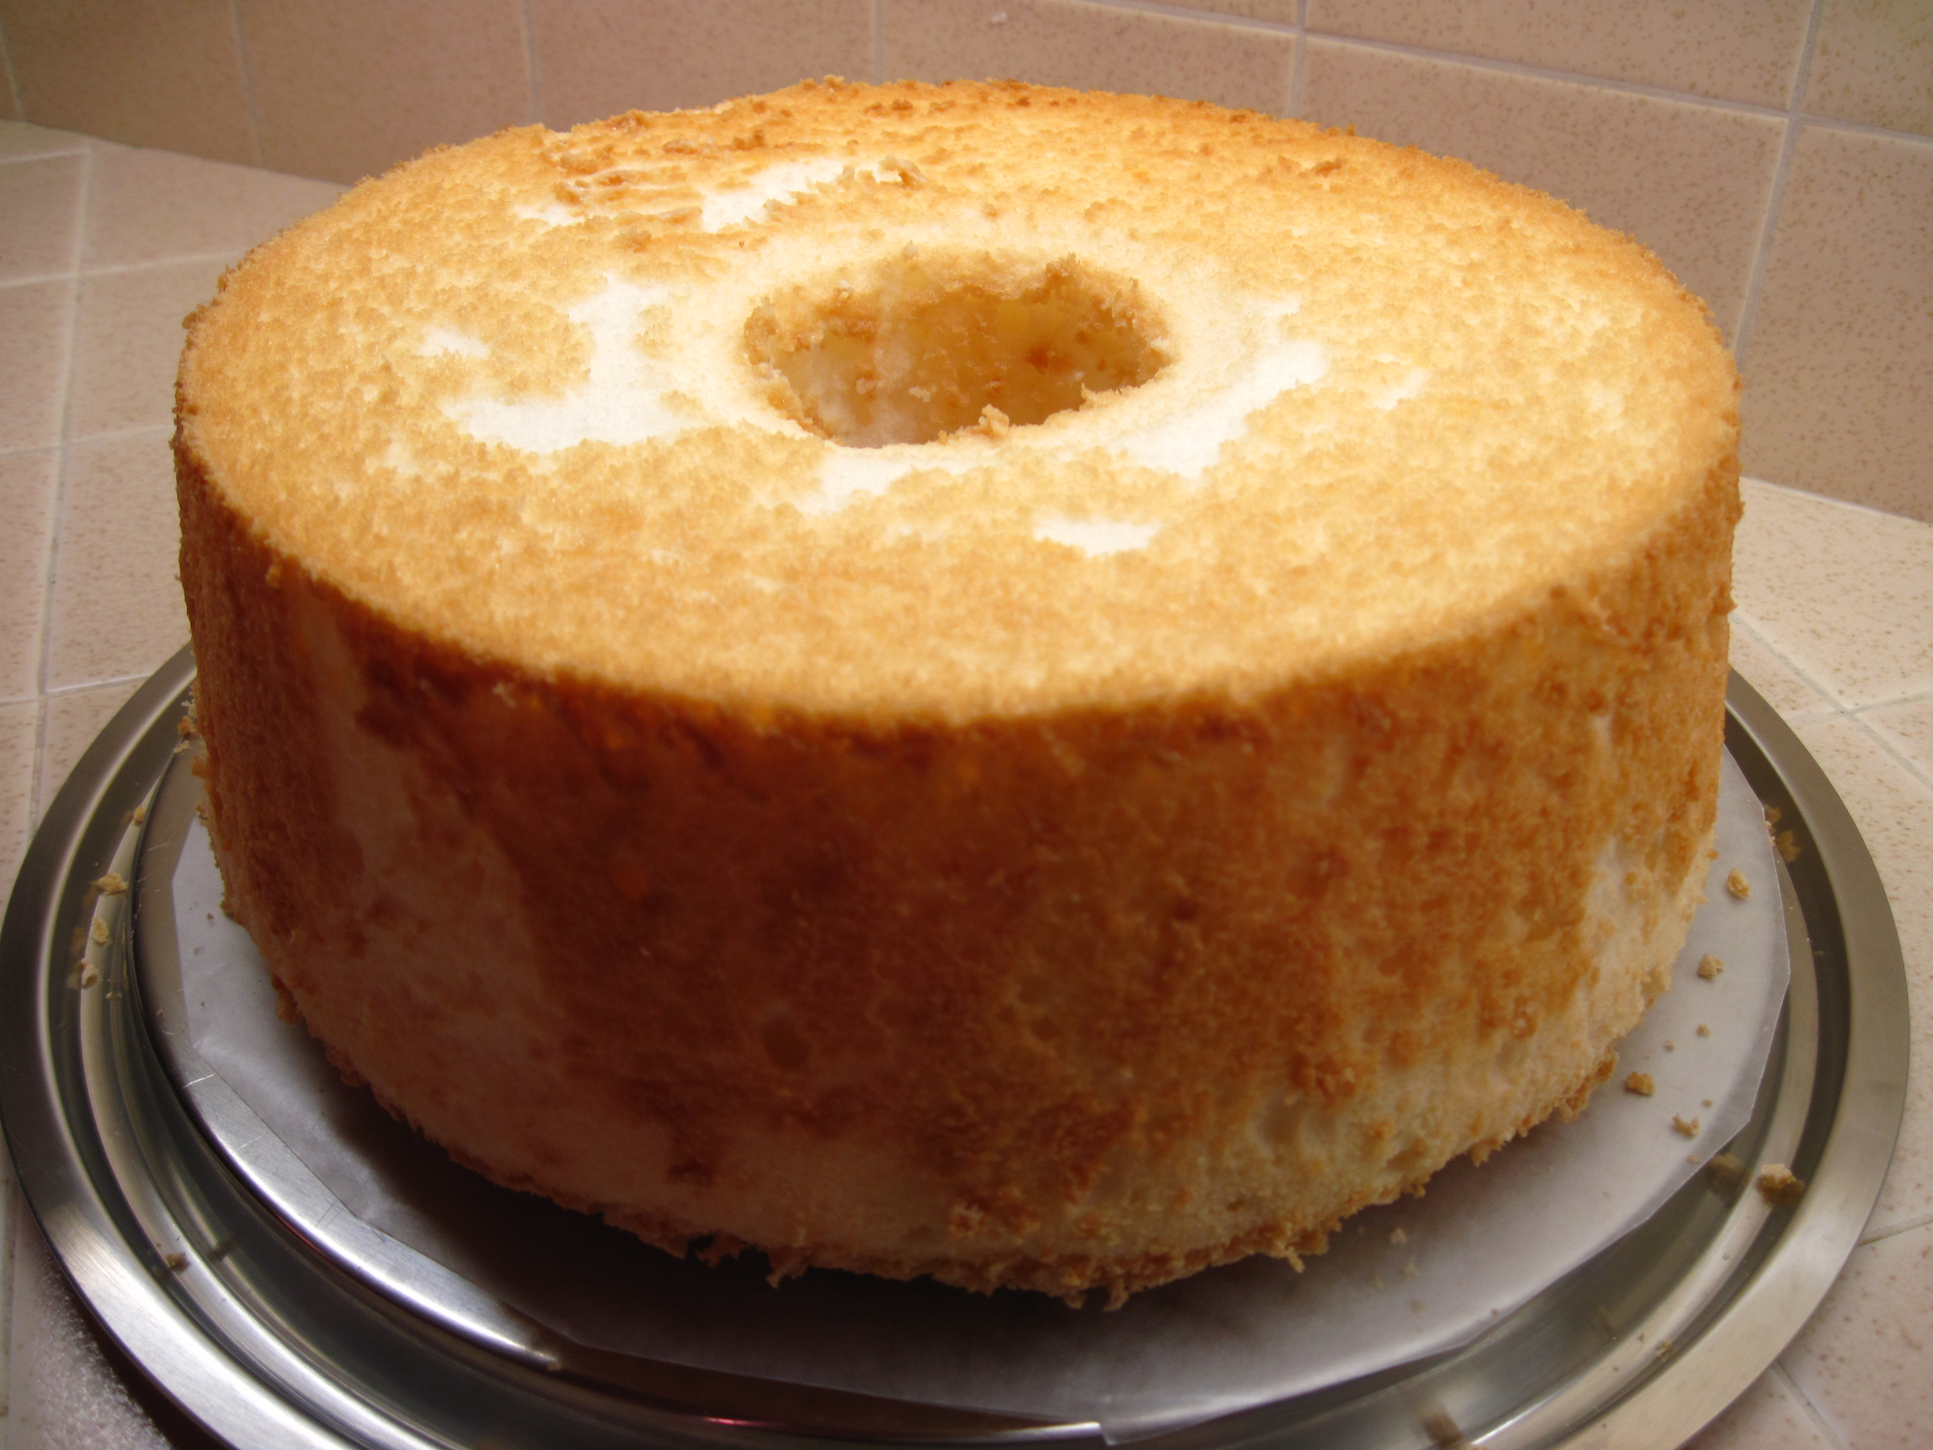
You Have the Cake (BV)

Slide 14
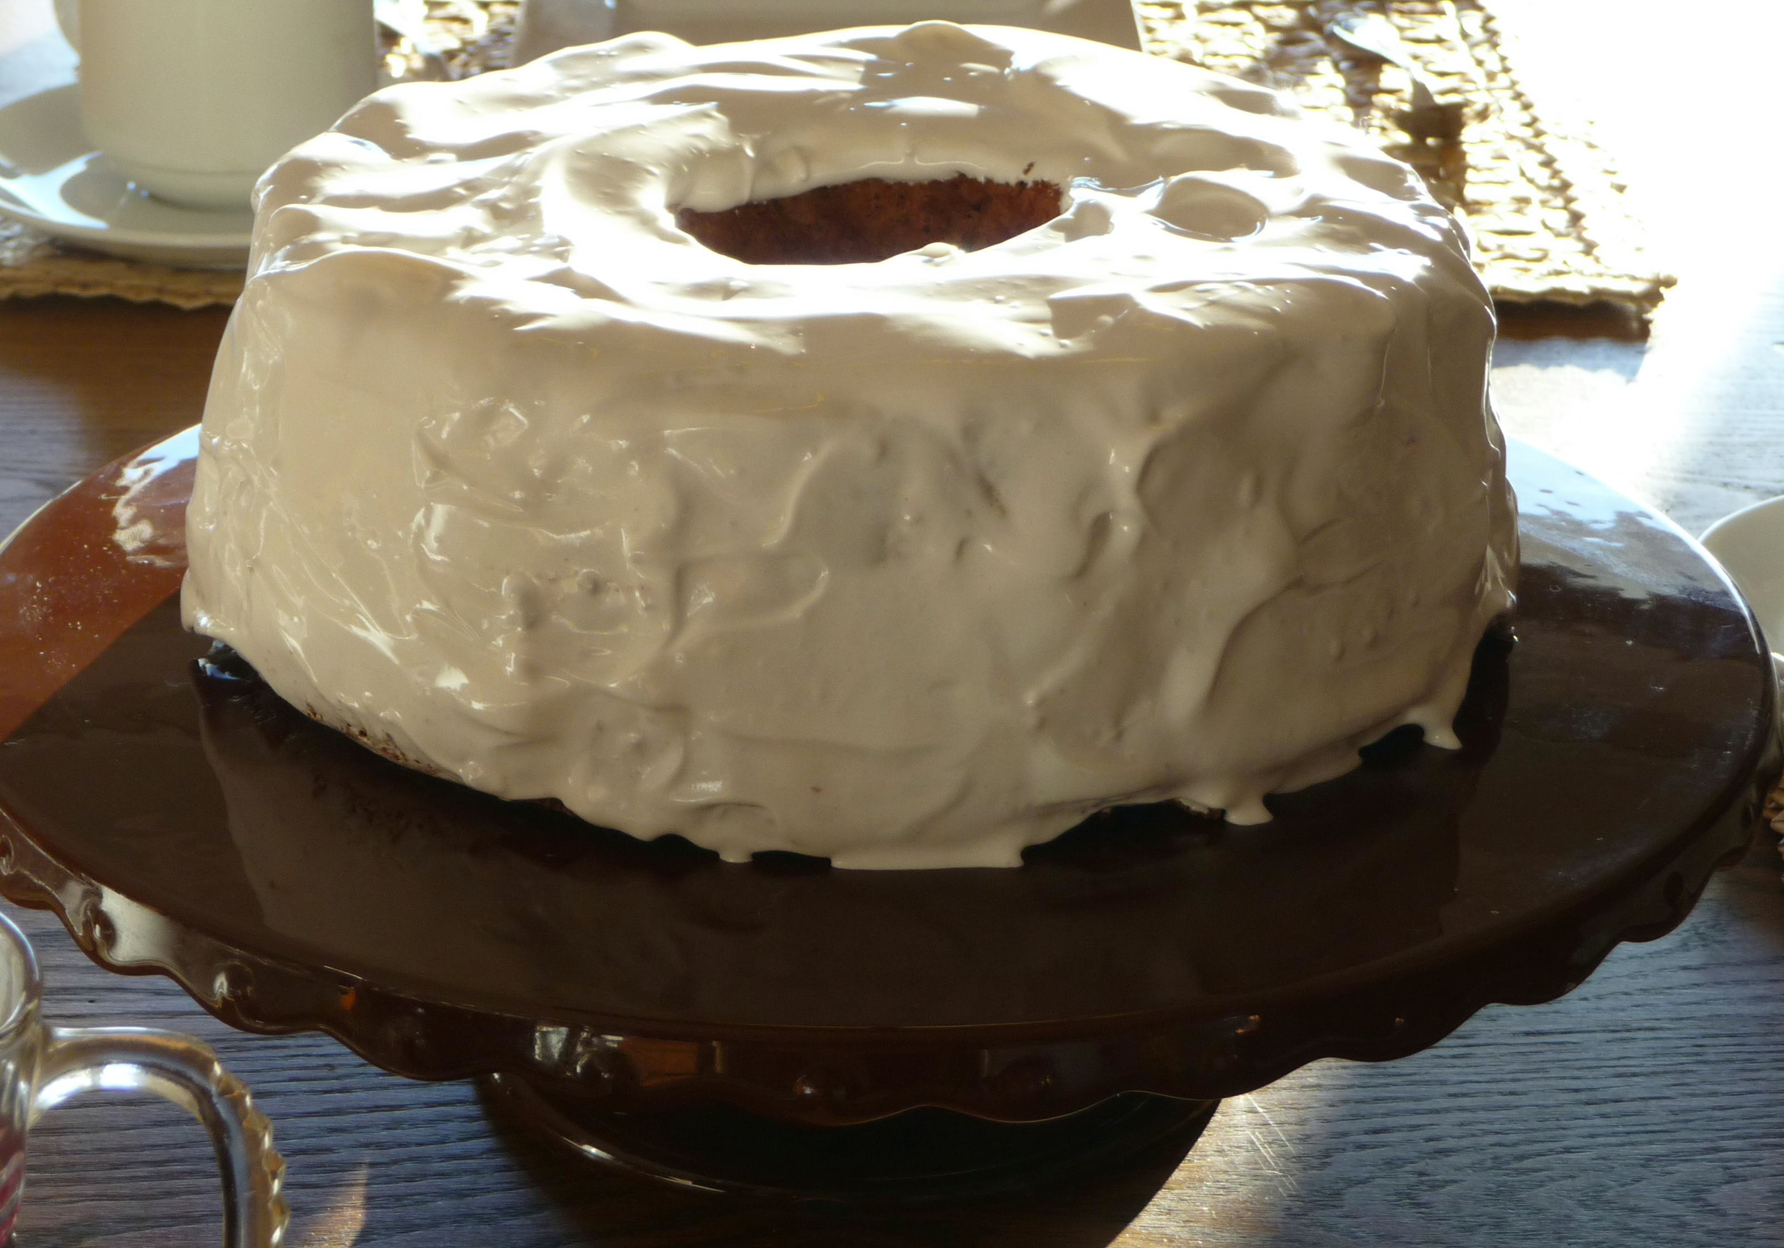
Now…..Put the Icing on with IBV

Slide 15
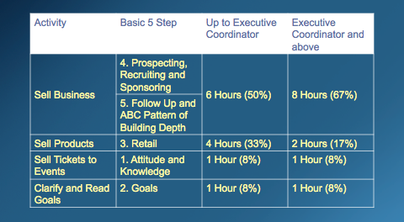
Building Your Business in 12 Hours

Slide 16
CONFERENCE CALL/ Free screenshare
1. Please join my meeting:
https://www.freeconferencing.com/meetings/927-003-717
2. Join the conference call:
Join my conference call:
Dial: (712) 432-0900
Access Code: 166526#
Additional Help
Joining the Conference - At the scheduled date and time of the online meeting, dial into the conference line and when prompted enter the access code followed by the pound key.
Joining the Meeting - Click on the provided meeting link listed above. On the next page fill out your name in the Meeting Login box. Once filled in, click on the Login button.
Thank you for using FreeConferencing.com!

Slide 17


